Slide 1
Bone Diseases
Dr. Bayad J. Mahmood
Board certified maxillofacial surgeon

Slide 2
Introduction
In order to understand the pathology of the diseases affecting the human bones we should remember the histology and composition of the bones.
Generally bone diseases results form:
Defects or disturbances in the cells of the bone including osteocyte, osteoblast and osteoclast.
Disturbance in the absorption or metabolism of calcium.
Inadequate blood supply to the boney tissues.
As the bone contains the bone marrow so diseases of the bone may affect or interfere with bone marrow functions.

Slide 3
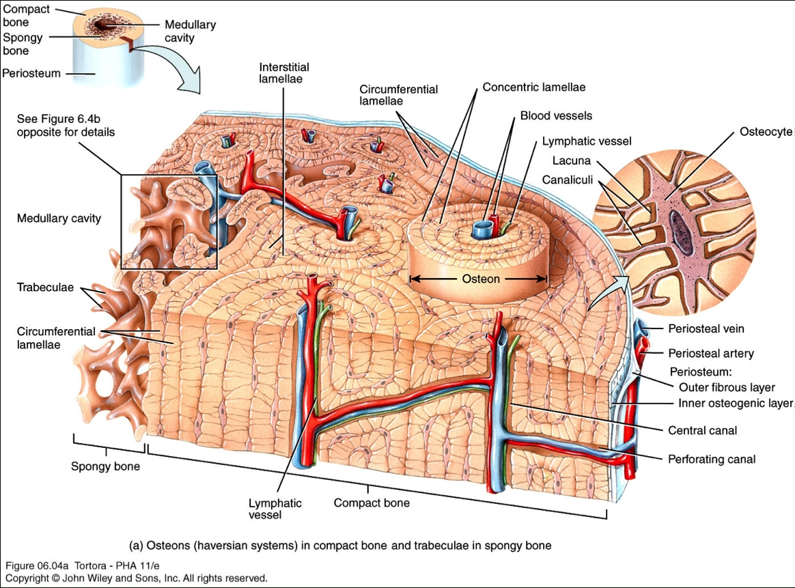
Normal jaw skeleton
The mandible and maxillary bones form in membrane and they may contain odontogenic epithelium and neurovascular bundles within their substance.
Most diseases arising in the jaws are of odontogenic origin, but both non-odontogenic local and systemic disorders may affect the jaws.
At histological level, bone is composed of mineralized collagenous matrix containing osteocytes. It is organized into an outer cortex and an inner cancellous (trabecular) structure.

Slide 4
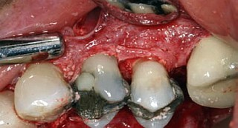
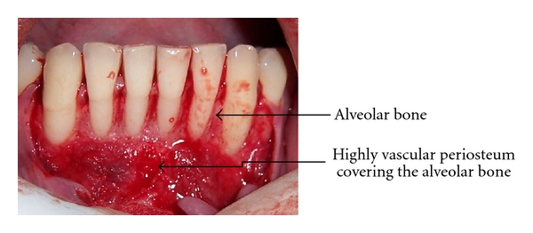
Bone remodeling is achieved by the coordinated activity of osteoclasts (bone-resorbing cells) and osteoblasts (bone-forming cells) in bone metabolic units.
Bone is surrounded by periosteum, which is continuous with oral mucosa in certain places in the jaws.
The vascular supply to bone is via periosteal vessels and marrow spaces.

Slide 5
Classification of bone diseases
Inflammatory bone diseases.
Non Neoplastic bone diseases, which divided into the following :
  Genetic BD.
  Metabolic BD.
  Diseases of unknown cause.
Neoplastic bone diseases.

Slide 6
Inflammatory Bone Diseases
The bone of the jaw is remarkably resistant to infection but the incidence of acute alveolar abscess ( periapical abscess) is common and usually penetrate the cortex and periosteum discharging into the oral cavity or skin as a sinus.
Inflammatory bone disease requires ischemia, infarction and bacterial infection and these diseases usually associated with bone destruction and bone formation.
The failure of microcirculation in the cancellous bone is a critical factor in the establishment of inflammatory bone diseases, because the involved area becomes ischemic and necrotic.
Bacteria can then proliferate, because normal blood-borne defenses do not reach the tissue, and the osteomyelitis spreads until it is stopped by medical and surgical therapy.

Slide 7
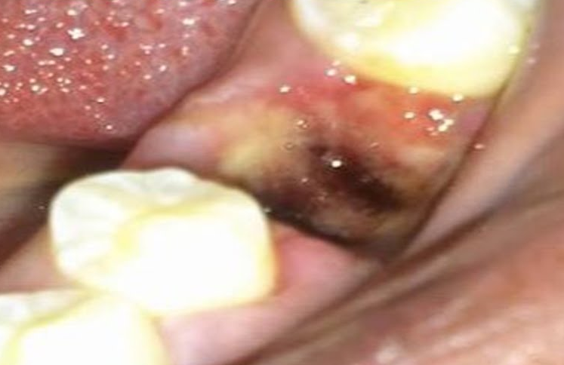
1*Acute alveolar osteitis (dry socket, alveolitis sicca dolorosa, fibrinolytic alveolitis):
It is a painful complication after tooth extraction when the blood clot is disintegrated exposing alveolar bone and cause necrosis of the socket wall. It’s occur in about 3% of all extraction and about 22% after extraction of lower wisdom tooth.
Predisposing factors:
Excessive use of local anesthesia with vasoconstrictor.
Excessive trauma during tooth extraction.
Smoking epically after tooth extraction.
Female on contraceptive pills.
Sclerosing bone diseases like Paget’s disease.
Pericoronitis .
History of dry socket or radiotherapy.

Slide 8
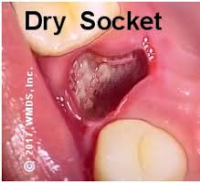
Clinical features:
Pain start (2-4) days after tooth extraction.
Females affected more than males and mandible affected 3 times more than maxilla?
Localized pain in the socket and it is very sensitive to touch.
Gingival margin is swollen and dusky red in color.
The socket is devoid of clot or it may contain brown friable clot.
Fuel odor and taste.
Lymphadenopathy or they may be tender.

Slide 9
Treatment of established dry socket:
Reassurance of the patient with x-ray examination of the socket .
Irrigation of the socket with warm normal saline or chlorhexidine.
3 -Insertion of suitable dressing material like iodoform pack or lidocaine (lignocaine) gel on ribbon gauze are useful.
4-Avoid deep curettage of the socket?
5- Analgesia and antibiotics coverage if lymphadenopathy is present.

Slide 10
Osteomyelitis:
is inflammation of the medullary cavity of a bone caused by an infection. It is seen particularly in those patients whose defense mechanism against infection is compromised because of local or systemic factors.

Slide 11
*Acute Osteomyelitis :
It’s also called acute pyogenic osteomyelitis because the pyogenic bacteria which cause the disease are similar to those causing odontogenic infections.
The bacteria which responsible for the infection includes streptococci, anaerobic cocci such as Peptostrepto-coccus,gram-negative rods such as Fusobacterium and Prevotella.
The disease usually occur after trauma or spread of odontogenic infection.

Slide 12
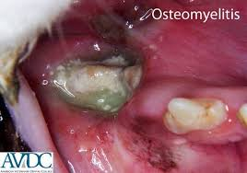
Clinical features:
Severe deep seated pain with tenderness and swelling in the affected area.
The mandible is affected more frequently than the maxilla.
An important symptom is a developing numbness over the lip and chin as a result of inferior alveolar nerve involvement .
The patient give a history of trauma or dental infection.
Pus formation and lymphadenopathy in addition to general manifestation like fever.

Slide 13

Management
Benzylpenicillin or clindamycin and metronidazole are normally started and altered as necessary according to the results of pus sensitivity testing.
The patient may require hospital admission for incision and drainage with irrigation of the area.
Removing obviously non vital teeth in the area of the infection is essential in the treatment.
For acute osteomyelitis that results from jaw fracture, wires or bone plates that may have been used to stabilize a fracture in the area, or any obviously loose pieces of bone.
Antibiotics should be continued for at least 4 weeks after control of the acute infection.

Slide 14
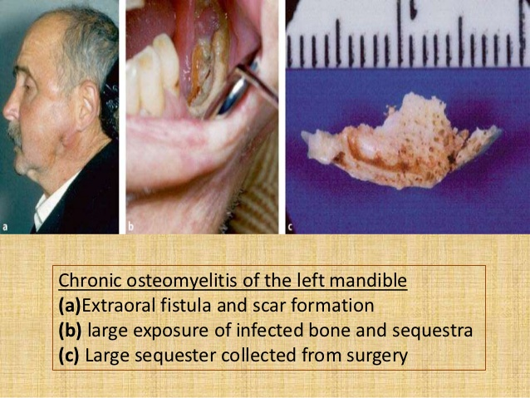
*Chronic osteomyelitis
Usually developed from untreated acute osteomyelitis or low grade infection, also other conditions may predispose to the development of the diseases like diabetes or long-term corticosteriod use and bone abnormalities such as Paget's disease or cemento-osseous dysplasia.

Slide 15
Clinical features:
Pain and swelling is less severing than in acute form of the disease.
Pus discharge from the skin or oral mucosa.
Mandible is enlarging due to bone deposition.
Sensation of the lower lip is intact

Slide 16
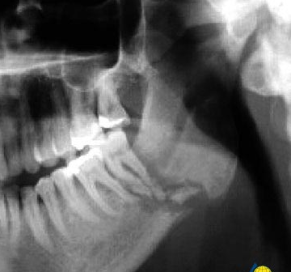
Radiographic features:
Irregular radio-opaque areas (sequestra) surrounded by radiolucencies are visible (moth eaten appearance).
A late sign of chronic osteomyelitis is radiological evidence of periosteal new bone at the lower border of the mandible or above the buccal or lingual cortices.

Slide 17
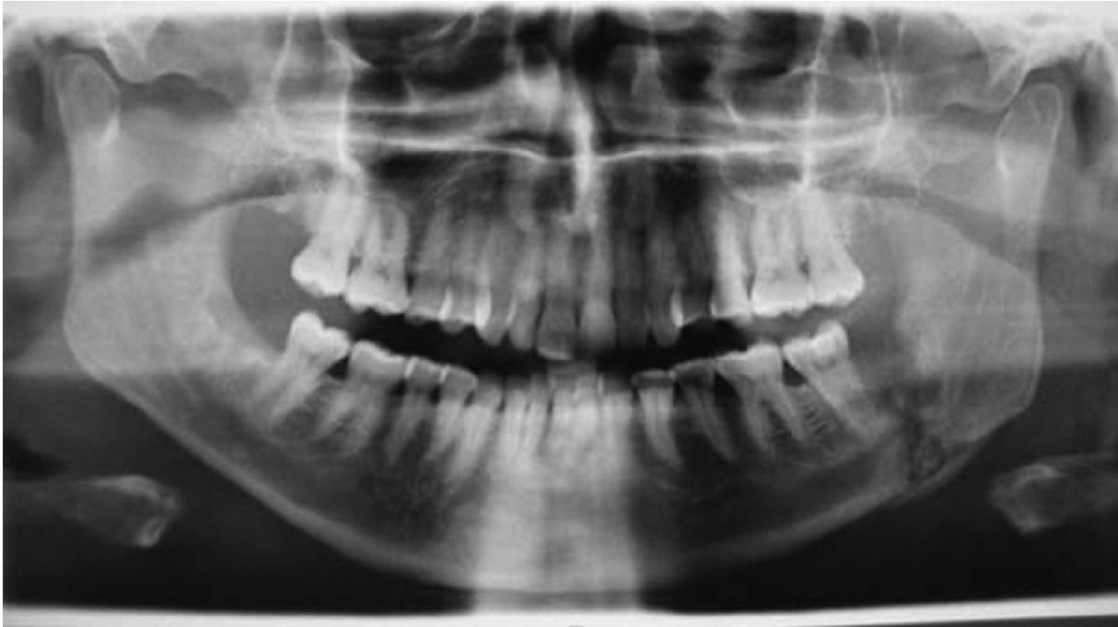

Slide 18
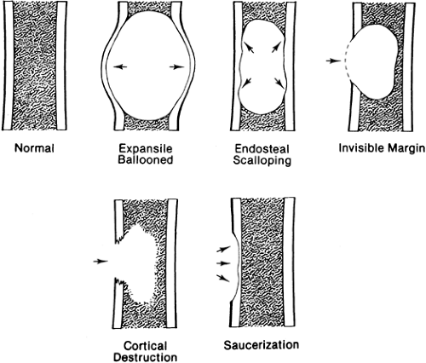
Treatment:
Before treatment of chronic osteomyelitis the following should be done:
*Biopsy: because some bone tumor give the same pictures of the disease.
*Culture and sensitivity test: to determine the type of the bacteria and microorganism.
The management of chronic osteomyelitis is usually surgical and medical as following :
1-Surgical drainage of pus and removal of the sequestra (sequestrectomy).
2-Excision of the external sinuses with irrigation of the area.
3-Bone saucerization .
4-Antibiotics coverage like acute form.

Slide 19
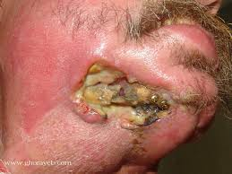
*Osteoradionecrosis
One of the most severe and complicating sequelae of radiotherapy for patients with head and neck cancer is osteoradionecrosis.
Basically, osteoradionecrosis is devitalization of the bone by cancericidal doses of radiation.
The bone within the radiation beam becomes virtually non vital from an endarteritis that results in elimination of the fine vasculature within the bone.
The turnover rate of any remaining viable bone is slowed to the point of being ineffective in self-repair. The continual process of remodeling normally found in bone does not occur.

Slide 20
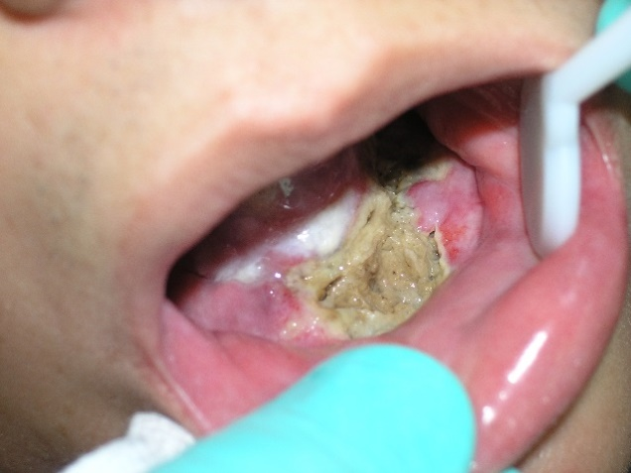
Clinical features
A reduction in vascularity, secondary to endarteritis obliterans, and damage to osteocytes as a consequence of ionizing radiotherapy can result in radiation-associated osteomyelitis or osteoradionecrosis.
The mandible is much more commonly affected than the maxilla.
Pain may be severe and there may be pyrexia.
The overlying oral mucosa often appears pale because of radiation damage.

Slide 21
Management:
Prevention of osteoradionecrosis is vital. Patients who require radiotherapy for the management of head and neck malignancy should ideally have teeth of doubtful prognosis extracted at least 6 weeks prior to treatment.
When extraction of teeth is required in patients who have had radiotherapy to the jaws, a specialist opinion should be considered .The management of is similar to osteomyelitis.
Only occasionally systemic antibiotics are necessary, because osteoradionecrosis is not an infection of the bone but rather a non healing hypoxic wound.
Because of the decreased vascularity of the tissues, systemic antibiotics do not gain access to the area to perform the function for which they are intended. However, in acute secondary infections, antibiotics may be useful to help prevent spread of the infection.

Slide 22
Any loose sequestra are removed, but no attempt is made initially to close the soft tissues over the exposed bone.
Most wounds smaller than 1 cm eventually heal, although it may take weeks to months.
For non healing wounds or extensive areas of osteoradionecrosis, surgical intervention may be indicated. In this instance resection of the exposed bone to the margin of unexposed bone and primary soft tissue closure can be attempted. This is successful in many cases.
Greatly improved results have recently been obtained by the use of hyperbaric oxygen therapy in conjunction with surgical intervention.

Slide 23
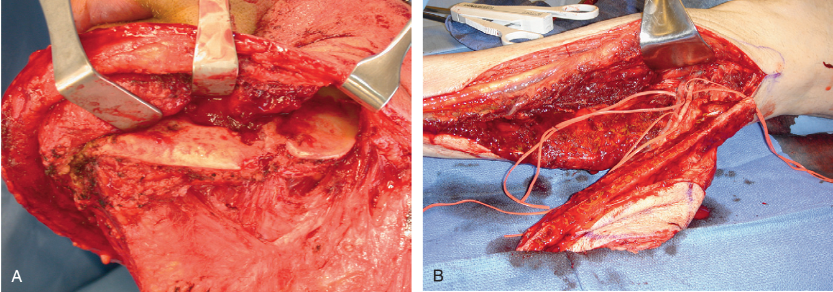
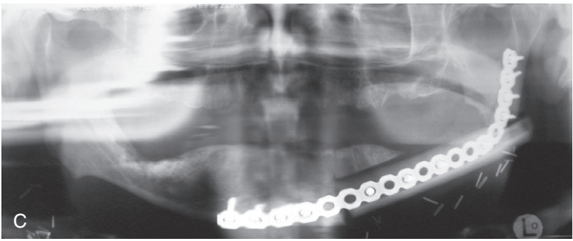
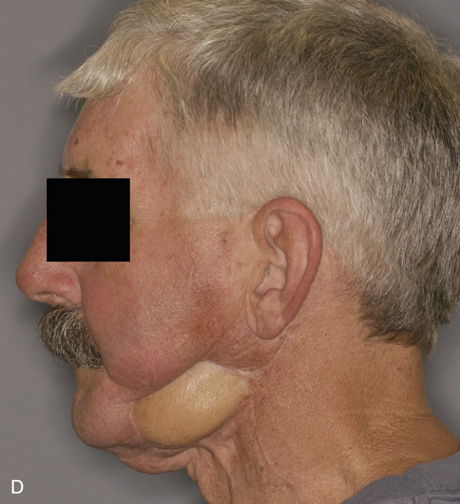

Slide 24
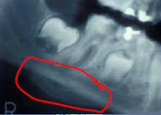
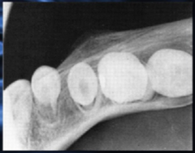
*Garre's osteomyelitis
Chronic osteomyelitis with proliferative periostitis, formerly known as Garré’s osteomyelitis, is characterized by the formation of new bone beneath the periosteum at the surface of the cortex, which covers an inflammatory area .
Common pathogens include staphylococci and streptococci.
The lesion is characterized by non tender swelling at the inferior border of the mandible.
The skin as well as the mucosa has a normal appearance.

Slide 25
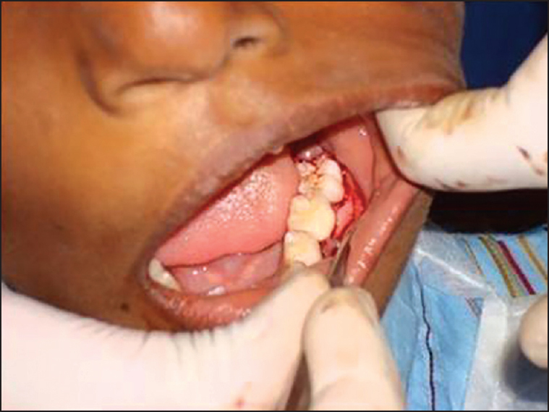
Clinical features
This condition is usually seen in children and younger adults in the body and ramus of the mandible.
Swelling is the principal feature.
Symptoms and signs of an overlying periapical periodontitis will usually be present.
Pathology
Garre's osteomyelitis is characterized by subperiosteal new bone formation. there may be 'onion skin layering' of the reactive bone.

Slide 26
Management
Removal of the diseased tooth will result in resolution.
Some time the bone is needs shaving when there is obvious facial deformity.

Slide 27
Non Neoplastic Bone Diseases
Dr. Bayad J. Mahmood
Board certified maxillofacial surgeon

Slide 28
Classification of bone diseases
Inflammatory bone diseases.
Non Neoplastic bone diseases, which divided into the following :
  Genetic BD.
  Metabolic BD.
  Diseases of unknown cause.
Neoplastic bone diseases.

Slide 29
This group of diseases is divided into the following:
I-Genetic BD:
a- Osteogenesis imperfesta.
b- Osteopetrosis.
c- Achondroplasia.
d- Cleidocranial dysplasia.
e- Cherubism.
f- Sickle cell anaemia.
g- Thalassaemia major.
II- Metabolic bone disease
Rickets
Scurvy
Hyperparathyroidism
Osteoporosis
Acromegaly
III-Diseases of unknown causes:
Fibrous dysplasia
Ossifying fibroma
Paget’s disease
Langerhan’s cell disease
Giant cell granuloma
Aneurysmal bone cyst
Simple bone cyst

Slide 30
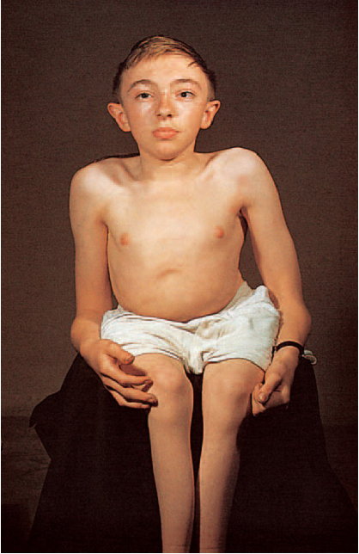
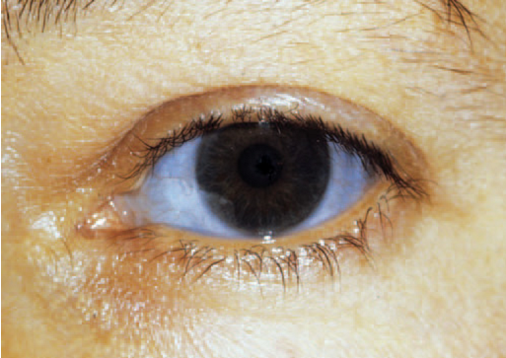
Osteogenesis imperfesta
It’s a hereditary BD in which the bone is fragile and poorly formed due to the defect in the osteoblast which fails to form adequate amount of bone and result in weak and thin bones.
Clinical and radiological features:
Easily fractured and fragile bone (type I collagen deficiency).
Oral manifestation showed
Teeth appear brown or purple in color (dentinogenesis imperfecta).
Blue sclera in about 70% of the patients (blue sclera is normal in infants below 6 months)
Hearing loss with long bones deformities.

Slide 31
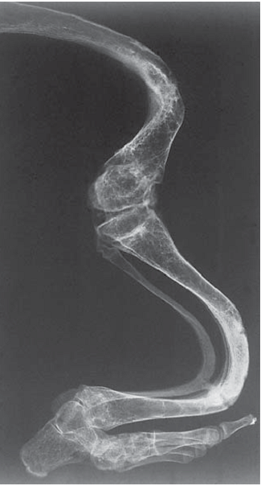
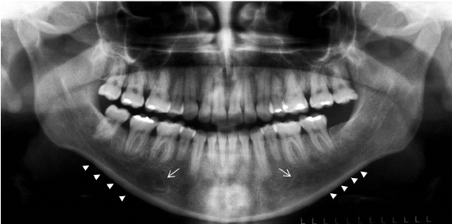
Radiographically:
There is generalized porosity or radiolucencies of the bones.
Pulp chamber appear obliterated.
Mandible appears with thin cortex.
The roots appear stunted.
Treatment:
There is no treatment available. Severely affected teeth need extensive dental treatment and home care. The fractured bones usually healed with deformities.

Slide 32
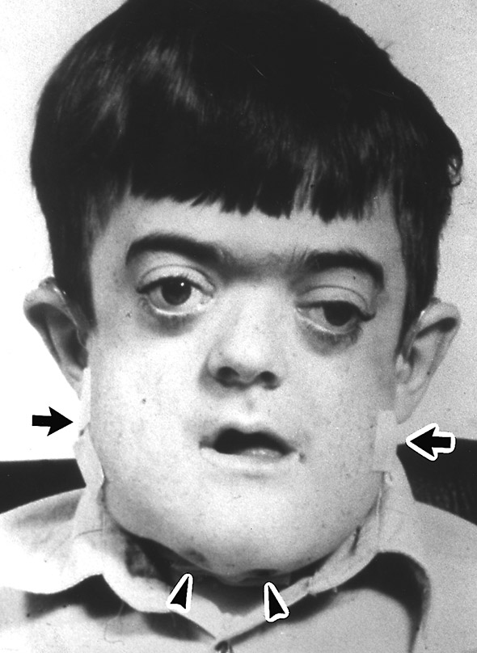
Osteopetrosis(Alber’s-Schonberg or Marble BD)
A rare hereditary skeletal bone disease characterized be increased in bone density due to the defect in osteoclast and abnormal bone remodeling .
There are types of this disease:-
1-Malignant form (infantile) usually discovered early or few months of the child life and its prognosis is poor.
2- Benign form ( adult) usually discovered later in life and its detected when radiograph was made for other purposes.

Slide 33
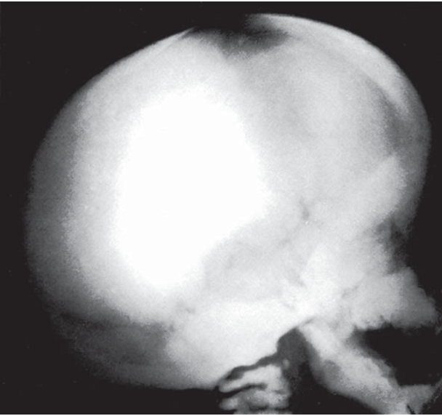
Clinical features:
I- Malignant form
Wide sclerosis which causing narrowing of cranial foramina
Narrowing of the marrow space .
Susceptibility to infection and anemia duo to decrease in no. RBC and WBC .
Deafness, blindness, and facial paralysis.
Facial deformity.
Delay teeth eruption.
Usually the patient dies within early life.
II- Benign form
The disease is asymptomatic however fractures of the bones and osteo-
myelitis are the most common complications

Slide 34
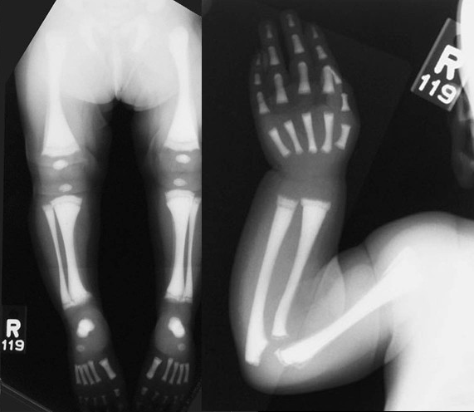
Radiographic features:
Increased in skeletal bone density.
No distinction between cortical and cancellous bone.
Treatment
No specific therapy is available for treatment of osteopetrosis.
Supportive measures like blood transfusion.
Antibiotics for control of infection.
Special care to prevent osteomyelitis after tooth extraction.

Slide 35

Achondroplasia
It’s the most common type of genetic bone disease. The essential defect is failure of normal proliferation of the cartilage in the epiphysis of the long bones specially the limbs resulting in short limbed dwarfs.
Clinical features
The limbs are short in relation to trunk size .
Normal head size.
Mid face hypoplasia.
Dental malocclusion.
Treatment
Dental treatment can be done for these patient as a normal persons .

Slide 36
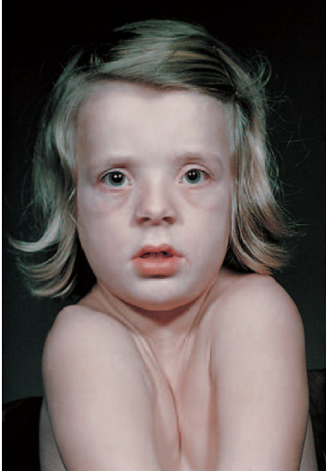
Cleidocranial dysplasia
Hereditary bone disease affecting chiefly the skull and clavicles with wide variety of anomalies affects other bones.
Clinical features
The patient is short stature with large head and mid face hypoplasia
The shoulders are narrow and show marked drooping
The patient can move the shoulders and approximate them in front
the chest .
Absence or hypoplastic clavicles.
Narrow arched palate.
Increased prevalence of cleft palate.
Prolonged retention of deciduous teeth.
Delay or failure of eruption of permanent teeth.

Slide 37
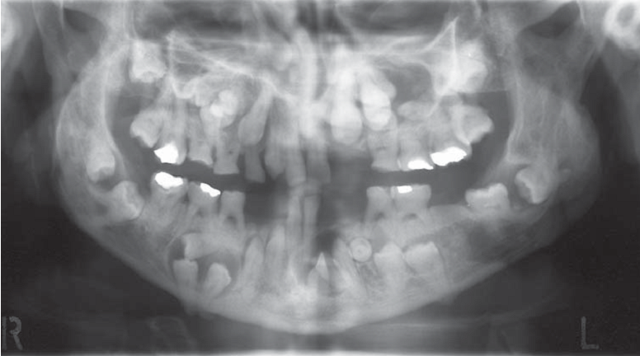
Radiographic features
Skull x- ray show delay closure of sutures and fontanels
Chest x-ray show absence or hypoplastic clavicles either unilaterally or bilaterally .
Jaws x-ray show un erupted permanent teeth, superneumerary teeth and distorted crown and root shapes.
Treatment
No specific treatment is needed.
Extraction of the deciduous teeth will not promote eruption of permanent teeth so surgical exposure is indicated with orthodontic treatment.

Slide 38
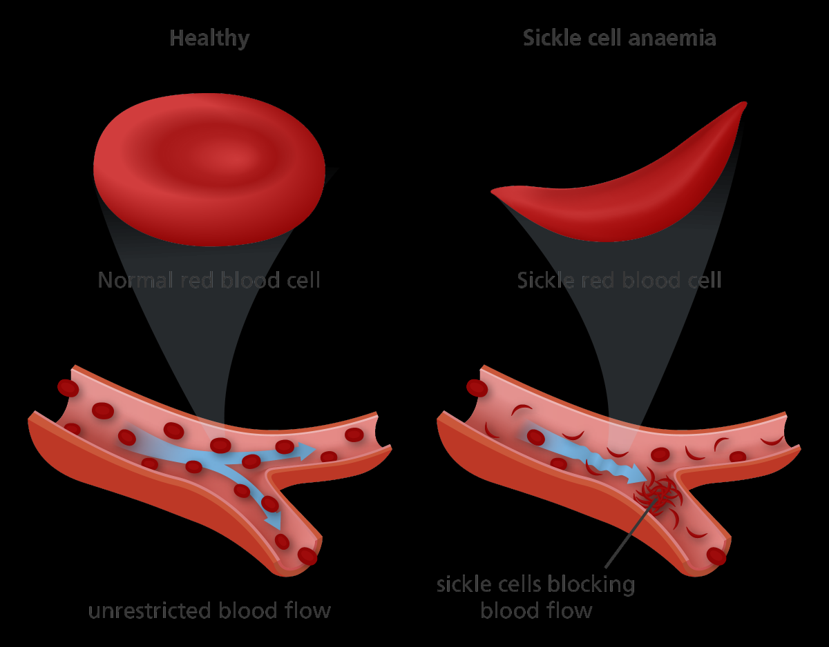
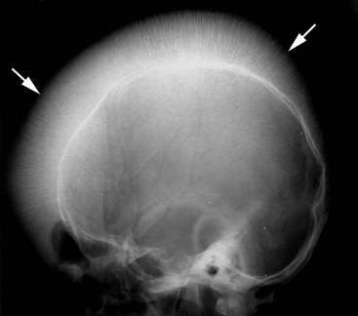
Sickle cell anaemia
Genetic disorder of the haemoglobin synthesis causing deformity of the RBC from normal biconcave disc to sickle shape.
Clinical features
The patients are anaemic and have joints pain.
Development sickle cell crisis due to the block of the capillaries by RBC lead to ischemia in the affected organ.
The most organs affected by the crisis is the respiratory system.
Skull x-ray show hair on end appearance.

Slide 39
Treatment
Dental treatment to be done under LA.
Avoid treatment during the crisis.
Haemotological investigation before the treatment specially haemoglobin.
Antibiotic coverage during the treatment.

Slide 40
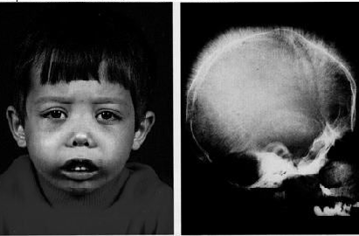
Thalassaemia major
Disorder of the haemoglobin chains which accumulate within the RBC. The RBC will be recognized as abnormal cell by the spleen leading to destruction of the RBC by spleen.
Clinical features
Anaemia
Massive bone marrow hyperplasia to produce RBC.
The jaws are enlarged specially the maxilla result in chipmunk face.
Skull x-ray show hair on end appearance.

Slide 41
Treatment
Dental treatment to be done under LA.
Special investigation of infectious diseases is need in case of history of multiple blood transfusion.
Haemotological investigation before the treatment specially haemoglobin and platelets.
Correction of anaemia before the treatment.
Antibiotic coverage before dental treatment.
Aseptic technique to decrease risk of infection.

Slide 42
Metabolic bone diseases
Rickets (hypovitaminosis D)
Vit. D increase intestinal calcium intake, bone calcium mobilization and renal calcium re-absorption.
Clinical features
Deficiency causing growth retardation.
Delay teeth eruption.
Deformity of the lower limbs.
Treatment
Replacement therapy .
Scurvy
Vit. C deficiency causing defective in the collagen and osteoid matrix. This cause gingival bleeding and delay wound healing.
Treatment
Replacement therapy.

Slide 43
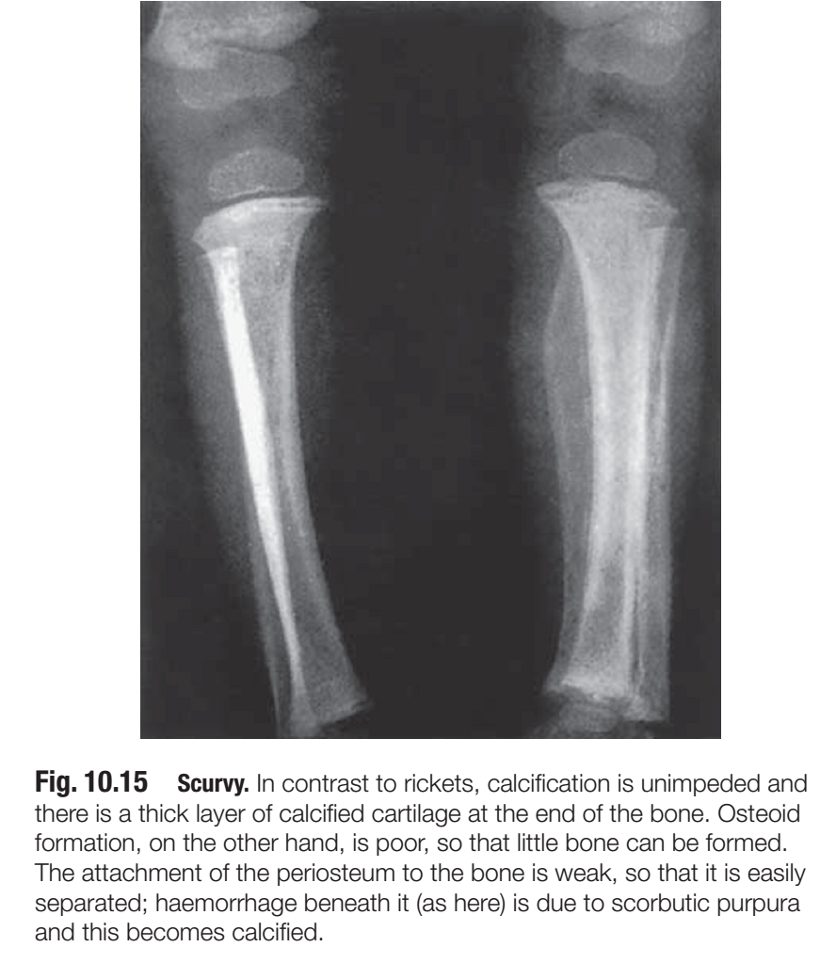
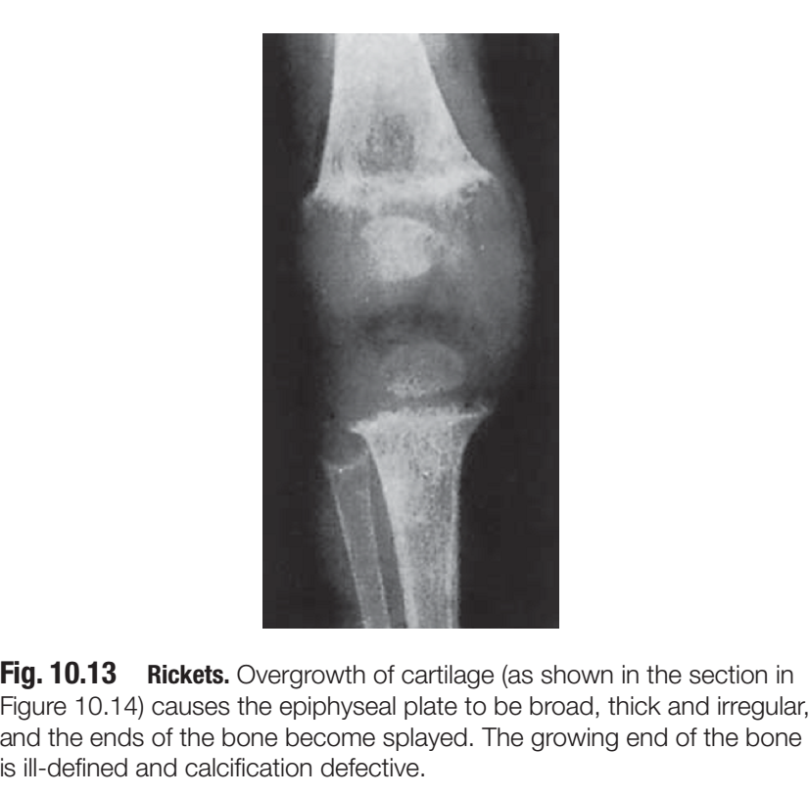

Slide 44
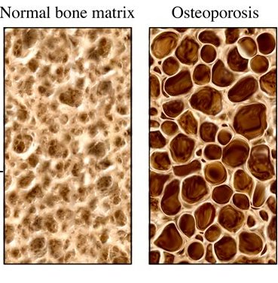
Osteoporosis
This disease result from decrease the absorption of the calcium from the GIT specially old age. The cause is either GIT or renal disease.
Clinical features
1-Common in women past menopause
2-About half the women over 60 in US have osteoporosis
3-Bone density loss is caused by failure of osteoblasts to laydown bone
matrix
4-Radiographs will demonstrate significant loss in bone density.
Treatment
Includes an increase in calcium, vitamin D, and sex hormone supplements.

Slide 45
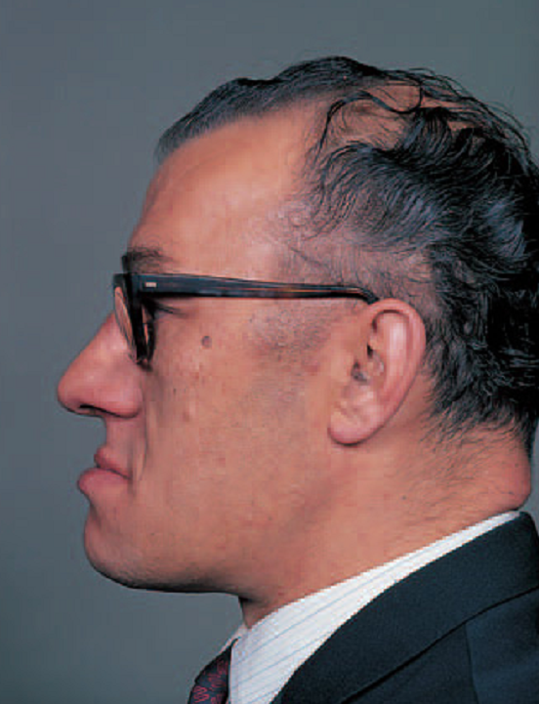
*Acromegaly
Uncommon disease characterized by excessive production of growth hormone after closure the epiphyseal plate in the affected patient. Usually this condition is due to adenoma of the pituitary gland.
Clinical features
Terminal phalanges of the hand and feet are enlarged.
Large skull.
Large mandible causing prognathism.
Macroglossia and thick lip.
Crowns of the teeth are normal but the roots are long and hypercementosied.
Radiographically, enlarged sell turcica, large skull and prominent frontal sinus.

Slide 46
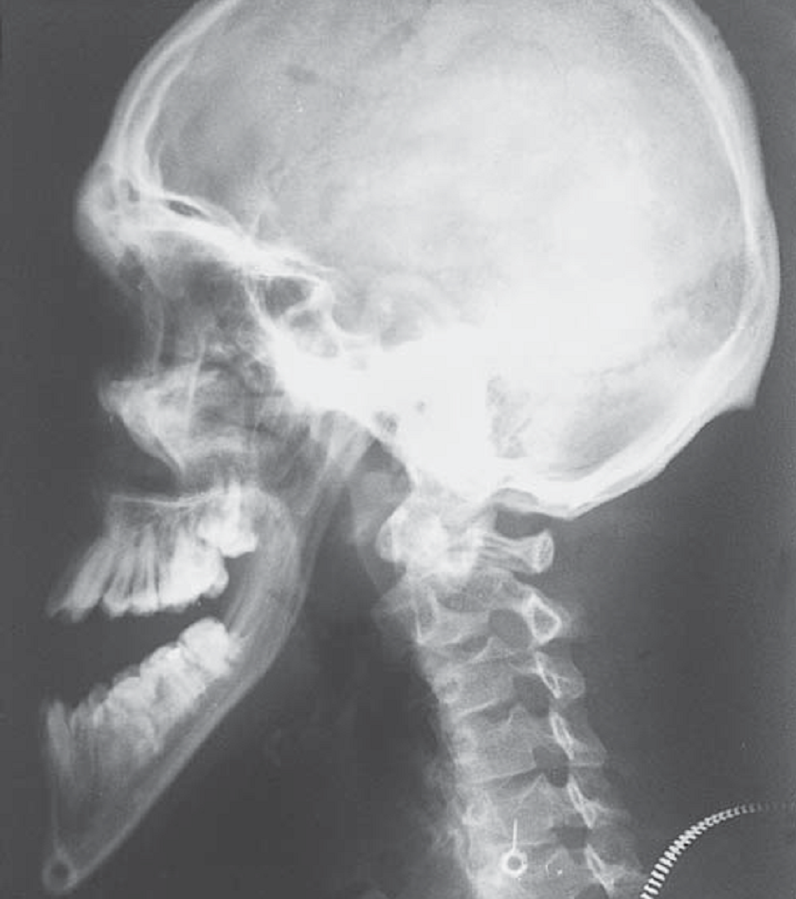
Treatment
Removal of the part of pituitary gland (hypophysectomy).
Control the general condition of the patient like heart disease

Slide 47
This group of diseases is divided into the following:
I-Genetic BD:
a- Osteogenesis imperfesta.
b- Osteopetrosis.
c- Achondroplasia.
d- Cleidocranial dysplasia.
e- Cherubism.
f- Sickle cell anaemia.
g- Thalassaemia major.
II- Metabolic bone disease
Rickets
Scurvy
Hyperparathyroidism
Osteoporosis
Acromegaly
III-Diseases of unknown causes:
Fibrous dysplasia
Ossifying fibroma
Paget’s disease
Langerhan’s cell disease
Giant cell granuloma
Aneurysmal bone cyst
Simple bone cyst

Slide 48
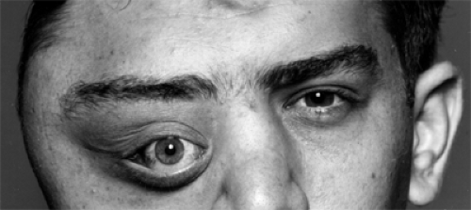
Diseases of unknown causes:
Fibro-osseous lesions of the jaws
Fibro-osseous lesions are characterized by the replacement of normal bone with a tissue composed of collagen fibers and fibroblasts that contain varying amounts of mineralized substance, which can be either bone or cementum-like material.
The cause of the disease is unknown but it may be developmental lesion, reactive, dysplastic, or neoplastic lesion.

Slide 49
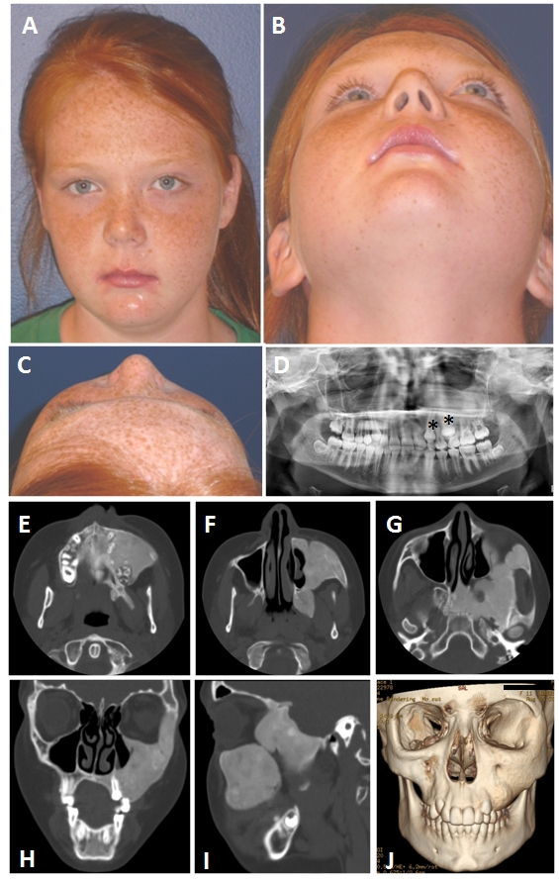
Fibrous dysplasia
Fibrous dysplasia is a developmental hamartomatous fibro-osseous disease of unknown etiology and it has 3 forms:
1. Monostotic fibrous dysplasia : this type form about 80-85% of all the cases usually affect one bone, particularly the jaw bone also it may affect the skull or the ribs. The clinical features are:
The maxilla affected more than mandible.
The 1st sign of the disease is gradually increased painless swelling which s not well circumscribed and cause gradual facial asymmetry .
Males and females are equally affected usually during 1st and 2nd decade of life
In jaws, the mass may displace the teeth and cause tipping and malalignment of teeth.

Slide 50
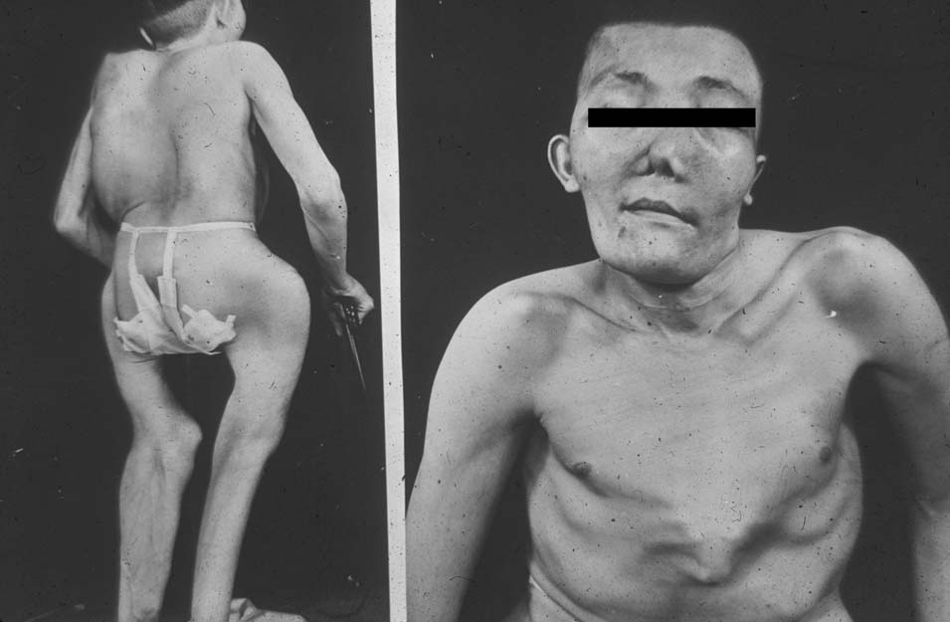
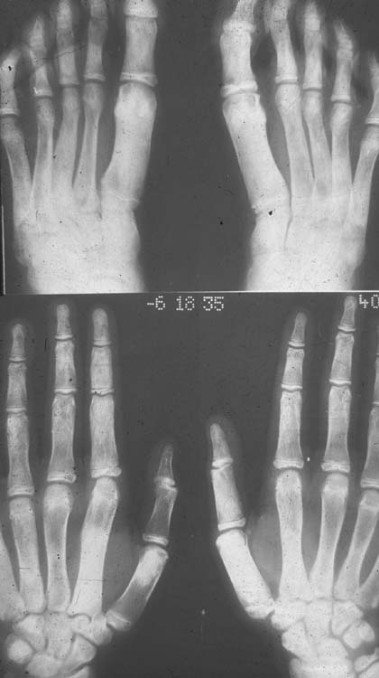
2. Polyostotic F D :( Jaffe’s syndrome):
Affecting multiple bones.
It is rare but in females is as common 3 times as males.
Distribution of the lesion is very variable and frequently occurs in bones of lower limb, skull, vertebrae, ribs, and pelvis and there is a tendency to be localized to one side of the body.
The disorder may be accompanied by skin pigmentation consist of brownish macules overlie affected bones and appear especially on the back of the neck, trunk, buttocks, or thighs, but hardly ever on the oral mucosa.
Pathological fractures is common in such cases.

Slide 51
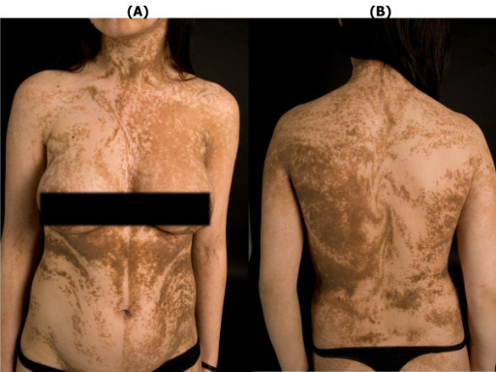
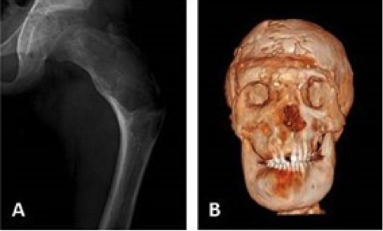
3. McCune Albright syndrome:
About 3% of fibrous dysplasia is sometimes referred to as Lichtenstein-Jaffe disease.
It is almost always a disease of females associated with endocrine disorders.
Multiple lesions are associated with patchy melanic pigmentation of skin (caf´e-au-lait spots).
Endocrine disturbances predominating precocious puberty, Hyperthyroidism, Hyperparathyroidism.

Slide 52


Slide 53
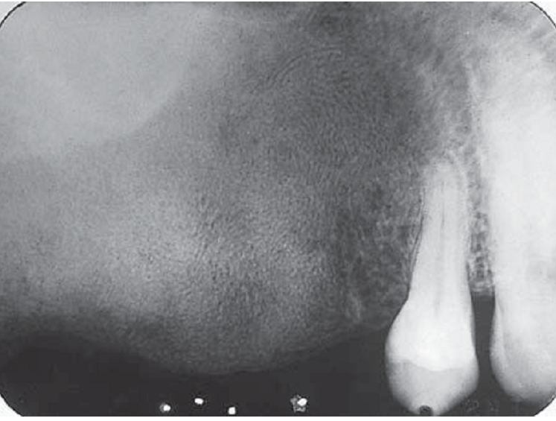
Radiologic features of fibrous dysplasia
Ground glass or orange peel or thumb print appearance.

Slide 54
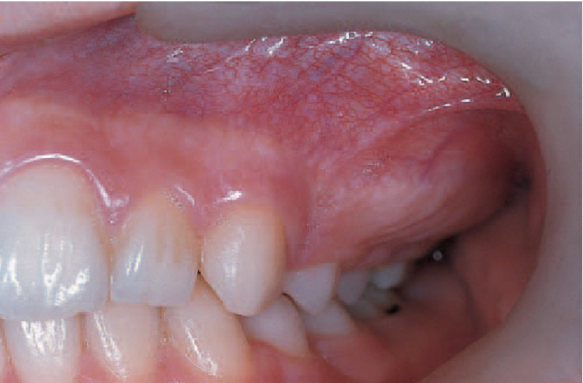
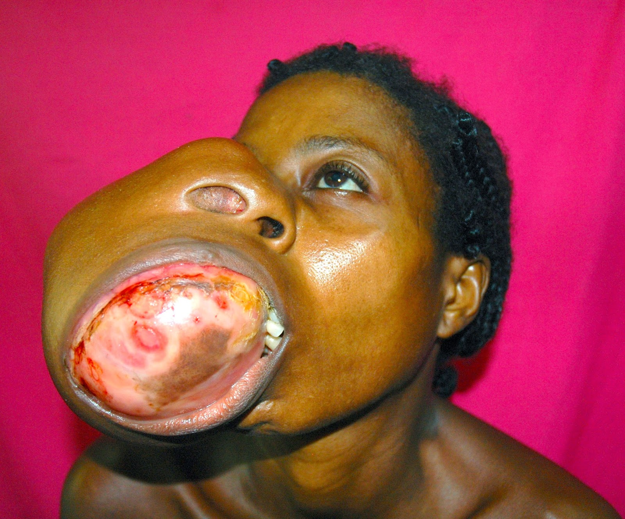
Treatment
Medical treatment may involve the use of bisphosphonates that inactivate osteoclasts and limit invasion of lesions into normal bone.
Surgical treatment include shaving or re contour the shape of the affected bone which usually done after the age of 18 yrs.
Notes:
The lesion generally asymptomatic; biopsy for diagnosis alone may be adequate. Observation may be appropriate if the lesion is minor, but development of any neurological signs or disfigurement would indicate surgical or medical management.

Slide 55
Cemento-osseous dysplasia
It represents a pathologic process of the tooth-bearing areas and probably represent the commonest manifestation of fibro-osseous disease.
They are frequently asymptomatic and require no treatment.
In this condition, there is a disordered production of bone and cementum like tissue in the jaws.
The etiology of these lesions remains in doubt but local trauma (like abnormal occlusal forces) may play some part.
The predominance of cases occurs in females and also they are of periodotal ligament origin.

Slide 56
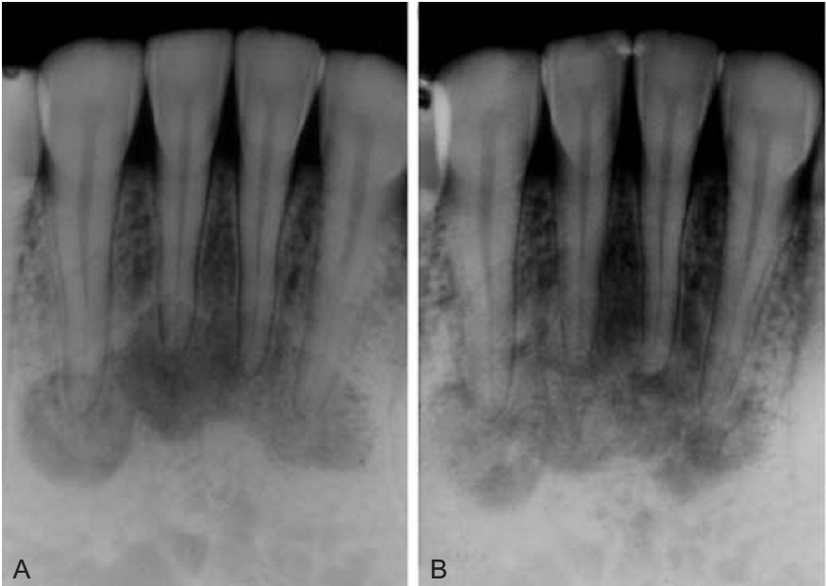
a. Periapical cemento-osseous dysplasia:
It affects women, particularly middle aged (over 30-year) more than 10 times as frequently as men.
It presents as circumscribed lesions in periapical areas of few teeth which are vital with the anterior mandible is the most usual site.
They are asymptomatic, but can be seen accidentally in radiographs as radiolucent, of mixed density, or radiopaque depending on their stage of development.
In its early stage, they differentiated from periapical granuloma .
No treatment is necessary as the disorder is self-limiting

Slide 57
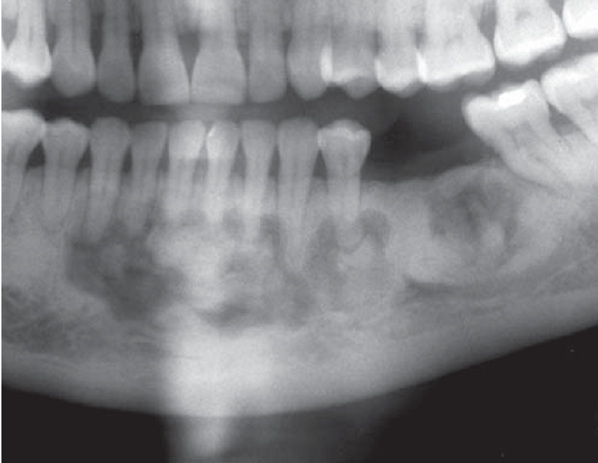
b. Florid cemento–osseous dysplasia:
The lesions of florid cemento-osseous dysplasia are often multiple and symmetrically distributed in the jaws.
Frequently involve 2 or more jaw quadrants.
Middle aged females and presents as painless, non-expansible lesion, and patients partially or totally edentulous.

Slide 58
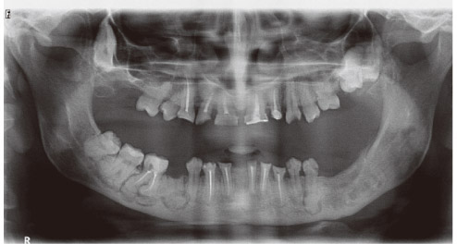
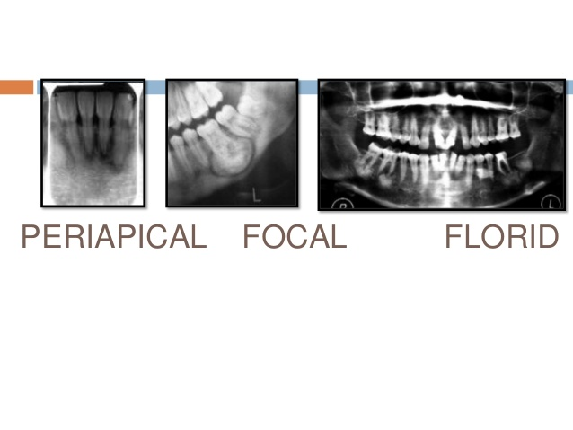
Familial gigantiform cementoma:
It is autosomal dominant variant of osseous dysplasia.
It involves usually multiple quadrants with expansible lesion often in anterior mandible.
Treatment is surgical for symptomatic cases and is limited to cosmetic recontouring.
Focal cemento-osseous dysplasia:
This term is given to changes similar to florid osseous dysplasia, but forming a single lesion and may frequently occur in sites of previous dental extraction.

Slide 59
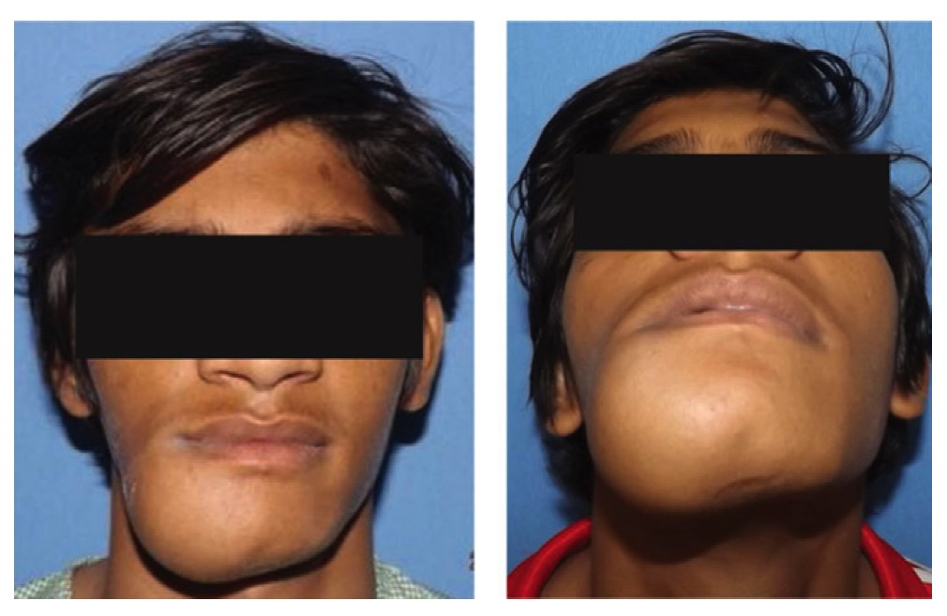
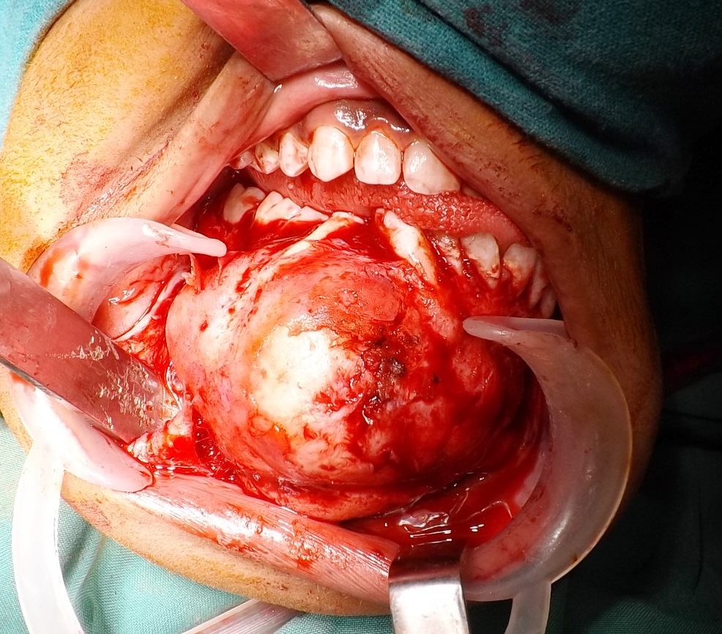

Ossifying fibroma: (cemento-ossifying fibroma)
It is a well circumscribed, slowly expansible painless growing neoplasm, usually in mandibular premolar or molar region. It occurs at later age, being most common in the 3rd and 4th decade of life.
Radiology: Usually presents as a well demarcated mixed radiolucency\radiopacity with smooth and often sclerotic borders. The lesion is usually solitary. Roots of related teeth are usually displaced and resorbed.
Treatment: Is usually surgical. The lesion often shells out easily at surgery with low recurrence rate. The lesion has a defined capsule and can be readily enucleated. Some operators suggest localized resection and segmental mandibular resection.

Slide 60

Juvenile aggressive ossifying fibroma:
Is a variant of ossifying fibroma in which the lesions occur in young children and adolescents with an aggressive behavior.
Mainly affecting individuals below the age of 15-yr.
The maxilla and paranasal sinuses.
Treatment: This condition is not necessitating aggressive surgery; conservative excision is still the recommended treatment.

Slide 61
Neoplastic Bone Diseases

Slide 62
Classification of bone diseases
Inflammatory bone diseases.
Non Neoplastic bone diseases, which divided into the following :
  Genetic BD.
  Metabolic BD.
  Diseases of unknown cause.
Neoplastic bone diseases.

Slide 63

Neoplastic bone diseases
1 -Primary — benign
Osteoma
Osteochondroma
2-Primary — malignant
Osteosarcoma
Chondrosarcoma
Ewing's sarcoma
Multifocal or potentially multifocal Myeloma
3- Secondary or Metastatic bony lesion

Slide 64



Osteoma and other bony over growth
Exostoses are localized overgrowths of bone, They consist of lamellae of compact bone, but large specimens may have a core of cancellous bone. specific variants are torus palatinus and torus mandibularis. They differ from other exostoses only in that they develop in characteristic sites and are symmetrical.
Torus palatinus commonly forms towards the posterior of the midline of the hard palate . The swelling is rounded and symmetrical, sometimes with a midline groove. If interferes with the fitting of a denture, should be removed.
Tori mandibularis form on the lingual aspect of the mandible opposite the mental foramen. They are typically bilateral, forming hard, rounded swellings . The management is surgical removal.

Slide 65


Gardner's syndrome
Gardner's syndrome comprises multiple osteomas of the jaw, polyposis coli with a high malignant potential, and often other abnormalities such as dental defects and epidermal cysts or fibromas.
It is inherited as an autosomal dominant trait but. Early recognition of these oral features should prompt endoscopy and possibly prophylactic colectomy.

Slide 66

Osteochondroma
These bony overgrowths grow by ossification beneath a cartilaginous cap.
Most arise from the region of the coronoid or condylar process and form a hard bony protuberance which can interfere with joint function.
Almost any age can be affected.
The lesion is subperiosteal.
As age advances, the mass progressively ossifies.
These tumours are benign and usually cease to grow after skeletal maturation.
Removal is therefore curative.

Slide 67

Osteosarcoma
Osteosarcoma is highly malignant and the most common primary (non-odontogenic) neoplasm of bone, but overall is rare, especially in the jaws.
The clinical features:
Osteosarcoma of the jaws is typically seen between the ages of 30 and 40.
Males are slightly more frequently affected.
The body of the mandible is a common site. There is typically a firm swelling which grows noticeably in a few months and becomes painful .
Teeth may be loosened and there may be paraesthesia or loss of sensation in the mental nerve area.
Metastases to the lungs may develop early.

Slide 68

Radio graphically,
A sun-ray appearance or Codman's triangles at the margins, due to lifting of the periosteum and new bone formation.
Treatment :Osteosarcoma is rapidly invasive and can metastasize early. Treatment is by early mandibulectomy or maxillectomy together with wide excision of any soft-tissue extensions of the tumour. This may be combined with radiotherapy and/or chemotherapy.
The prognosis depends mainly on the extent of the tumour at operation and deteriorates with spread to the soft tissues and lymph nodes

Slide 69


Ewing’s sarcoma
Ewing's sarcoma is rare but, when it affects the head and neck region, has a predilection for the body of the mandible.
Clinically, patients are usually children or young adults. Typical symptoms are bone swelling and often pain, progressing over a period of months. Teeth may loosen and the overlying mucosa ulcerates. Fever, leukocytosis, a raised ESR and anaemia may be associated and indicate a poor prognosis.
The initial treatment is wide excision or, if not possible, combination chemotherapy should also be given and appears to have improved the survival rate but increases the risk of lymphoid tumors later.

Slide 70

Multiple myeloma
Multiple myeloma is a neoplasm of plasma cells which produce a monoclonal immunoglobulin. It causes multiple foci of bone destruction, bone pain and tenderness.
Oral amyloidosis may be a part from the symptoms.
Proliferation of myeloma cells in the marrow frequently causes anaemia and sometimes thrombocytopenia.
Infections may result from depressed production of normal immunoglobulins.
Greatly raised ESR as a result of overproduction of immunoglobulin (usually IgG).
Skeletal radiographs typically show multiple punched-out areas of radiolucency, particularly in the vault of the skull.
Dental treatment may be complicated by anaemia, haemorrhagic tendencies, or increased susceptibility to infection

