Slide 1
Spread of infection from teeth
Dr.Bayad Jaza Mahmood
Board certified maxillofacial surgeon

Slide 2
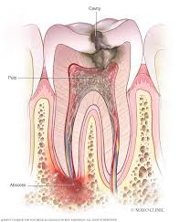
Dental infections are infections that originate at the tooth or its supporting structures and can spread to the surrounding tissue.
Dental infections most commonly occur when bacteria invade the pulp and spread to surrounding tissues.
Serious complications from dental infections are rare.

Slide 3
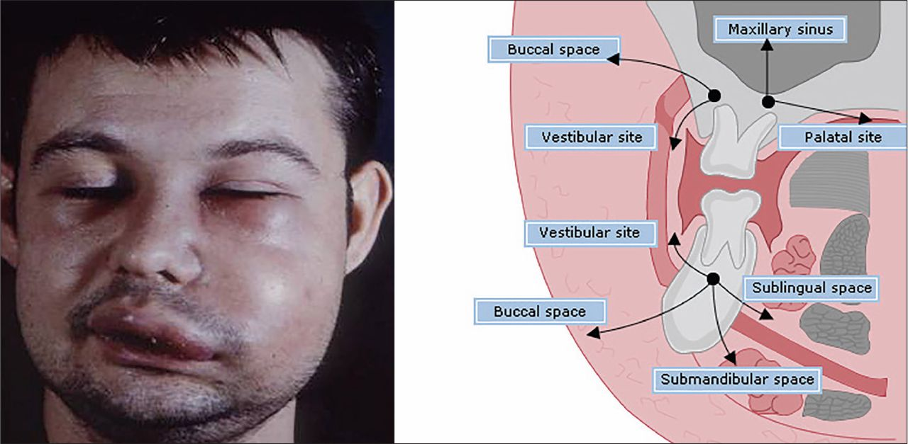
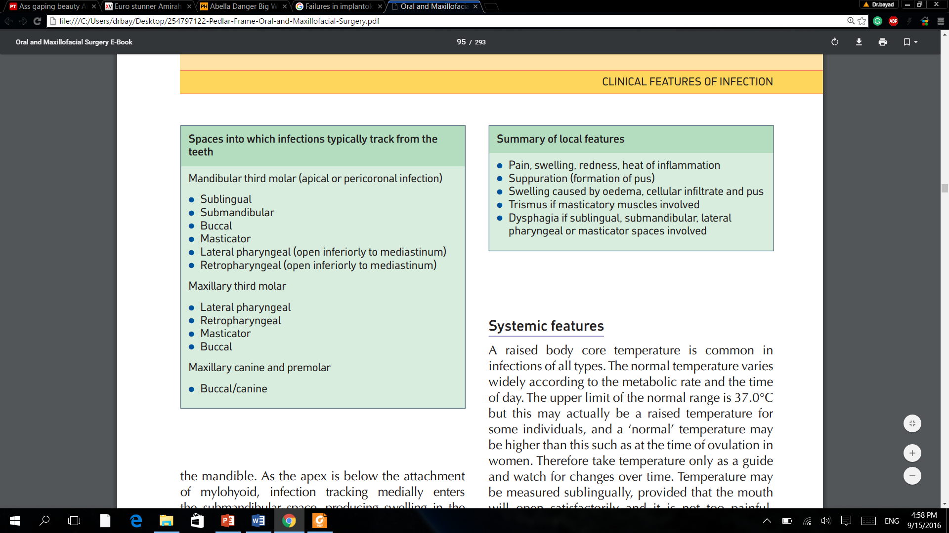
Spread of infection from teeth:

Slide 4
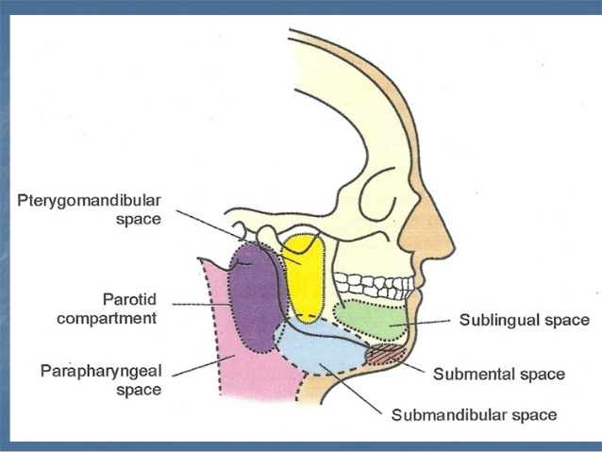
Primary fascial spaces?
The primary spaces are the spaces directly adjacent to the origin of the odontogenic infections.
    Buccal
    Canine
    Vestibular
    Submandibular
    Submental
    Sublingual

Slide 5
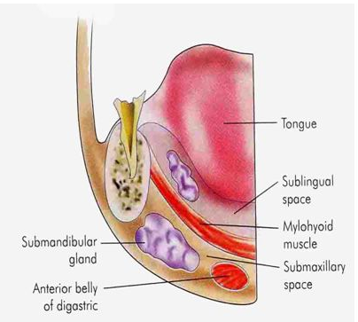

Slide 6
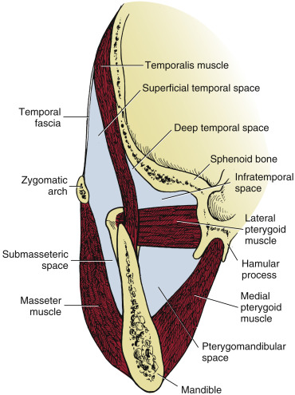
Secondary fascial spaces?
Facial spaces that become involved following spread of infection to the primary spaces:
    Pterygomandibular
    Superficial and deep temporal
    Infratemporal
    Retropharyngeal
    Masseteric
    Lateral pharyngeal
    Prevertebral

Slide 7
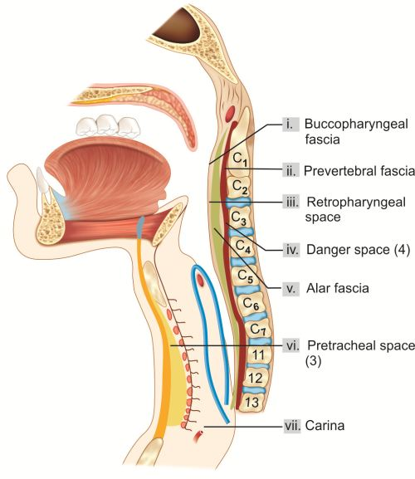

Slide 8
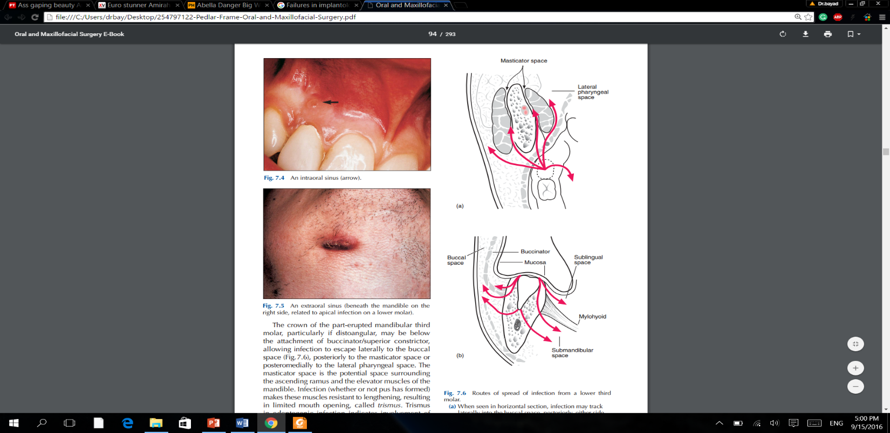

Slide 9
Treatment
Incise and drain the abscess, allowing the pus to drain out, and then wash the area with (saline).
Put the drain tube to prevent recollection.
Perform a root canal. This can help eliminate the infection and save the tooth. ...
Extract the affected tooth. ...
Prescribe antibiotics.

Slide 10
Thank you

