Slide 1
BIOPSY
Dr. Bayad Jaza Mahmood
BDS, FKBMS

Slide 2
Biopsy
Biopsy is defined as the complete or partial removal of a lesion for histopathological examination to aid definitive diagnosis.
Whereas biopsy usually establishes the definitive diagnosis, there are occasions when the result is not clear and in these circumstances the available histological data must be measured against clinical findings.

Slide 3
INDICATIONS FOR BIOPSY
Any lesion that persists for more than 2 weeks with no apparent etiologic basis.
Any inflammatory lesion that does not respond to local treatment after 10 to 14 days.
Lesion that interfere with local function.
Bone lesions not specifically identified by clinical and radiographic findings.
Any lesion that has the characteristics of malignancy such as Erythroplakia, Ulceration, Bleeding, Induration and fixation.

Slide 4
Contraindications
Poor general condition.
Anticoagulant therapy
Local infection near the site

Slide 5
Biopsy techniques:
Excisional biopsy
Incisional Biopsy
Punch Biopsy
Fine Needle Aspiration Cytology(FNAC) and CT guided FNAC.
Core Needle Biopsy.
Exfoliative Cytology.

Slide 6
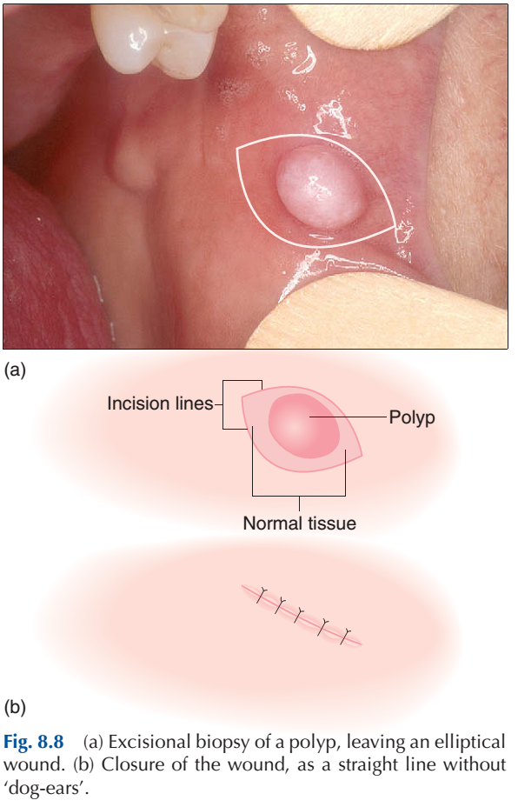
Excisional biopsy
An excisional biposy implies the complete removal of the lesion.
The entire lesion with 2 to 3mm of normal appearing tissue surrounding the lesion is excised if benign.
INDICATIONS:
Should be employed with small lesions less than 2cm.
The lesion on clinical exam appears benign.
When complete excision with a margin of normal tissue is possible without mutilation.

Slide 7
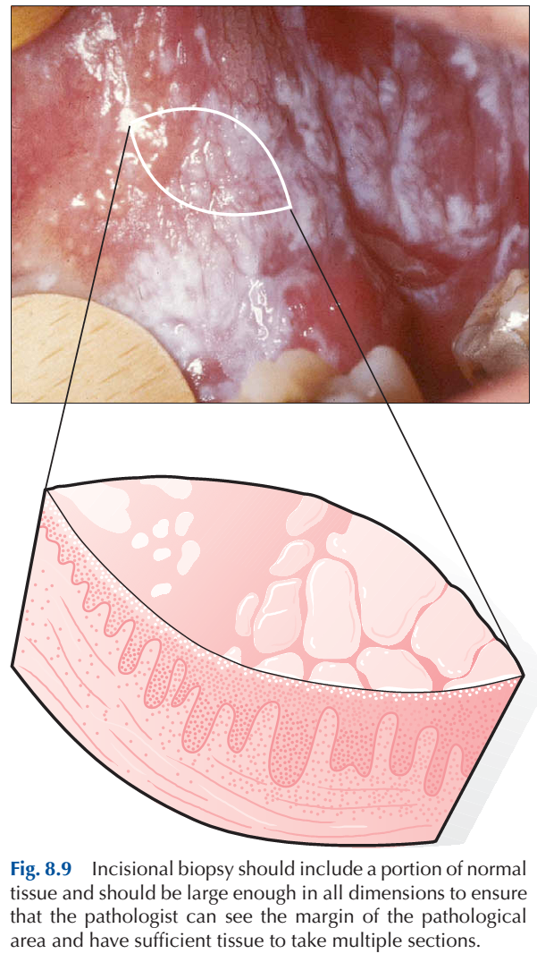
INCISIONAL BIOPSY
An incisional biposy implies the removal of the piece of lesion.
Indications:
Size limitations(> 2 cm).
Hazardous location of the lesion.
Great suspicion of malignancy.
Technique:
Representative areas are biopsied in a wedge fashion.
Margins should extend into normal tissue on the deep surface.
Necrotic tissue should be avoided.
A narrow deep specimen is better than a broad shallow one.

Slide 8
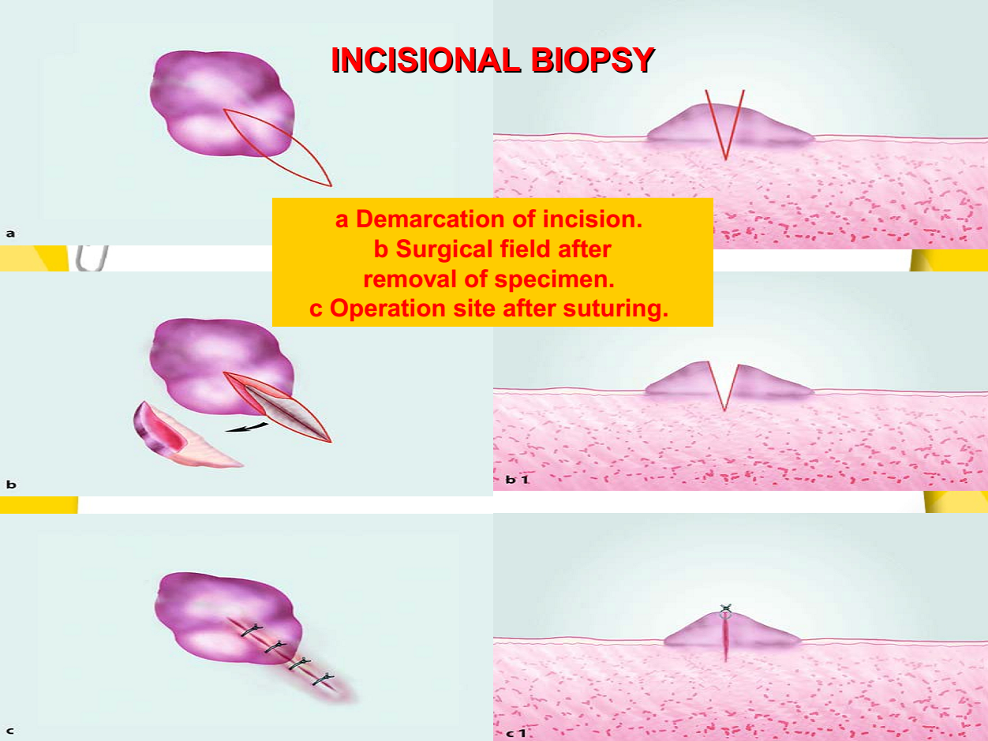

Slide 9
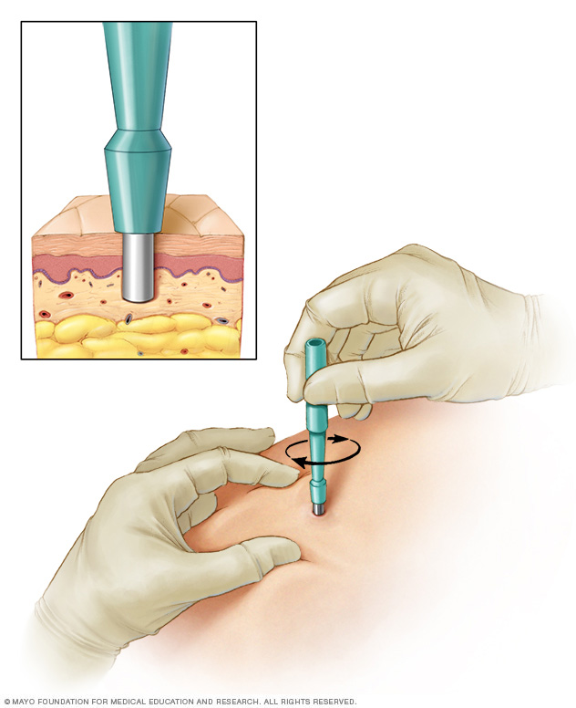
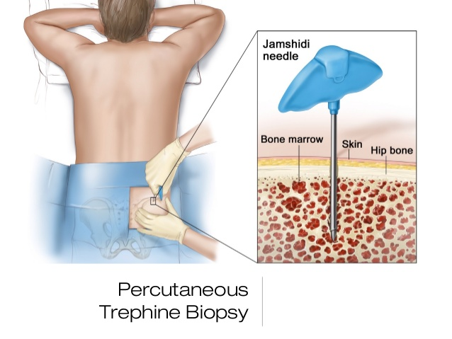
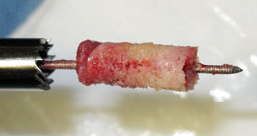
Punch biopsy
A circular blade can be used to remove a cylindrical core of tissue as a form of incisional biopsy: this punch biopsy technique is more commonly used on skin.
Trephines
In this technique a core of tissue is trephined from
the lesion. It may be used for soft-tissue swellings
or bone.
This provides sufficient material, retaining tissue architecture, for histological diagnosis and is
useful for lesions where access may be difficult.

Slide 10
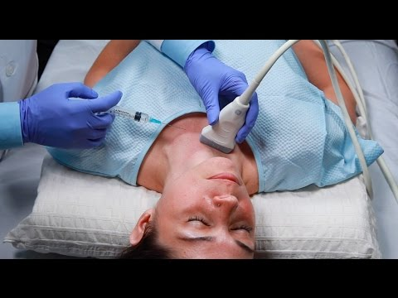
Aspiration biopsy
1. Fine-needle aspiration (FNA) cytology is a useful method for sampling soft-tissue masses in the head and neck, such as lymph nodes and salivary glands.
Procedure:
A 10- or 20-mL syringe with a 21-gauge needle is inserted into the centre of the deep tissue mass and the plunger pulled back, drawing a small tissue sample into the needle.
The needle tip is resited within the lesion and the procedure repeated several times. The sample is then delivered directly onto a microscope slide, spread and fixed. This is a valuable method but technique sensitive.
Accurate sampling is clearly essential and on occasions where the lesion is deep it can be combined with ultrasound investigation to ensure the needle is positioned within the lesion (ultrasound-guided FNA).

Slide 11
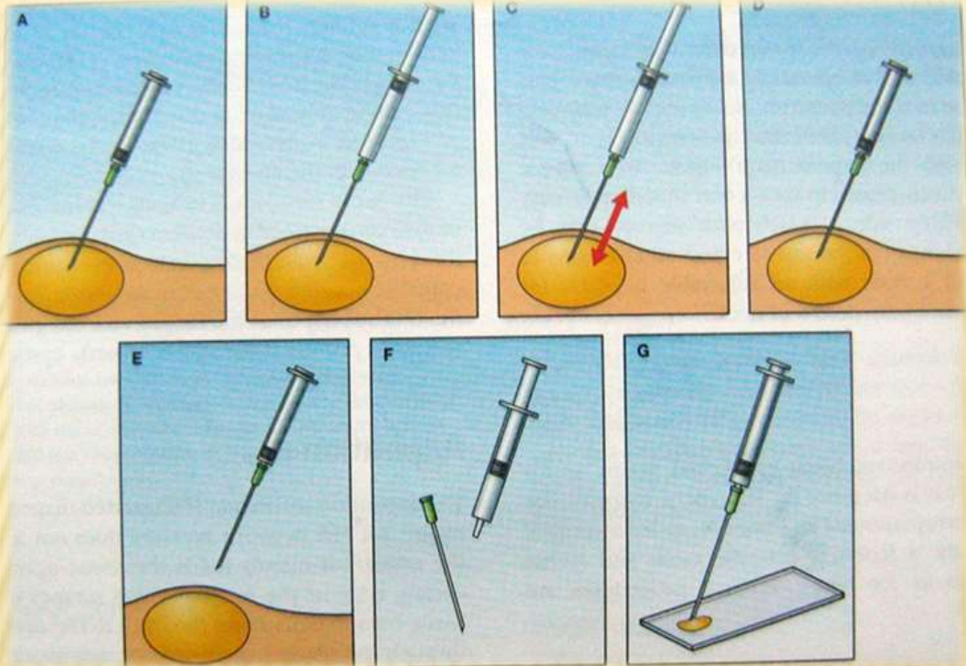
INDICATIONS
1. Non palpable lesions, or area difficult to biopsy but can be localized by CT, MRI, Ultrasound.
2. To rule out vascular lesions prior to open
surgery.
3. In cases where Biopsy is contraindicated on
medical background.
4. Used as a diagnostic screening test at
community level for head and neck masses.
5. Indicated for known tumors to assess effect of treatment.
6. Used to obtain tissue for specific studies.

Slide 12
ADVANTAGES OF FNA:
1. The technique is relatively painless, produces speedy results.
2. It is an inexpensive technique.
3. It requires little equipment.
4. The technique can be done as an out patient or a bed side procedure.
5. There is no problem with wound healing.
6. The technique is readily repeatable
DISADVANTAGES:
Requires great skills.
Needle can damage vital structure.
Internal bleeding possible.
Dissemination of tumor cells into damaged vessels.

Slide 13
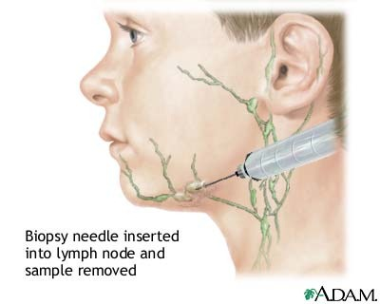
2. Core needle biopsy:
is the procedure to remove a small amount of suspicious tissue with a larger “core” (meaning “hollow”) needle.
It is usually performed while the patient is under local anesthesia.

Slide 14
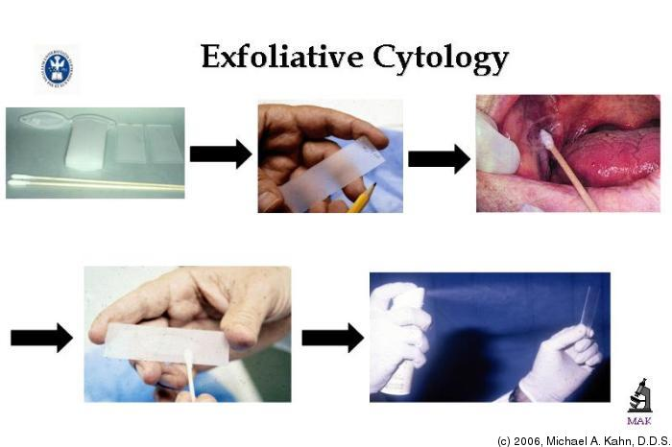
Exfoliative Cytology
It is a quick and simple procedure, is an
important alternative to biopsy in certain
situations. In exfoliative cytology, cells
shed from body surfaces, such as the
inside of the mouth, are collected and
examined.
This technique is useful only for the examination of surface cells and often
requires additional cytological analysis to confirm the results.
DANGERS OF BIOPSY
 Spreading of infection
 Haemorrhage
 Infection
 Operative trauma

