Slide 1
Ischemic Heart Diseases
It is a general term for group of cardiac diseases, characterized by ischemia or necrosis of part of heart tissue.
It includes:
Angina Pectoris (chest pain).
Myocardial Infraction (Ml or heart attack)
CVA

Slide 2
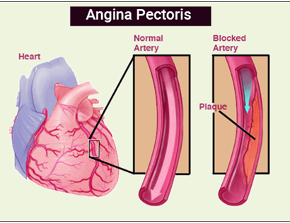
ANGINA PECTORIS
Angina pectoris is the name given to episodes of chest pain caused by myocardial ischemia secondary to CAD.
It affects around 1% of adults and its prevalence rises with increasing age.
The severity and prognosis of angina depends upon the degree of coronary artery narrowing and has a varied clinical presentation.
The usual underlying causes are atherosclerotic plaques that rupture with resulting platelet activation, adhesion and aggregation, and thrombosis impeding coronary artery blood flow (or, if this is complete occlusion, myocardial infarction).

Slide 3
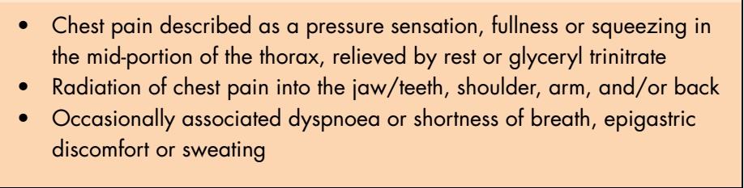
Features of angina

Slide 4
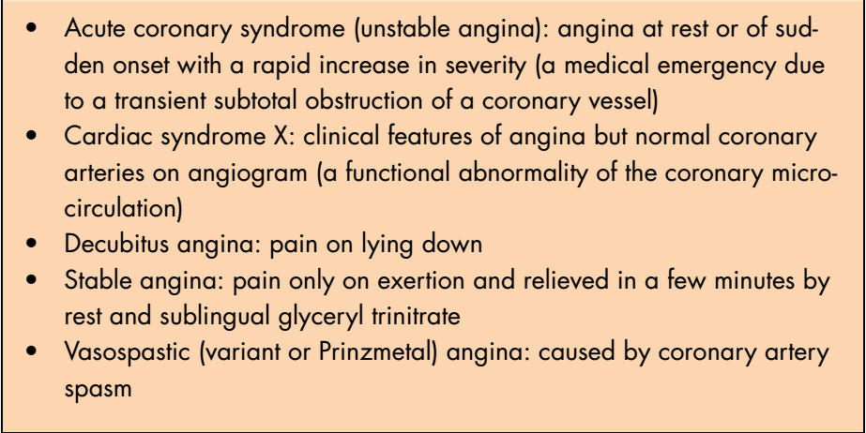
Angina variants

Slide 5
Management of angina
Consultation of physician to control the condition.
Use anxiety reduction protocol such as short duration atraumatic procedures,….
Preoperative nitroglycerine or sometimes sedations (oral diazepam) is useful.
If the patient have developed angina intraoperatively:
Stope the procedure.
Give nitroglycerine
Give oxygen
Monitor vital signs.
Accompany the patient to home.

Slide 6
If the patient not relived within 5 minutes repeat nitroglycerine 3 times for 15-20 minutes.
If the pain persists and other symptoms such as nausea, vomiting and syncope and hypertension the myocardial infarction (MI) will be suspected and the patient should take 300mg aspirin (chewing), and oxygen.
Conscious sedations and general anesthesia should be avoided in patients with recent angina, unstable angina and MI.
In patients with unstable angina the treatment should be deferred until physician is agreed because of risk of developing MI, otherwise the patient can be given nitroglycerine sublingually and vital signs should be monitored.

Slide 7
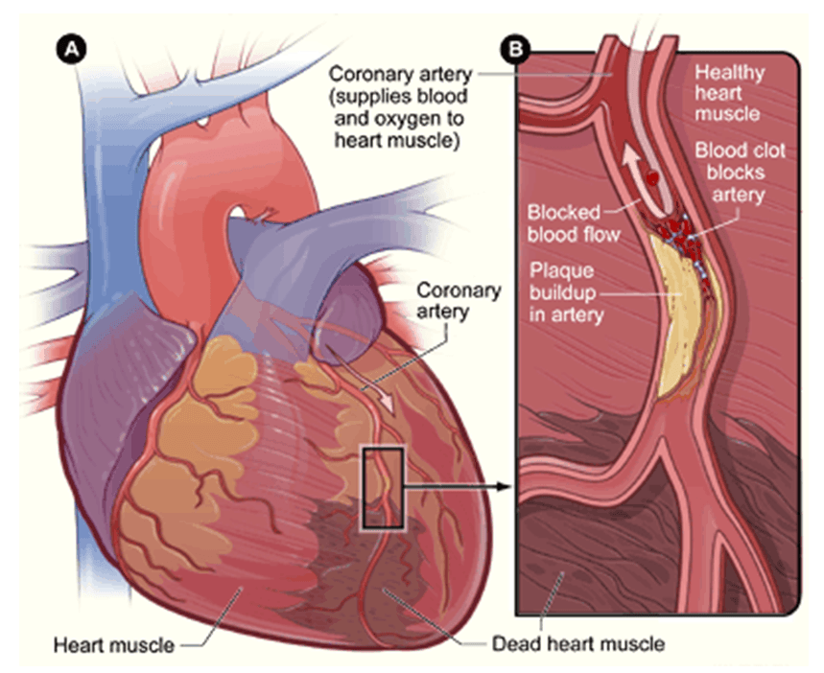
MYOCARDIAL INFARCTION
Myocardial infarction (coronary thrombosis or heart attack) results from the complete occlusion (blockage) of one or more coronary arteries.
It arises when atherosclerotic plaques rupture causing platelet activation, adhesion and aggregation with subsequent thrombus formation within the coronary circulation.
Angina may progress to MI but fewer than 50% of patients with MI have no any preceding symptoms.

Slide 8
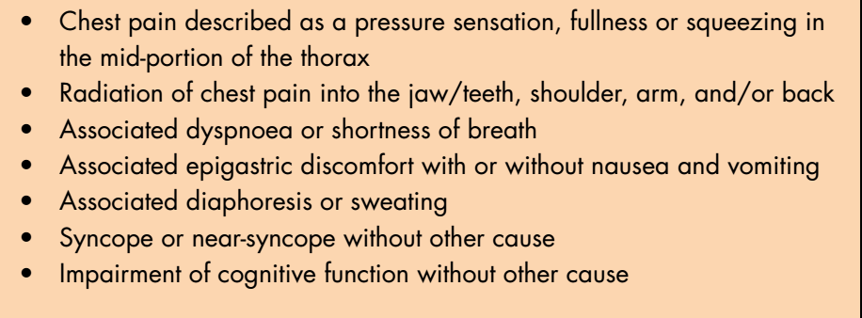
Features of myocardial infarction

Slide 9
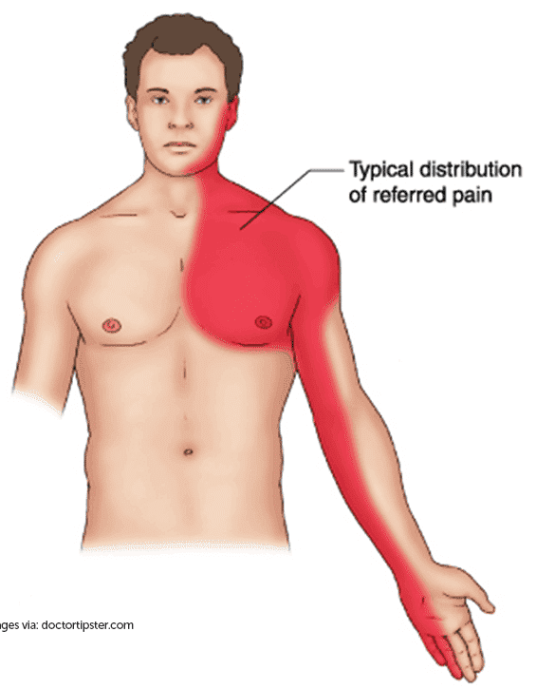
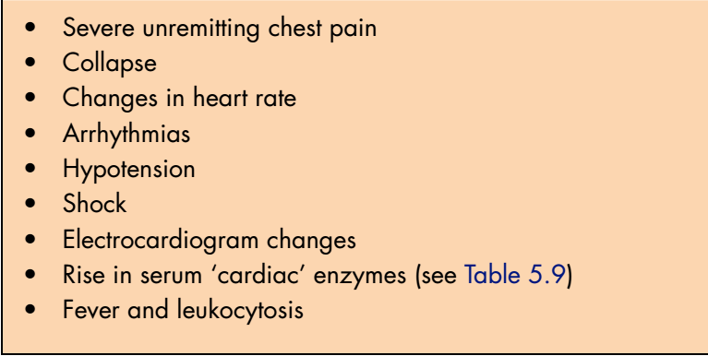
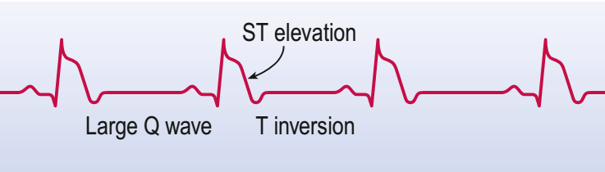
Myocardial infarction – diagnosis
(More than 140).
(ST elevation).

Slide 10
Management of MI patients undergoing dental procedures
Patients within 6 months of MI at greater risk of another attack.
Consult the physician.
Dental treatments can precipitate arrythmia and aggravate cardiac ischemia, so the elective procedures should be deferred.
For emergency treatment:
Simple emergency procedures under L.A within 6 months of MI can be performed but after consultation of specialist.
Symptomatic patients with old history of MI (>6months) can be done safely but with stress reduction protocol.

Slide 11
The physician may advocate the preoperative use of GTN (glycerine trinitrate).
Monitor the vital signs (BP, Pulse, SPO2, ECG).
If MI is suspected intraoperatively the following should be done:
Alert emergency services (if in community) or cardiac arrest team (if in hospital).
Aspirin (300 mg); to be chewed. Clopidogrel
Rest and reassure
Pain relief: opioid analgesia (diamorphine 2 mg/min).
Oxygen or nitrous oxide with at least 28% oxygen by face mask or intranasally
Primary percutaneous intervention, or thrombolysis – streptokinase/ tissue plasminogen activator (t-PA) to dissolve the coronary thrombus.
Insulin infusion to prevent a stress hyperglycaemia (high blood sugar level)
Glyceryl trinitrate infusion to relief pain and prevent pulmonary oedema (fluid accumulation within the lungs)
Prompt treatment of complications, particularly cardiac arrhythmias, including the initiation of cardiopulmonary resuscitation.

Slide 12
Thanks

