Slide 1
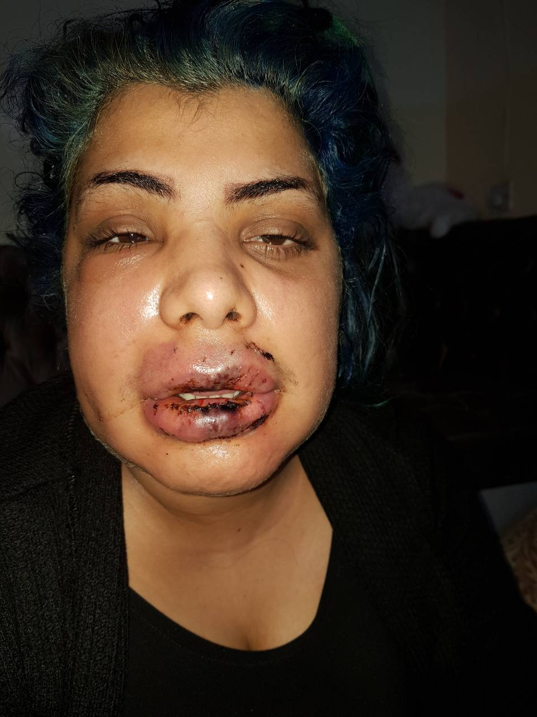

Slide 2
HYPERTENSION
Dr.Bayad J. Mahmood
BDS, FKBMS, AACME.HD

Slide 3
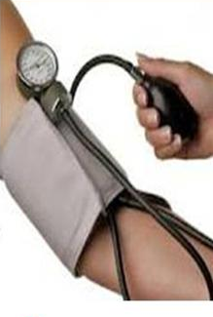
Hypertension is a persistently raised blood pressure, or Hypertension may be defined as an elevated BP of at least 140/90 mmHg, based on at least two readings on separate occasions.
The BP is dependent on the heart and vasculature, autonomic nervous system, endocrine system and kidneys.
The BP is lowest at night and highest in the morning. Since the BP rises with anxiety, measurements should be made with the patient relaxed and fully at rest.
Long-standing hypertension accelerates atheroma and predisposes to: coronary artery disease; cerebrovascular disease; chronic kidney disease (hypertensive nephrosclerosis) hypertensive retinopathy, left ventricular hypertrophy.
Hypertension shortens life by 10–20 years. The risk of these sequelae is greater in people who also have diabetes and cardiac or renal disease.

Slide 4
Types of hypertension:
Idiopathic or essential’ hypertension: about 40% of adults in the developed world have hypertension but in more than 90% the cause is unknown.
Secondary’ hypertension: In 1–2% of hypertensive patients, an identifiable cause is present and this is termed ‘secondary’ hypertension.

Slide 5
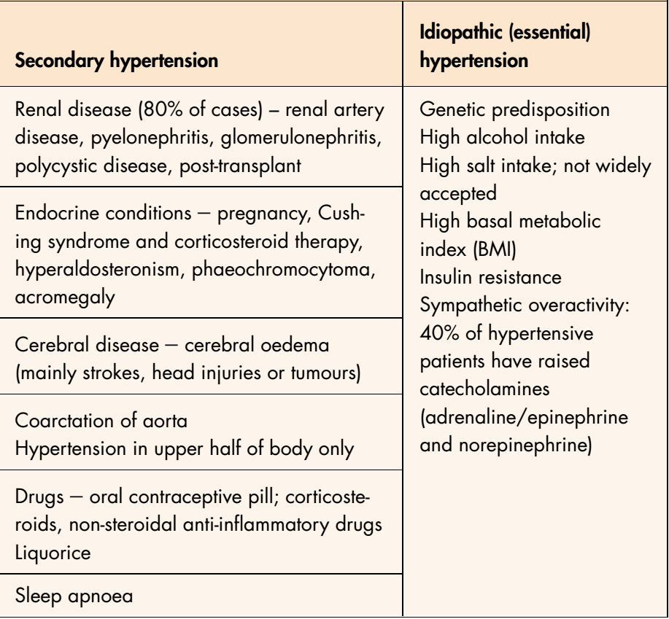
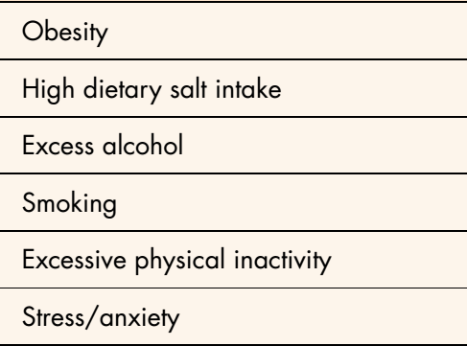
Causes of hypertension:
Lifestyle risk factors modifying hypertension

Slide 6
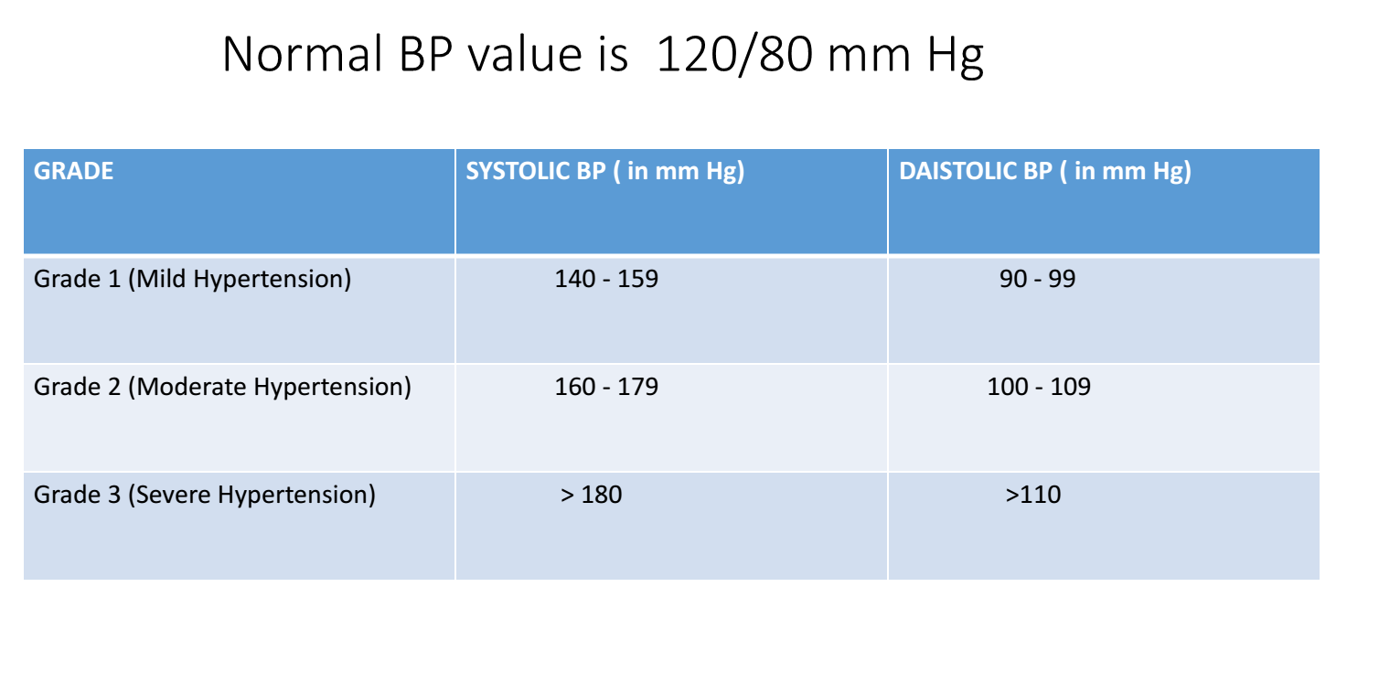

Slide 7
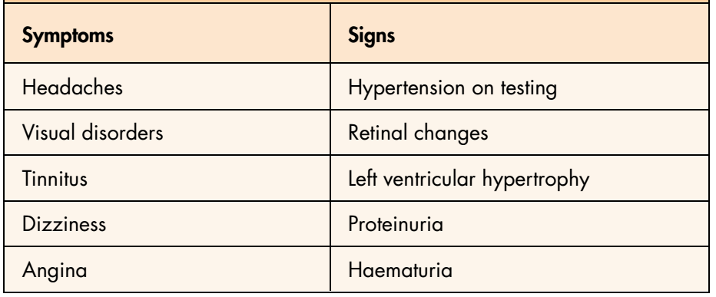
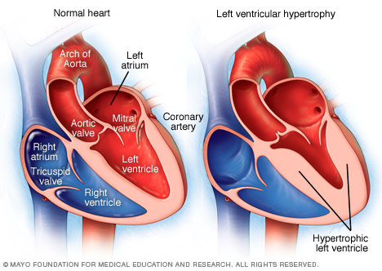
Features of advanced hypertension

Slide 8
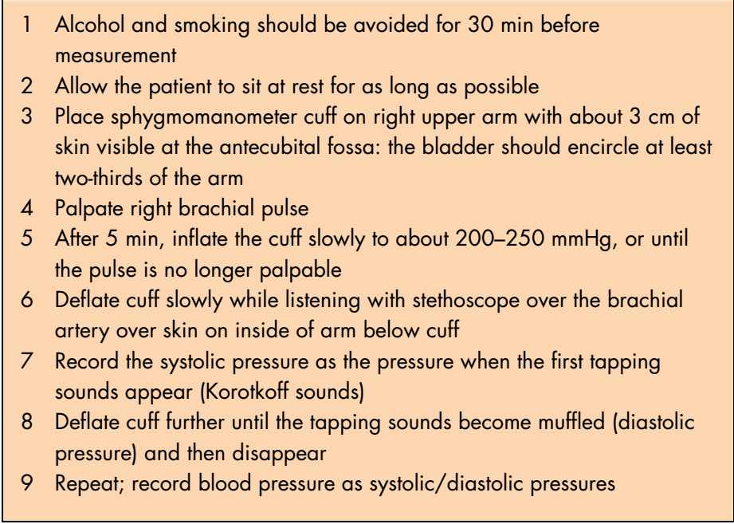
Manual technique for recording blood pressure

Slide 9


Slide 10
General management
Consult the physician before treatment.
Investigations:
chest radiography (cardiomegaly is suggestive of hypertensive heart disease).
ECG (may indicate IHD).
serum urea and electrolytes (deranged in hypertensive renal disease).
3. Check blood pressure on three different occasions.
4. Late morning treatment because of endogenous epinephrine is high and cardiac events are more possible to happen.
5. Rest and Reassurance of the patient, sometimes Temazipam is useful.

Slide 11
6. Antihypertensive patient morning dose of medication prior to surgery must be given.
7. Use the aspirating dental syringe to avoid accidental intravascular injection (increase HTN and ischemia).
8. It is better to use epinephrine free local anesthesia (plain).
9. Epinephrine interacts with:
Beta blocker -------- raise blood pressure.
Alpha blocker--------- increase vasodilatation.
10. Avoid rapid change in patient position to avoid orthostatic hypertension.
11. Minimally invasive surgical procedures, short duration procedures, atraumatic extraction, good hemostasis using pressure packing should be performed.
12. The patient should rest for at least 20 minutes before leaving the dental clinic.

Slide 12
Relation of HTN to the general anesthesia
All hypertensive drugs potentiated by G.A causing vasodilatation (dangerous hypotension) at the same time their stoppage might cause rebound hypertension this may be fatal.
Hypertension complicated by heart diseases and renal failure must be a contraindication to G.A.
Drugs my cause interactions:
Corticosteroids -------- Blood pressure.
NSAIDS ---------- decrease potency of antihypertensive drugs.
Complications of anti HTN (xerostomia, lichenoid reaction, gingival hyperplasia, erythema multiforme).

