Slide 1
Giant Cell Lesions and Histiocytosis
Dr. Bayad Jaza Mahmood
Board certified maxillofacial surgeon

Slide 2
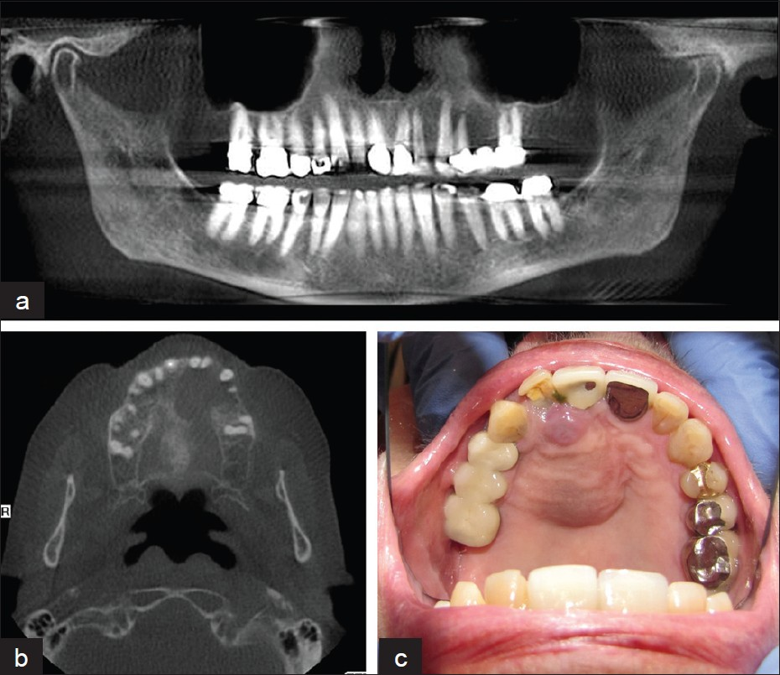
Giant cell lesions
These are group of diseases have the same features histologically and radiographically but they can be differentiated by their clinical features.
These diseases include the following:
Central giant cell granuloma ( CGCG).
Cherubism.
Hyperparathyroidism .

Slide 3
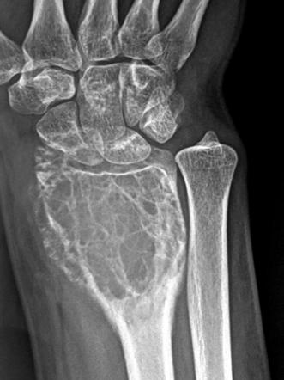
Central giant cell granuloma
Sometimes it’s called giant cell reparative granuloma and these lesions are hyperplastic rather than neoplastic lesions .The same lesion if affect other bone it will be called osteoclastoma which is differ from the CGCG by the:
CGCG has benign behavior while osteoclastoma tend to be malignant.
CGCGC affect patient usually below 25 yrs.
CGCG tend to form new bone while this not occurs in osteoclastoma.

Slide 4
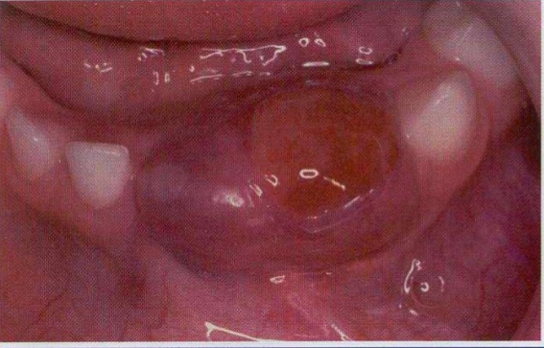
Clinical features
Usually affect people below 25yrs.
the mandible affected more than the maxilla. The area affected is usually anterior to the 1st molar tooth.
About 65% of the diseases occur in the female.
Presented as painless swelling.
The lesion is highly vascular and may cause severe bleeding during its surgery.

Slide 5
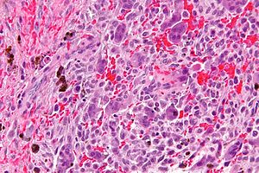
Types
Central (medullary ) type which occur in the bone marrow and it’s may cause root resorption.
Subperiosteal type which extends to the area below the periosteum along the cortical bone and it may cause ulceration of the oral mucosa.
Histopathology features:
Usually there is giant cell (osteoclast like cell) which cause destruction of the bone also there is fibrous tissue reaction with collagen formation.

Slide 6
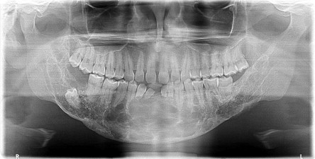
Radiographic features:
Unilocular or multilocular radiolucencies give appearance of soap bubble.
Treatment
1- Enucleation of the lesion.
2- Excision in extensive cases.
3- Medical treatment in some cases including steroid injection.

Slide 7

CherubiSm (familial fibrous dysplasia)
Cherubism is inherited as an autosomal dominant trait which present at Infancy as jaws swelling.
Histologically:
the diseases consist of giant cell in vascular connective tissues.

Slide 8
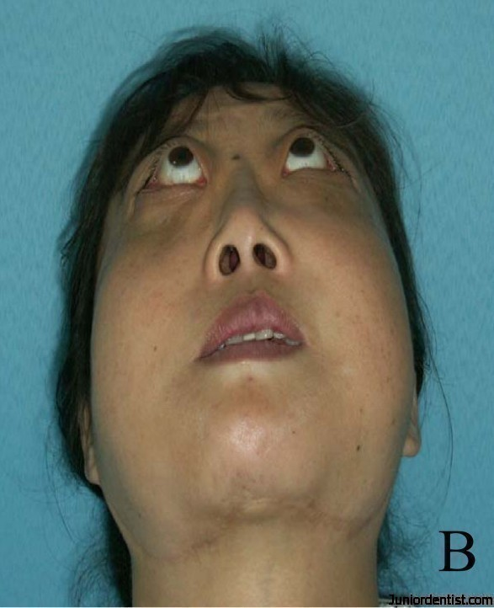
Clinical features
The onset is typically between the ages of 6 months to 7 years,
Typically there is symmetrical swellings are noticed at the age of 2 to 4 years
The angles of the mandible are mainly affected and, in severe cases, the maxillae also involved.
The symmetrical mandibular swellings give the face an excessively chubby appearance. Expansion of the maxillae may cause stretching of the skin and some retraction of the lower lids exposing the sclera.
Usually more than one member of the family is affected and the male affected more than females.
The alveolar ridges are expanded and the teeth are frequently displaced and may be loosened and sometimes interfere with speech or swallowing.
Despite lack of inflammation, there is frequently cervical lymphadenopathy, due to reactive hyperplasia and fibrosis. This is typically seen in the early stages and may completely subside by puberty.

Slide 9
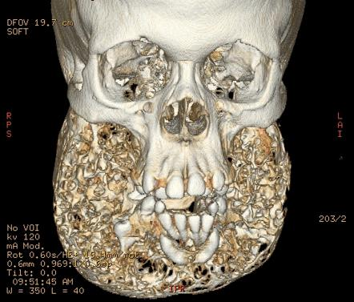
Radiographic features
The lesions simulate multilocular cysts as a result of fine bony septa extending between the soft tissue masses. The mandible and the maxilla are affected either unilaterally or bilaterally.
Treatment
Because of natural regression of the disease, treatment can usually be avoided.
If disfigurement is severe the lesions respond to curettage or to bone shaving .The disease is usually disappear at age of 22yrs.

Slide 10
Hyperparathyroidism
The lesions in the bones are due to over production of parathormone (PTH) which mobilizes calcium from the bones and raises the plasma calcium level.
There are 3 types of the disease:
Primary hyperparathyroidism is usually caused by hyperplasia or adenoma of the parathyroid but is uncommon
Secondary hyperparathyroidism results from prolonged stimulation of the parathyroid by persistently depressed plasma calcium. The most common cause is chronic renal failure. Secondary hyperparathyroidism is now a more frequent cause of osteolytic bone lesions than primary
Tertiary disease results from the development of adenoma in the secondary hyperthyroidism.

Slide 11
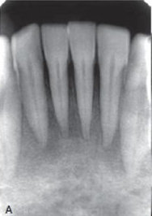
Clinical features
The most of the patient are above 60 yrs.
The female to male ratio is 4:1
Multicystic lesion affects more than one bone.
Increased serum calcium, parathyroid hormone, and alkaline phosphatase, but low serum phosphorus.
Increased kidney stone formation.
An early sign of the disease is loss of the lamina dura of the teeth in the periapical film.

Slide 12
Treatment
In primary hyperparathyroidism, surgical removal of the parathyroids is curative.
For secondary hyperparathyroidism the renal failure should be treated if possible. Bone lesions may respond to oral administration of vitamin D, whose metabolism is abnormal as a result of the renal disease.
If hypercalcaemia is of very long-standing, parathyroid hyperplasia may be irreversible and need to be treated by parathyroidectomy

Slide 13
Langerhan’s cell diseases (Histiocytosis –x) (Idiopathic histiocytosis)
The term of Langerhan’s cell is currently used for such diseases previously known as histiocytosis X or idiopathic histiocytosis.
These group of diseases characterized by proliferation of histiocyte like cell for unknown cause .
This tumor-like masses of proliferating histiocytes admixed with eosinophils infiltrate various tissues organs especially the bones lead to destruction of them.
Normally the Langerhan’s cell found in the skin, mucous membrane, lymph node and bone marrow.
The cells of origin of this disease have now been identified as the langerhans cells, which have a macrophage like function. At present time the causes these cell proliferation is unknown but some recent studies have suggested that it may have tumor properties or viral etiology. Other studies suggest allergic reaction.

Slide 14
Clinically types are:
Eosinophilic granuloma
Chronic disseminated type (Hand-Schuller-Christian )
Acute or (child) type (Letterer Siwe)

Slide 15
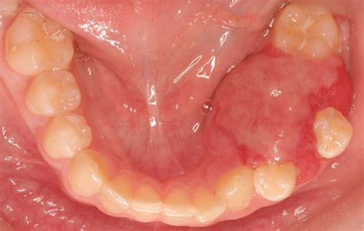
Eosinophilic grauloma
Solitary eosinophilic granuloma of the jaw causes localized bone destruction with swelling and often pain. The clinical features are:
Usually affect young adult male patients (>20yrs.)
Cause destruction of the alveolar bone and gingival tissues lead to the mobility of the teeth.
Mandible is affected in about 10-20% of the cases.
Other bones like ribs, long bone, and skull may also affected.
It represented as localize bone destruction with swelling and often pain and occasionally gross periodontal destruction exposes the roots of the teeth.

Slide 16
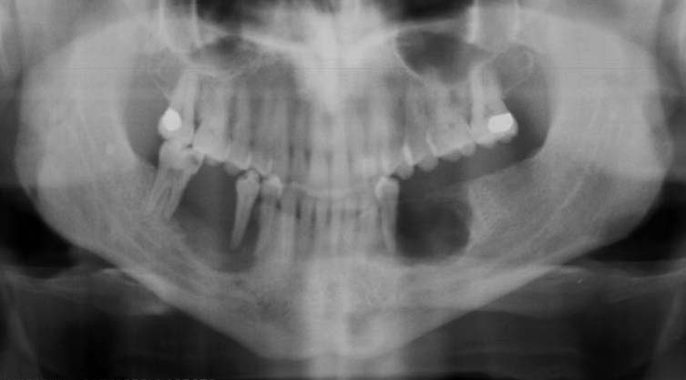
Treatment:
Radiographic features:
The lesion cause destruction of the alveolar bone and socket so it’s appear as rounded area of radiolucency with indistinct margins. The teeth (floating in air) is typical feature.
Usually the treatment is aggressive by the:
Local deep curettage
Local excision and the teeth are sacrificed as necessary.
Intralesional steroids have also employed
Low dose of radiotherapy.

Slide 17
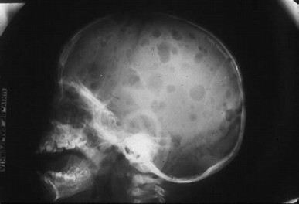
Chronic disseminated form: (Hand Schϋller Christian disease)
In this group, lesions are multifocal (multiple irregular radiolucent lesions) and involves several bones and often other organs.
Clinical features
The affected patients are 5-10 yrs.
Histiocytosis causing exophthalmos, diabetes insipidus and lytic skull lesions,
Jaws lesion are resemble eosinophilic granuloma usually affect the mandible.
Hepatosplenomegaly and lymphadenopathy.
The skin, kidney, brain and other bones are affected.

Slide 18
Treatment
Steroid injection or chemotherapy.
Localized radiotherapy
Local excision
Treatment of diabetes insipidus

Slide 19
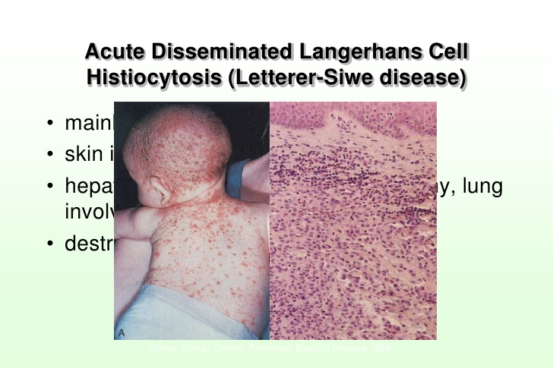
Letterer-Siwe syndrome
This aggressive form of histiocytosis affects infants or young children usually (2-4yrs.).
Progression to widespread disease, with involvement of skin, viscera and bones, can be rapidly fatal, despite treatment by irradiation and/or chemotherapy.
Overall, the behavior of Langerhans' cell histiocytosis is unpredictable, but the younger the patient and the greater the number of organ systems affected, the worse the prognosis due to recurrent infections and progressive anemia and depression of bone marrow.

Slide 20
Management
For multisystem disease, a combination of cytotoxic agents (often vinca alkaloids), corticosteroids and irradiation of active bone lesions is required.
Marrow transplantation.
Gene transfer therapy and monoclonal antibodies against the CD1a.
antigen are under trial.
Haematopoietic stem cell transplantation is currently being used.
Thalidomide has also been used and has been effective in some cases of disseminated disease.
Notes:
antibodies that are made by identical immune cells that are all clones of a unique parent cell.

