Slide 1
Diabetes mellitus
Dr. Bayad J. Mahmood
BDS, FKBMS

Slide 2
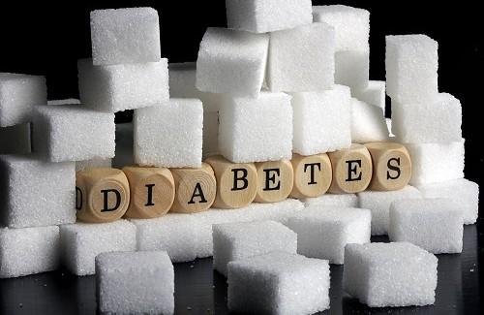
What’s diabetes?
Diabetes is a condition where the body either fails to produce insulin (Type 1 diabetes) or the insulin that is produced is no longer as effective (Type 2 diabetes).

Slide 3
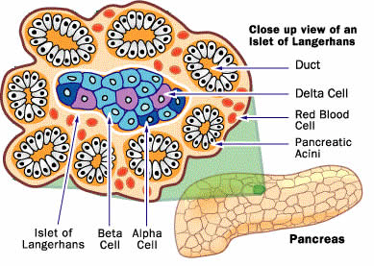
What's insulin?
Insulin is a hormone produced in the beta cells of the Islets of Langerhans within the pancreas. Insulin is released directly into the bloodstream and is therefore part of the endocrine system.
Insulin acts like a key which allows blood glucose to enter the cells around the body for use as an energy supply.
Glucose is essential for the body to function properly. The brain is particularly affected by any reduction in blood glucose supply due to its lack of capacity for glucose storage.

Slide 4
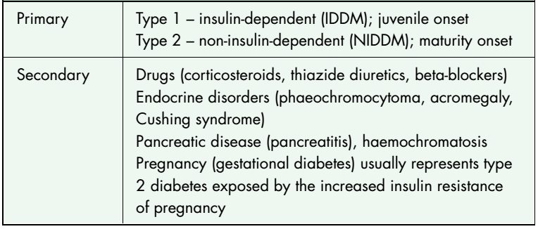
Classifiation of diabetes mellitus

Slide 5
Type 1 diabetes
formerly termed insulin-dependent (IDDM) or juvenile-onset diabetes, is most commonly diagnosed at about 12 years of age and commonly presents before the third decade, but can appear at any age.
It is characterized by antibodies directed against insulin and the pancreatic islets of Langerhans.
Type 2 diabetes
formerly termed non-insulin-dependent (NIDDM) or maturity-onset diabetes, accounts for 80–90% of diabetics.
Generally it occurs in genetically predisposed individuals over the age of 40 who are typically overweight.
Patients are insulin resistant and have diminished beta-cell function.

Slide 6
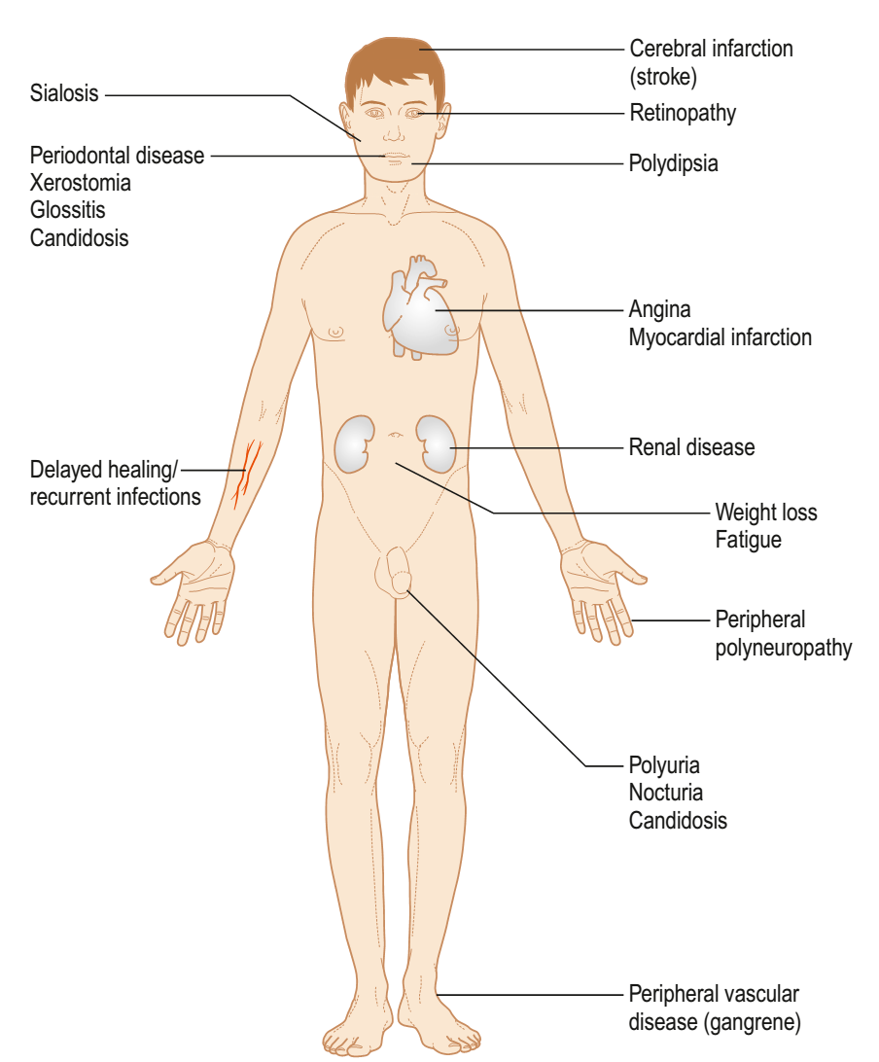
Clinical features

Slide 7
Criteria for the Diagnosis
Symptoms of diabetes plus casual plasma glucose level of 200 mg/dL or greater.
Fasting plasma glucose of 126 mg/dL or greater.
Glucose tolerance test: 2-hour plasma glucose level of 200 mg/dL or greater during an oral glucose tolerance test.
Plasma glucose taken 2 h after a person has consumed a drink containing 75 g of glucose in oral glucose tolerance test.

Slide 8
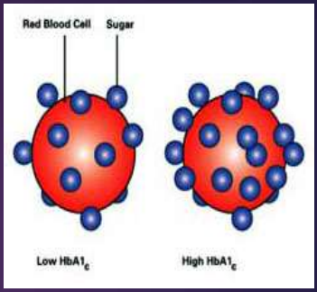
Glycohemoglobin.
Measurement of HbA1c levels is of value in the detection and evaluation of patients
HbA1c is an electrophoretically fast-moving hemoglobin component found in normal persons; it increases in the presence of hyperglycemia and may reflect glucose levels in the blood over the 6 to 12 weeks preceding administration of the test.
Normally, patients should have 6% to 8% HbA1c.

Slide 9
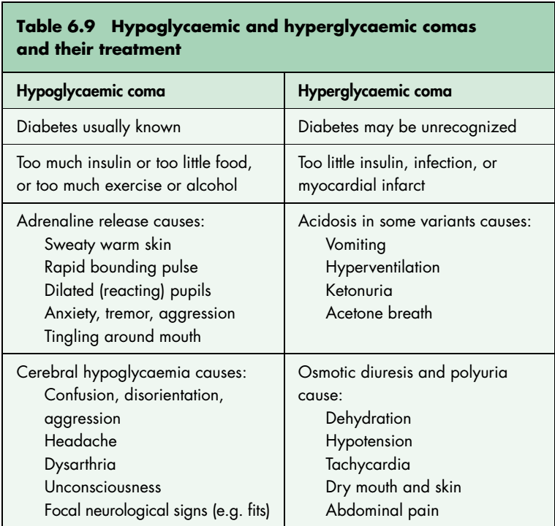
Complications of Diabetes

Slide 10
Treatment
Hypoglycemia | Hyperglycemia
Take blood for baseline glucose, electrolytes, urea, Hb and PCV if possible
If conscious, give GlucoGel or 2 teaspoons sugar, 3 lumps sugar, 3 Dextrosol tablets, | Put up infusion to rehydrate and give insulin
If comatose, lay the patient flat and raise the legs, give 20 mg 20% or 50% dextrose I.V. and on arousal 25 mg orally
If I.V. injection impossible, give glucagon 1 mg I.M
Call ambulance

Slide 11
MANAGEMENT under local anasthesia
Any dental patient whose condition remains undiagnosed but who has the cardinal symptoms of diabetes Should be referred to physician.
All patients with diagnosed diabetes must be identified by history, and the type of medical treatment they are receiving must be established.
Vital signs also serve as a guide to the control and management of disease in the diabetic patient.
If diabetes is well-controlled, all dental procedures can performed without special precautions, apply morning appointment, verify that the patient have taken medication and diet as usual and before starting the procedure , Use anxiety reduction protocol, perform atraumatic extraction.

Slide 12
IF Diabetes is poorly controlled e.g fasting blood glucose <70 mg/dL or >200 mg/dL and ANY complications [post MI, renal disease, congestive heart failure, symptomatic angina, old age, cardiac and blood pressure ≥180/110 mm Hg ,All elective dental procedures should be postponed.
Provide Only emergency care,
Consult patient physician
Critical setting: hospital
Patient preparation: ECG,PULSE,B.P,RESPIRATION MONITERING
Antibiotics should be given after surgery.

Slide 13
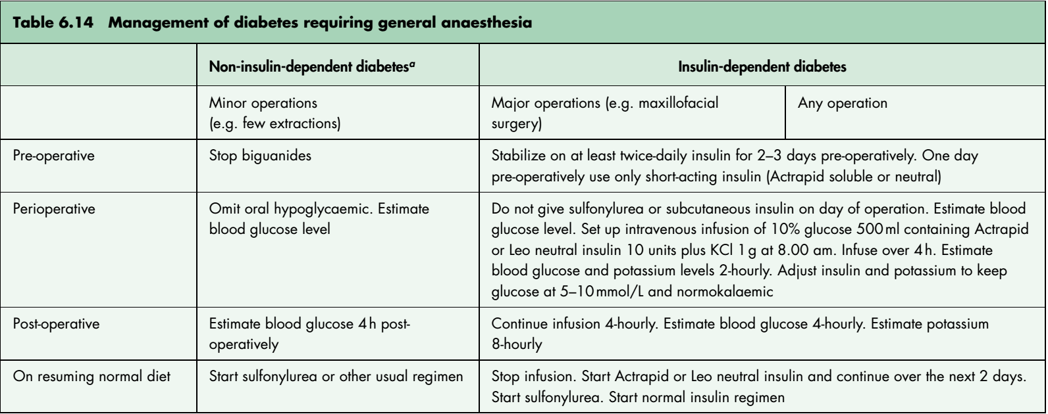

Slide 14
Thanks

