Slide 1
Odontogenic Tumors
Dr. bayad J. Mahmood
Board certified maxillofacial surgeon

Slide 2
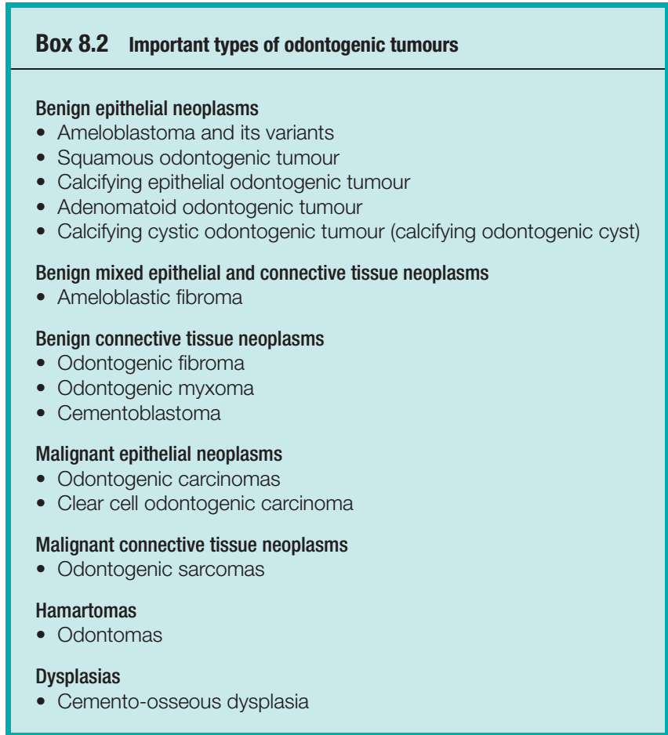
Odontogenic tumours are the most common neoplasms of the jaws.
There are many types and the majority are rare.
Classifications are complex, a simplified version of the current World Health Organization classification is shown in Box.

Slide 3
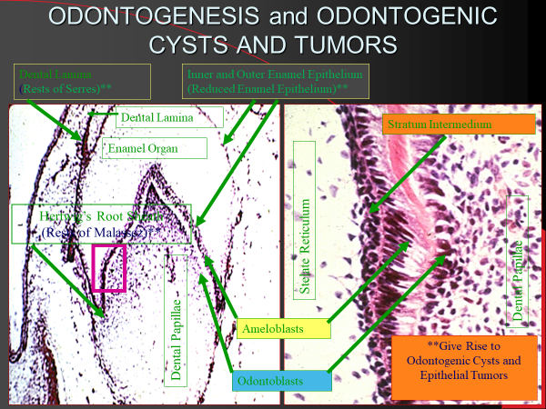

Slide 4
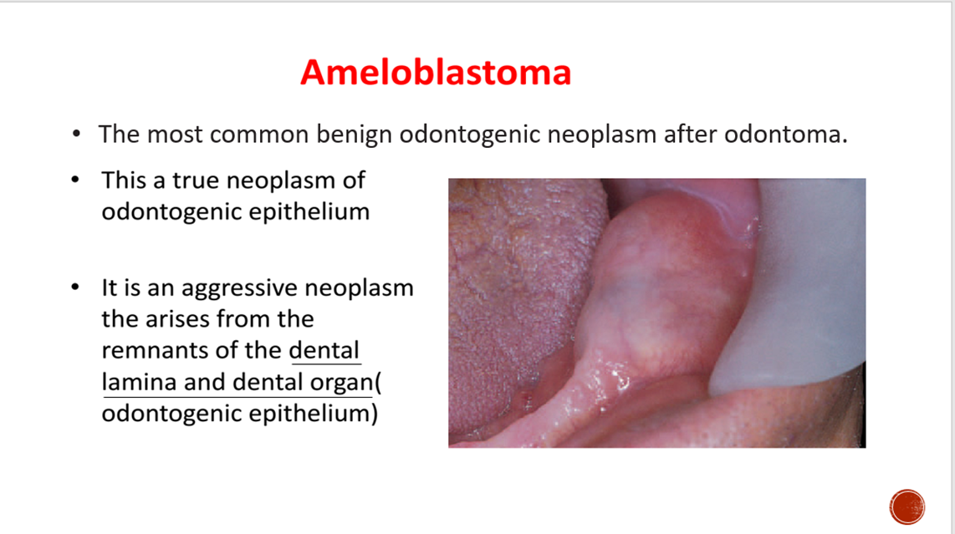

Slide 5
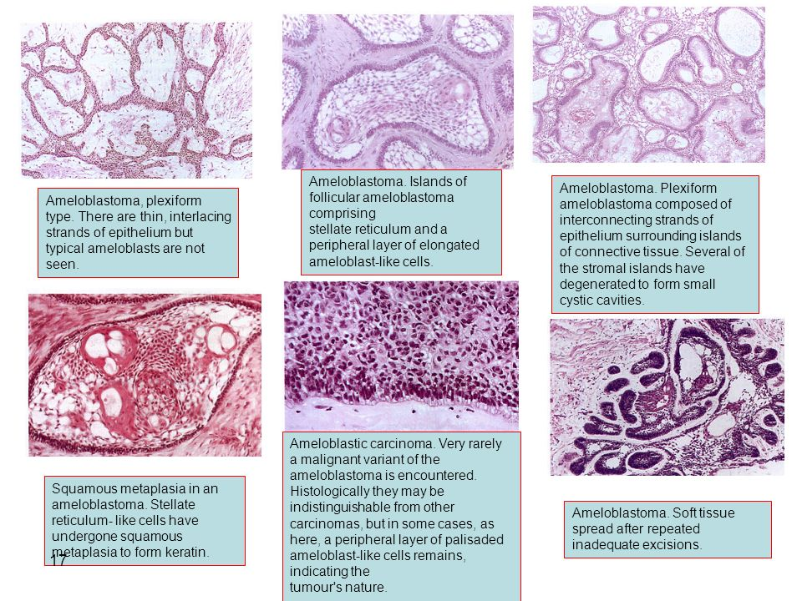
Types of ameloblastoma:
Clinical classification
1. Conventional/ Multicystic/Solid (most common)
2. Unicystic (Mostly below 10–20 years of age and Mostly in posterior mandible).
3. Peripheral (extraosseous), present in gingival or alveolar soft tissues and does not involve bone.
4. Malignant ameloblastoma
Based on histological type
1. Follicular ameloblastoma
2. Plexiform ameloblastoma
3. Acanthomatous ameloblastoma
4. Granular cell ameloblastoma
5. Basal cell type of ameloblastoma
6. Desmoplastic ameloblastoma

Slide 6
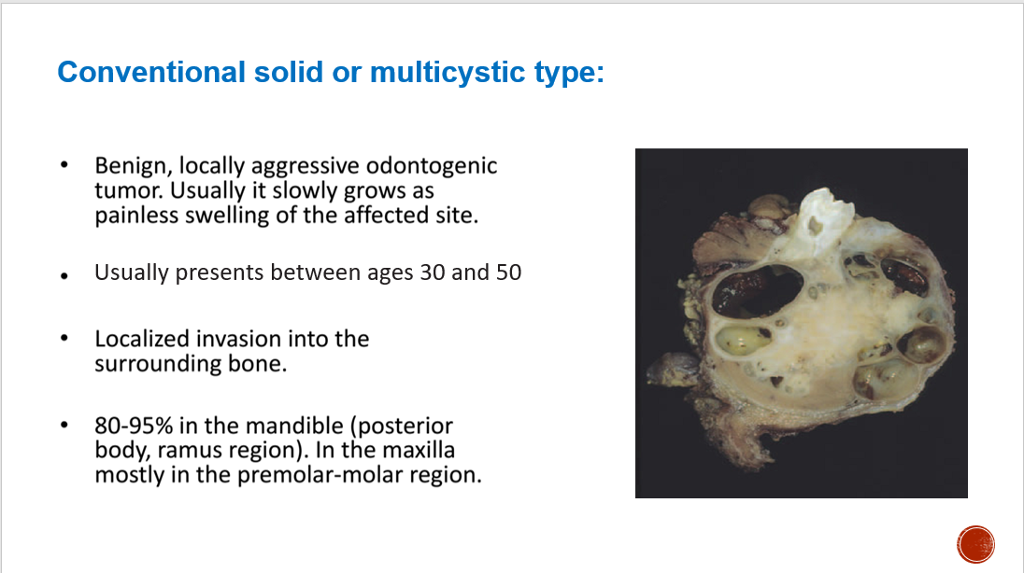

Slide 7
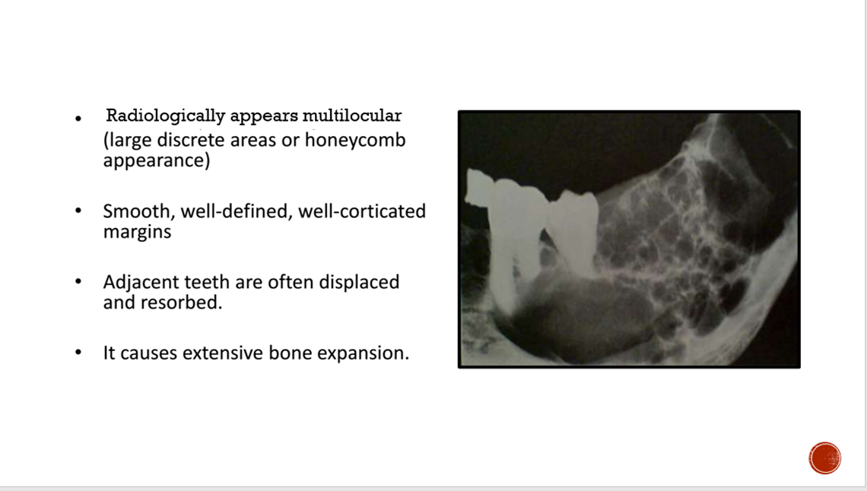

Slide 8
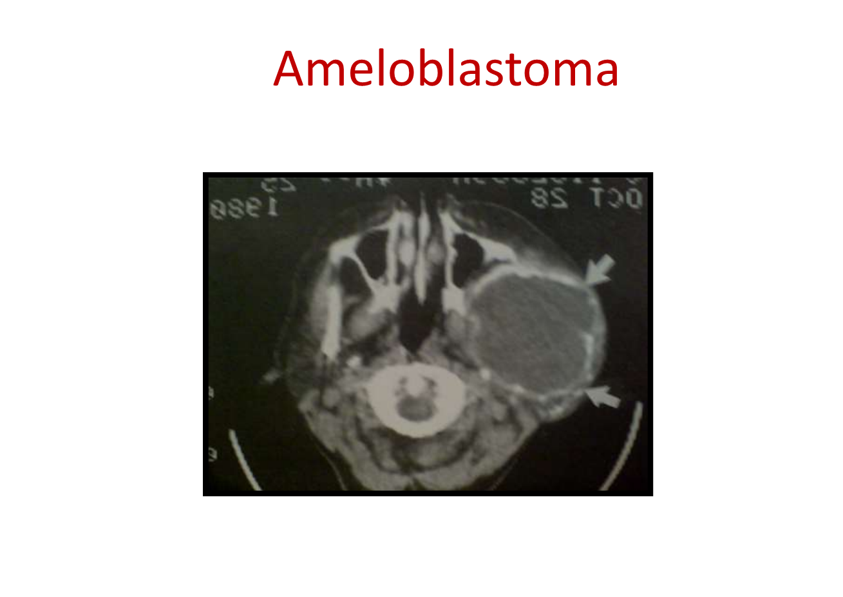
Maxillary ameloblastomas can invade the cranial base causing extensive destructions and be lethal.

Slide 9
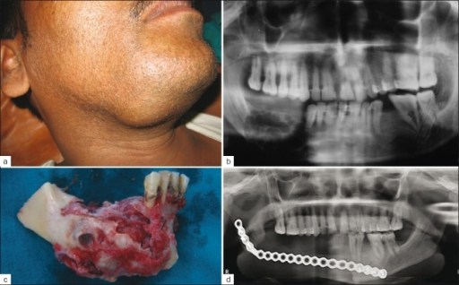
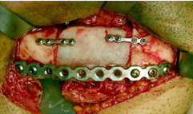
Treated either by enucleation (usually for peripheral type), excision and resection with a margin of normal tissue (1-1.5cm).
Resection is with or without reconstruction by bone graft or synthetic materials (plate).
Resection provides best treatment option because it is associated with minimal or no recurrence.
Incomplete removal leads to recurrence.

Slide 10
Metastasizing ameloblastoma and ameloblastic carcinoma
METASTASIZING AMELOBLASTOMA | AMELOBLASTIC CARCINOMA
Histologically is typical ameloblastoma which is apparently benign. | Histologically poorly differentiated and shows dysplasia.
Metastases to the lung, some cases appear to have resulted from aspiration or implantation at surgery. | Metastasize to lymph nodes, If metastasis is present the prognosis become poor.
Treatment: resection with safe margin with or without reconstruction, treatment of metastasis (local excision). | Treatment: resection with safe margin with or without reconstruction, treatment of metastasis (neck dissection).

Slide 11
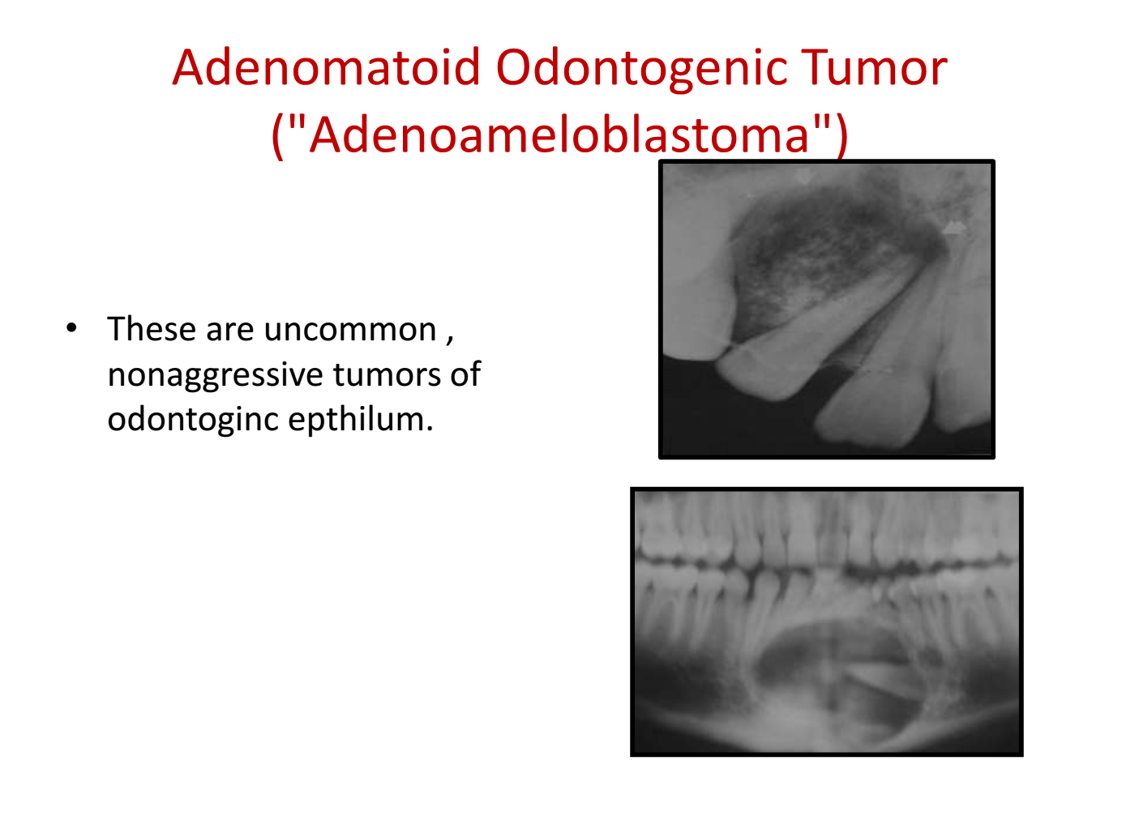
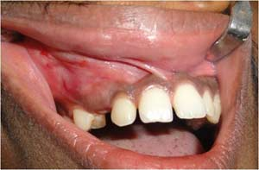

Slide 12
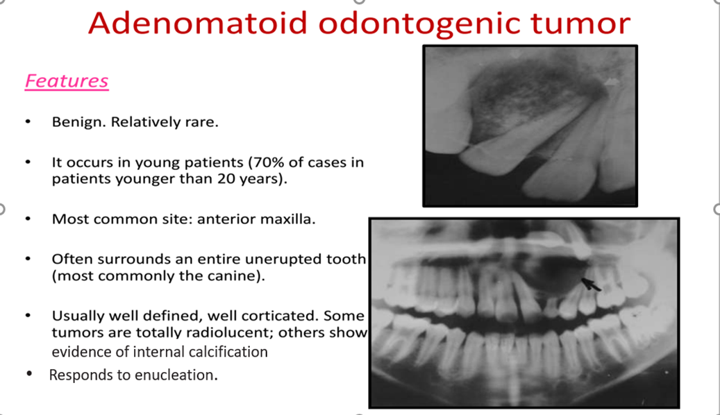

Slide 13
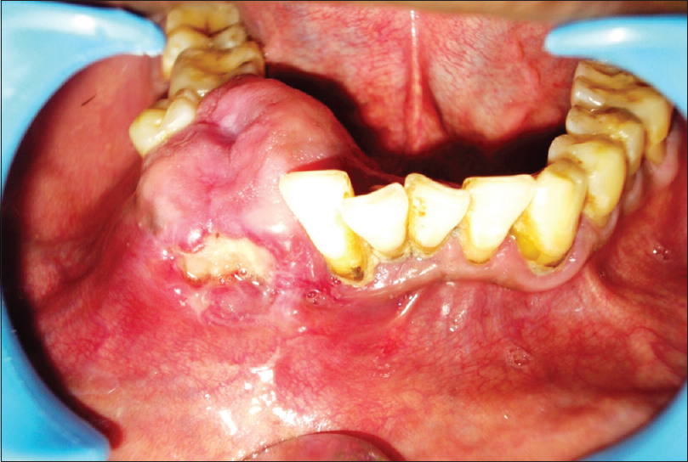
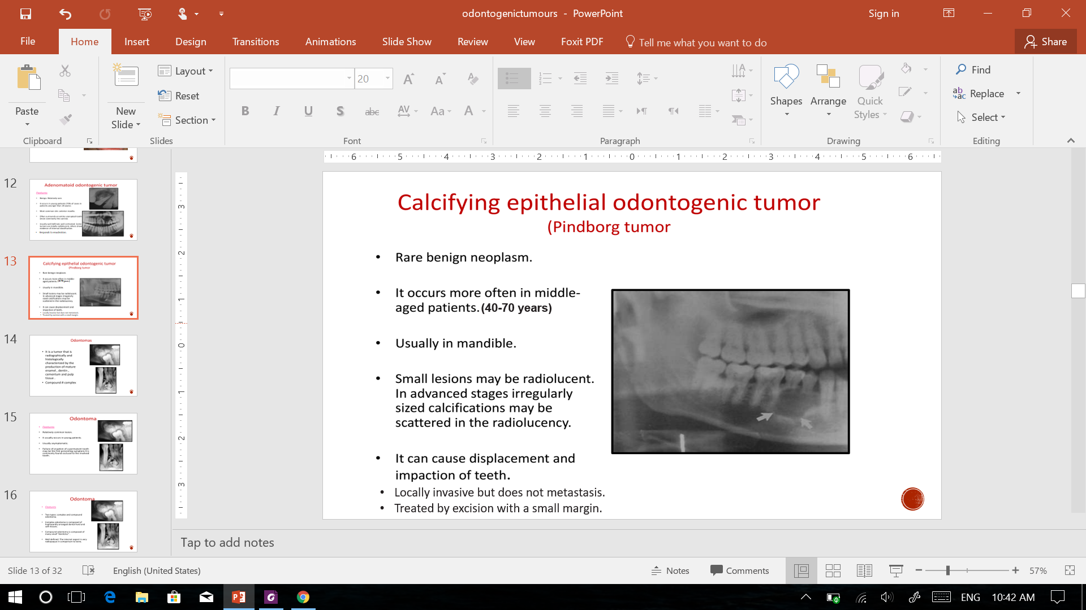
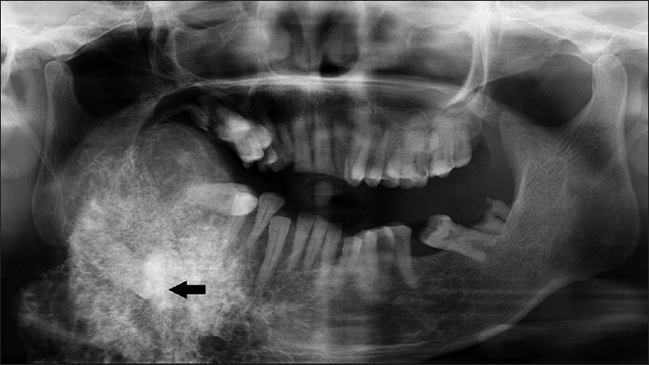
CALCIFYING EPITHELIAL ODONTOGENIC TUMOUR

Slide 14
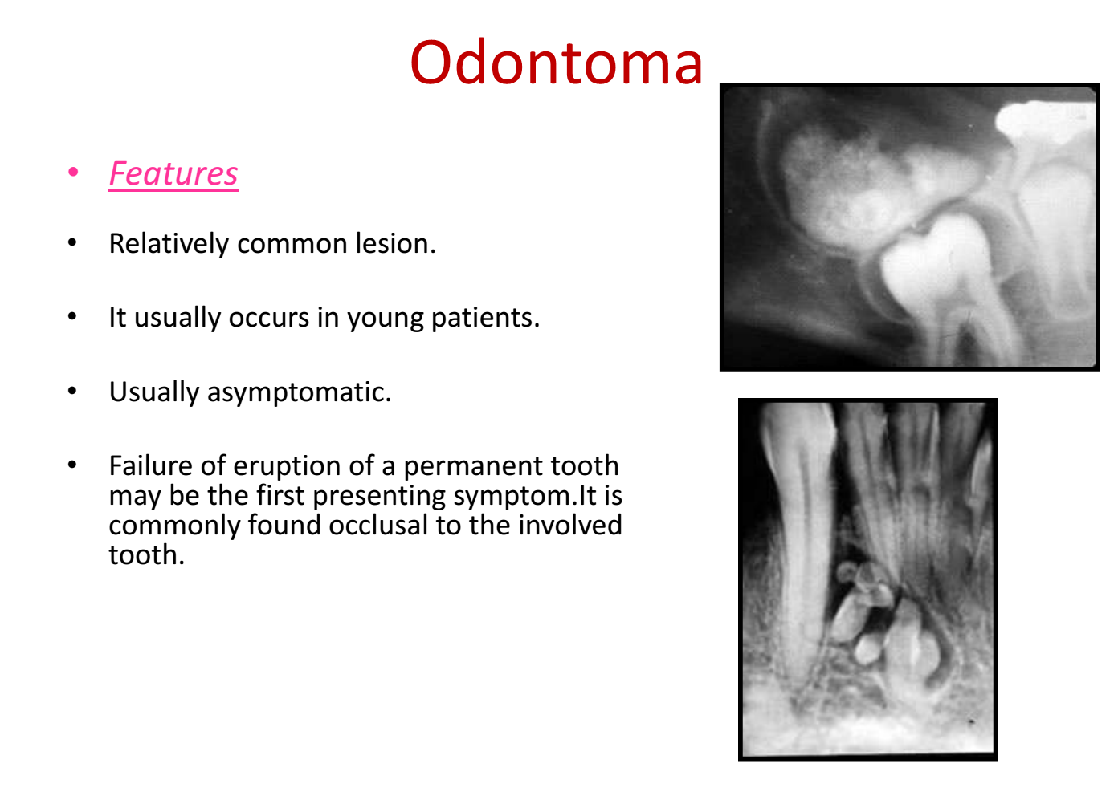

Slide 15
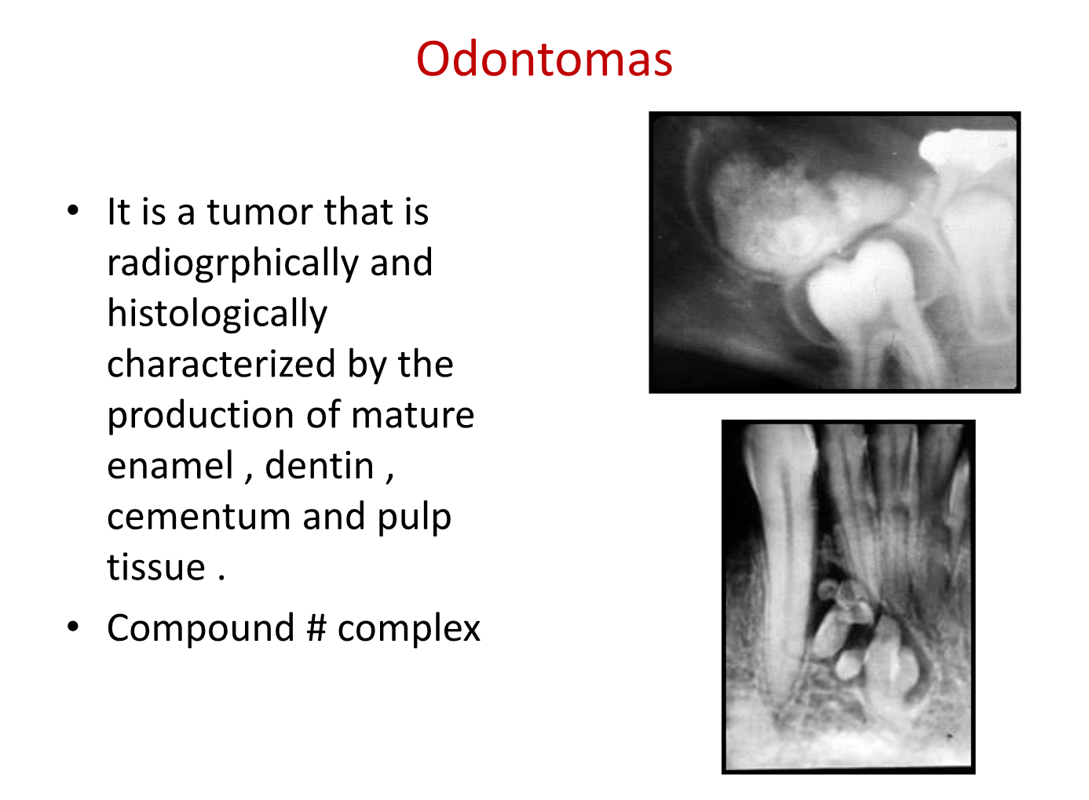

Slide 16
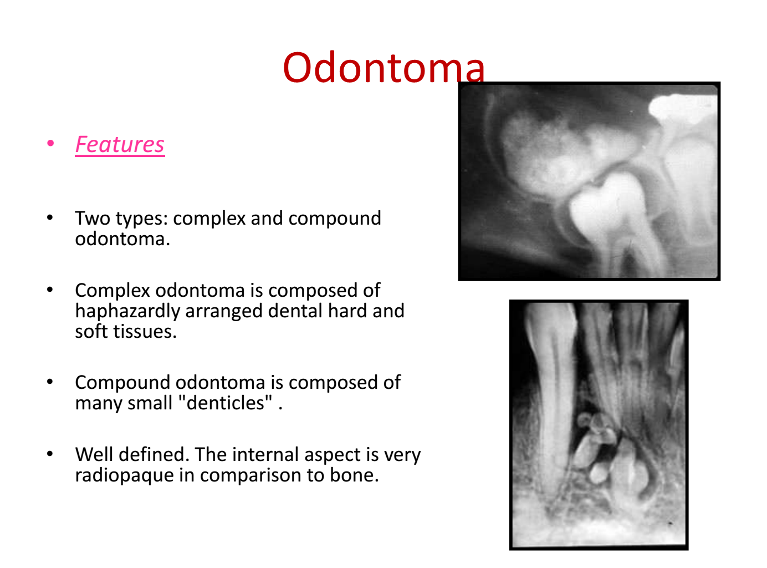

Slide 17
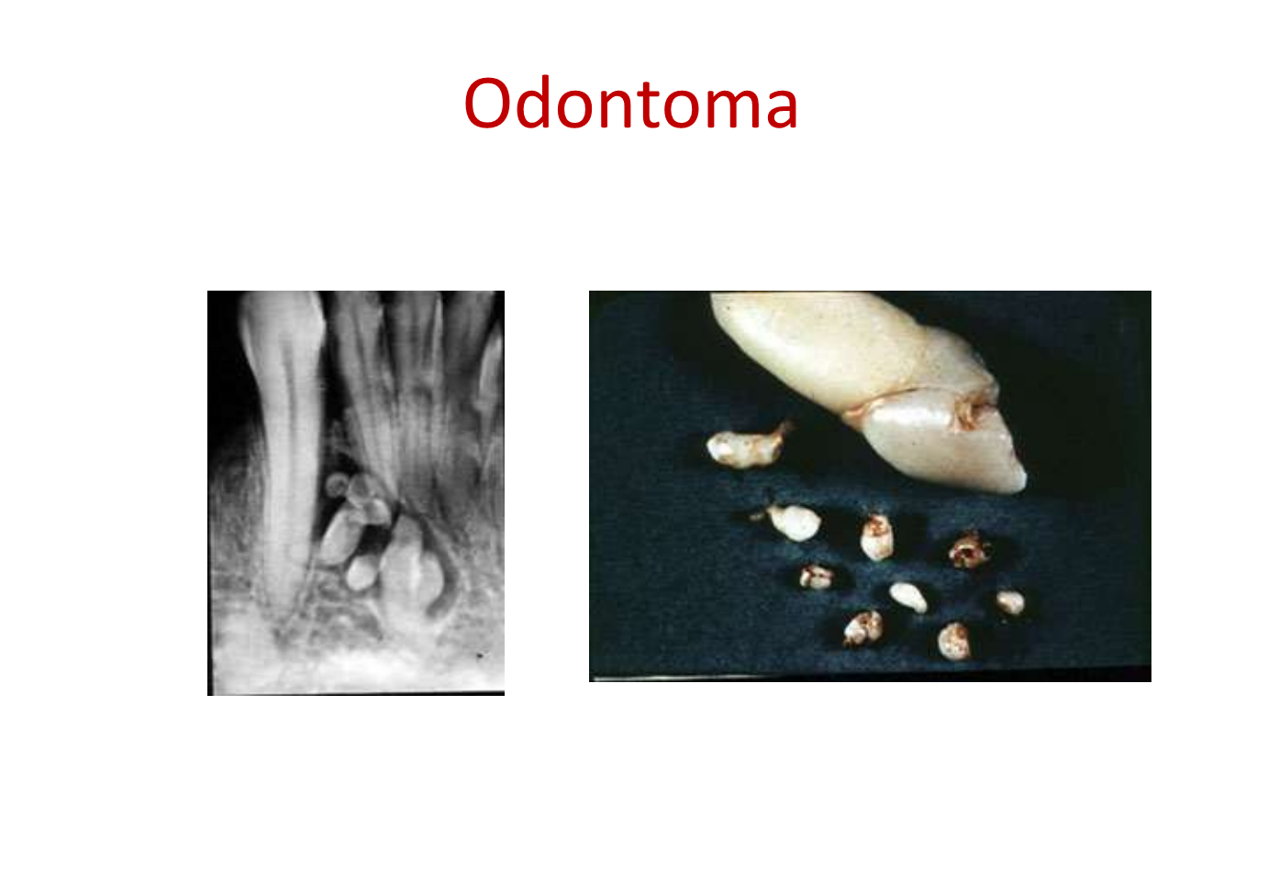
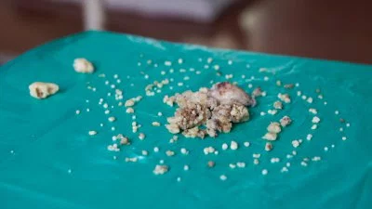
treatment
Compound odontoma:
The mass should be enucleated as a potential obstruction to tooth eruption or cyst formation.
Complex odontoma:
Conservative surgical excision.

Slide 18
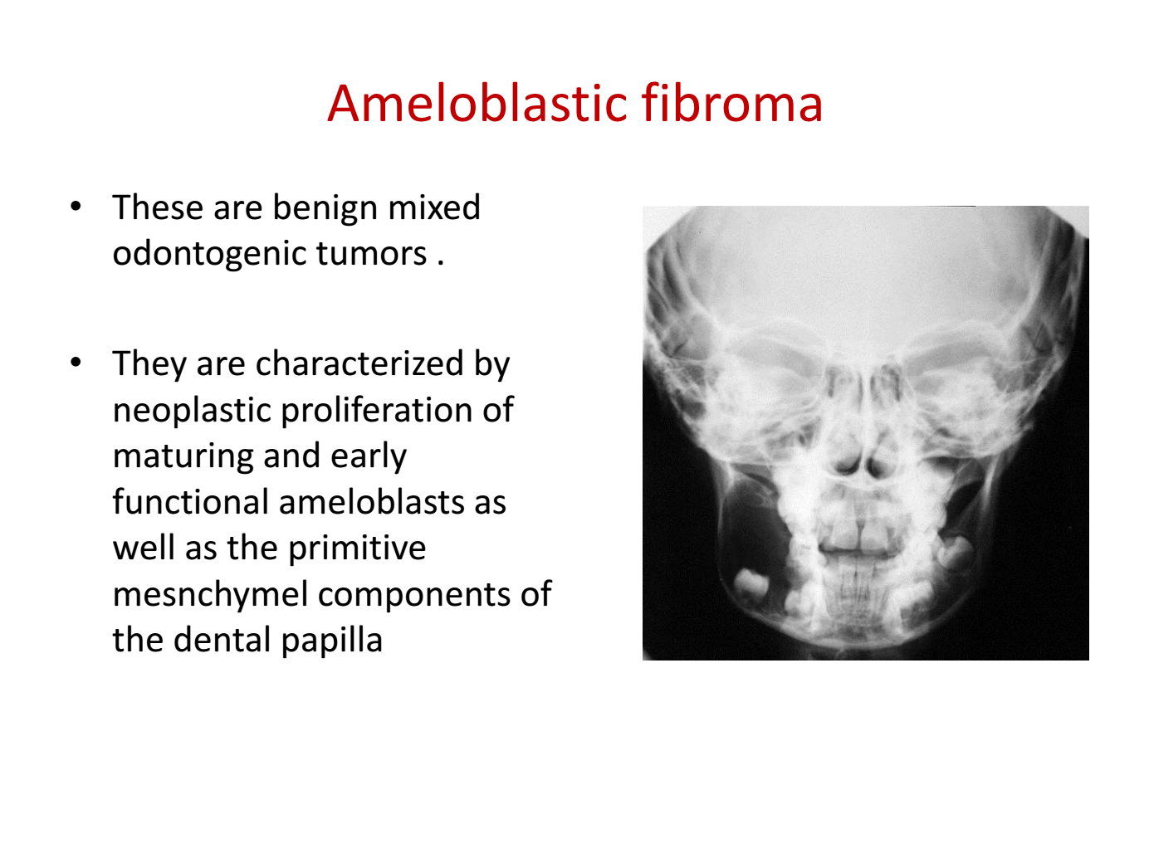

Slide 19
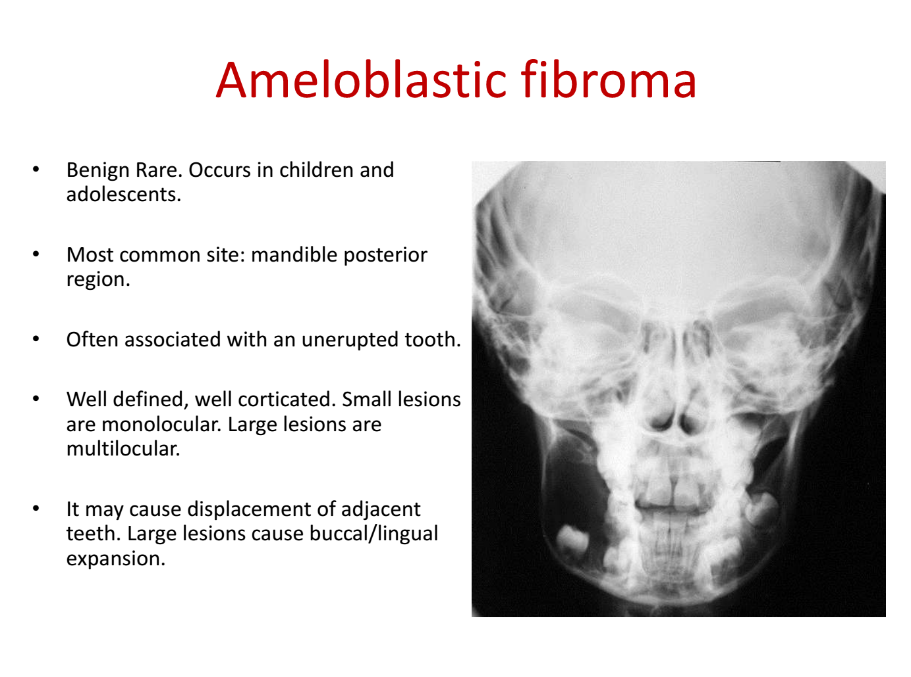

Slide 20
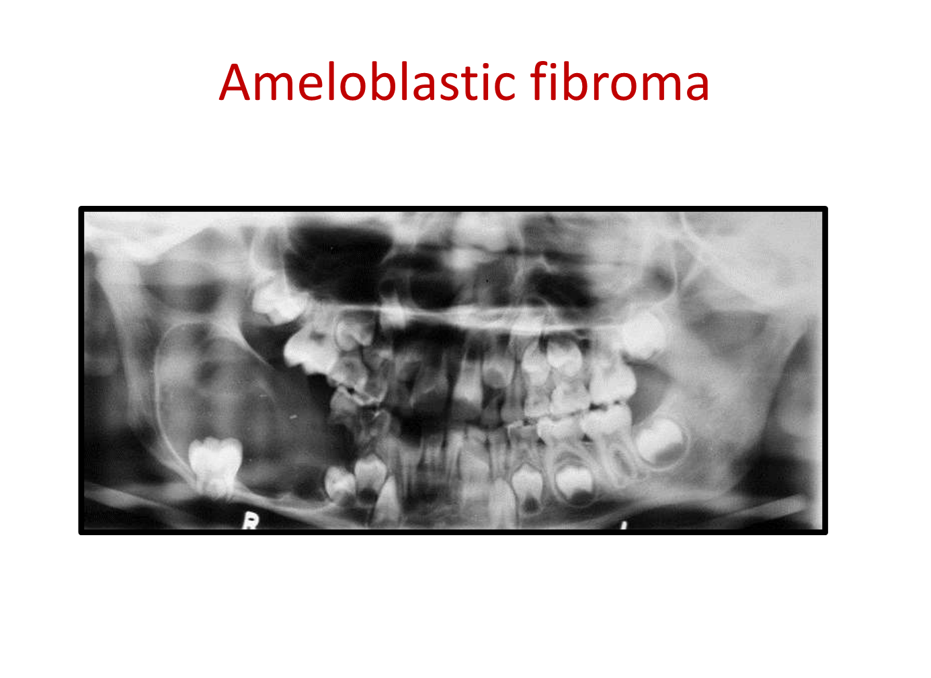

Slide 21
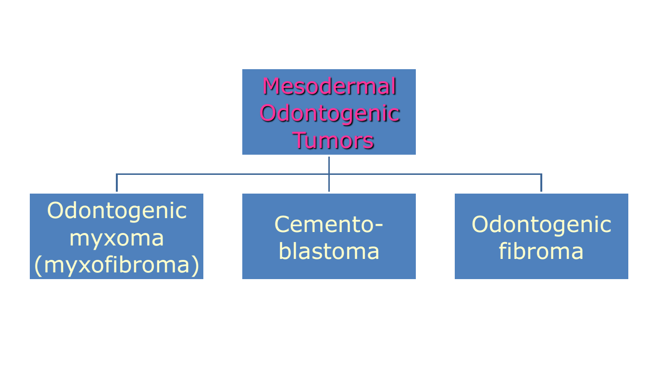

Slide 22
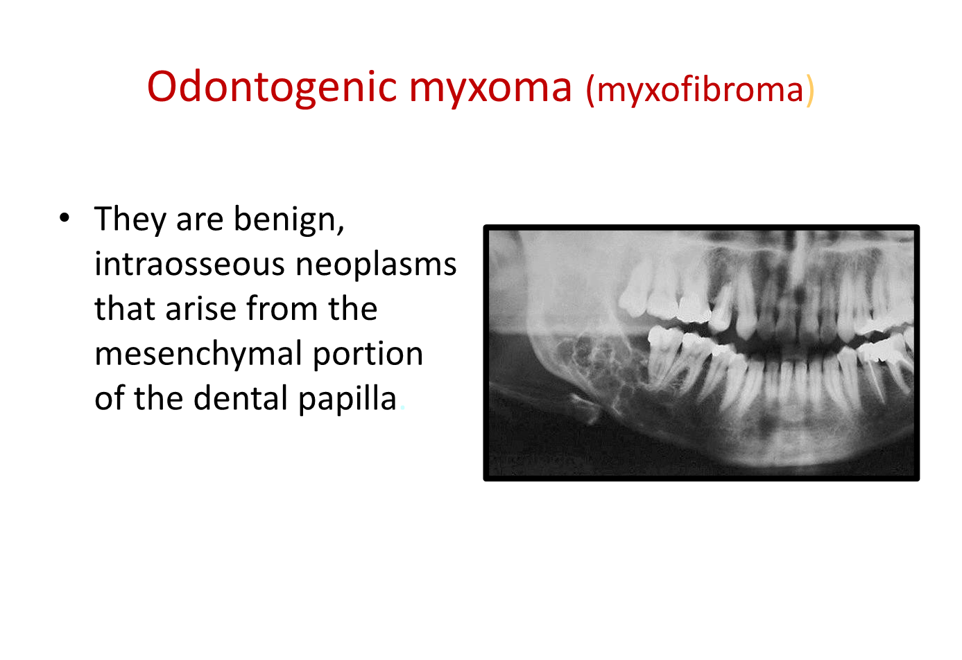

Slide 23
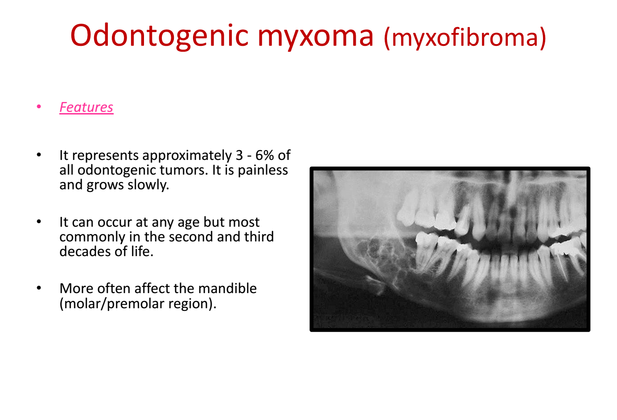
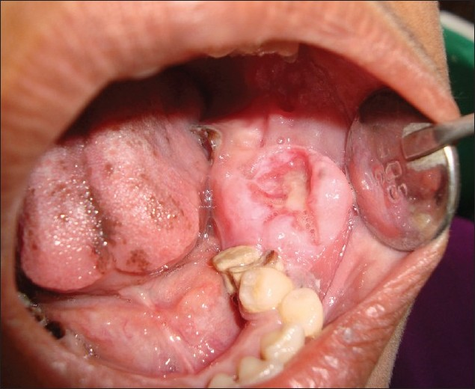

Slide 24
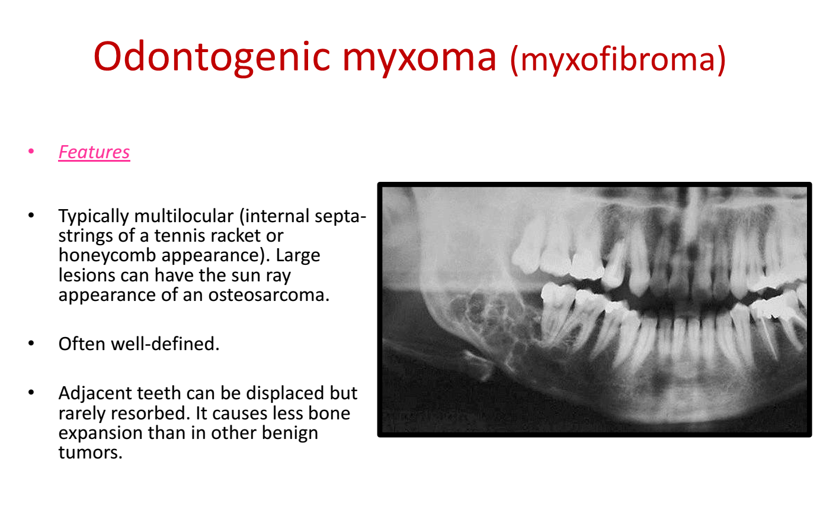

Slide 25
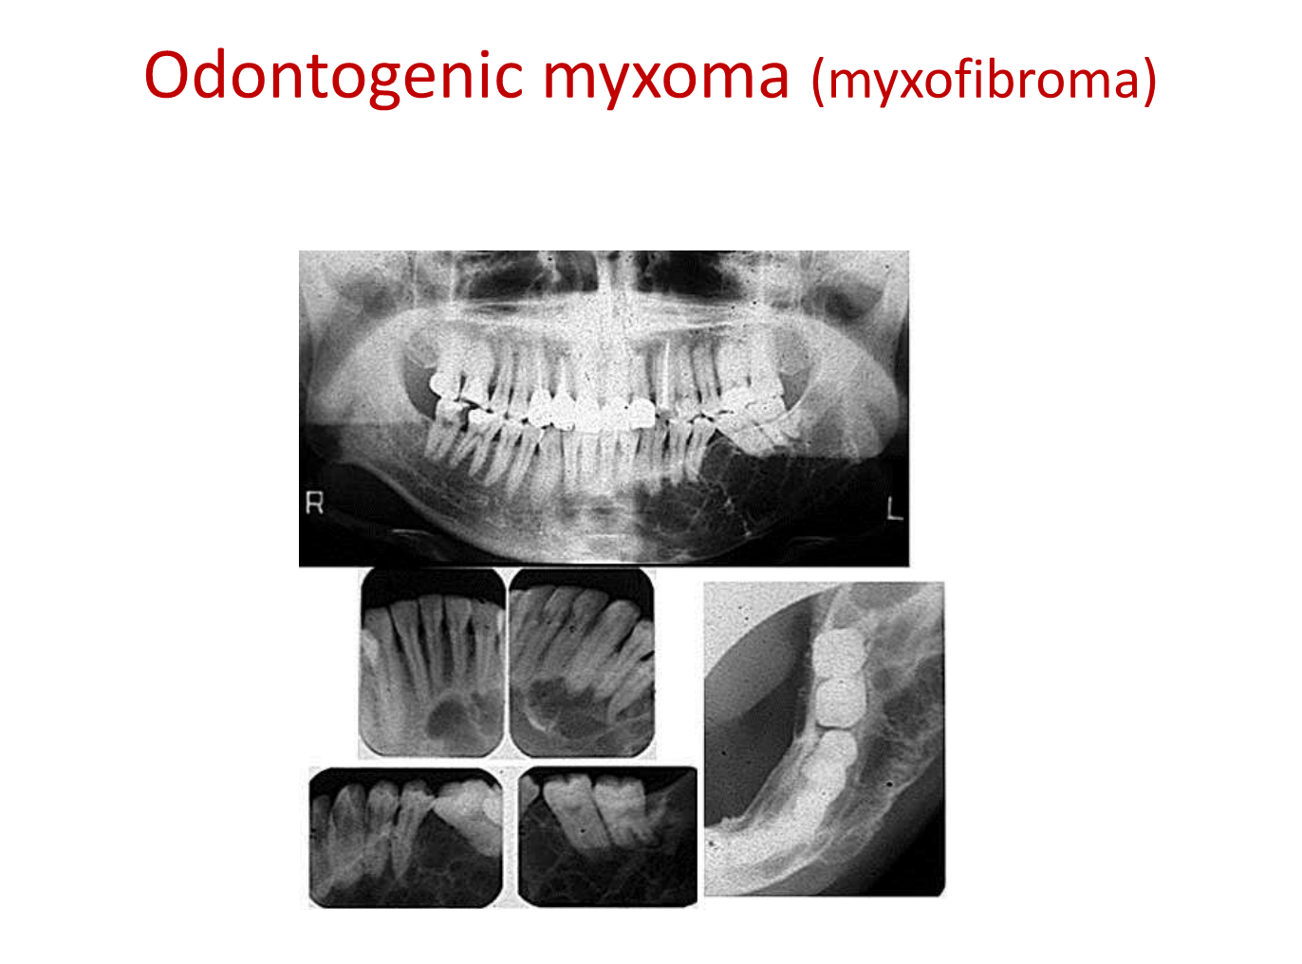

Slide 26
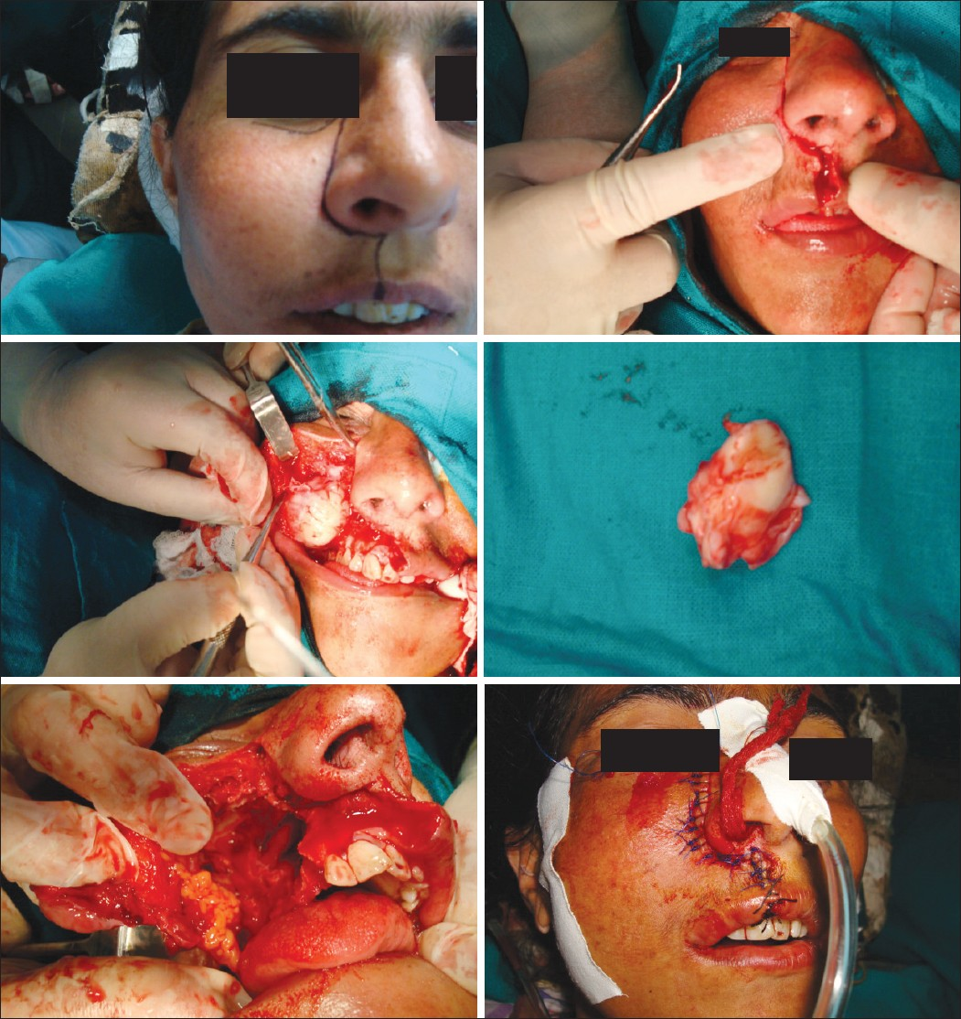
Treatment:
Partial enbloc excision of the lesion.
This mode of treatment is because of the high recurrence rate of these tumors after conservative treatment.

Slide 27
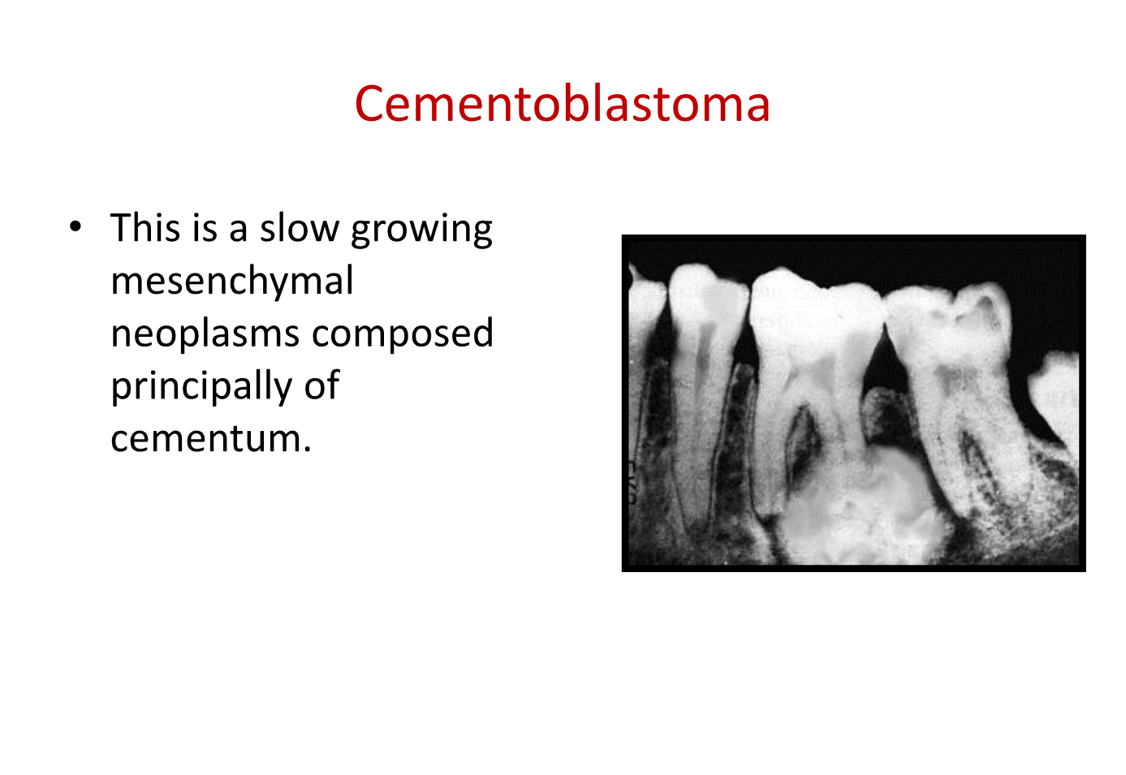

Slide 28
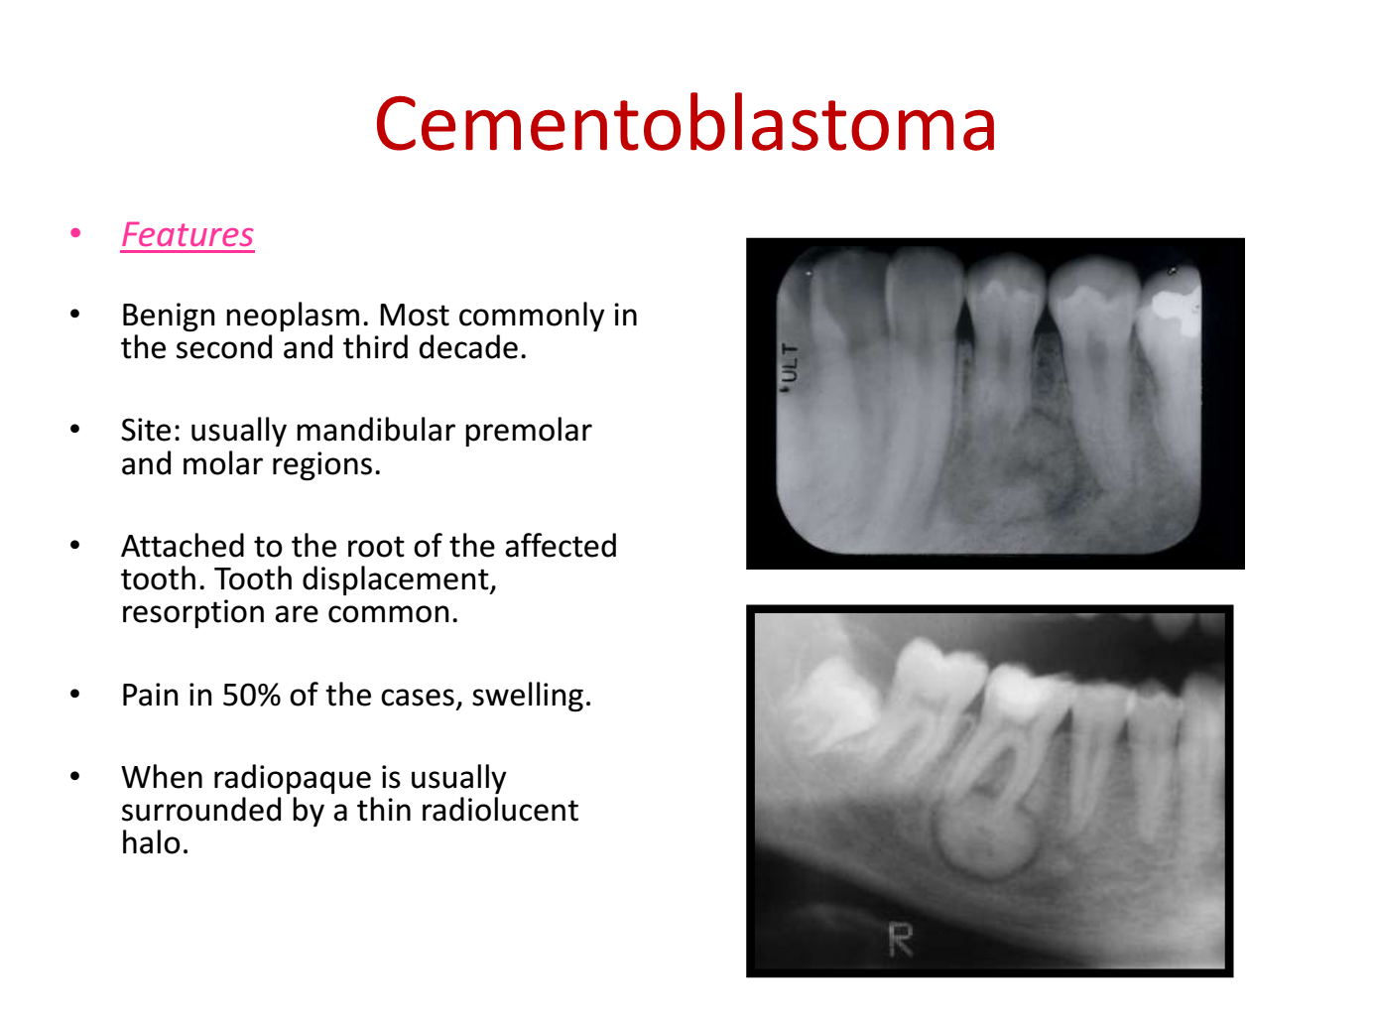

Slide 29
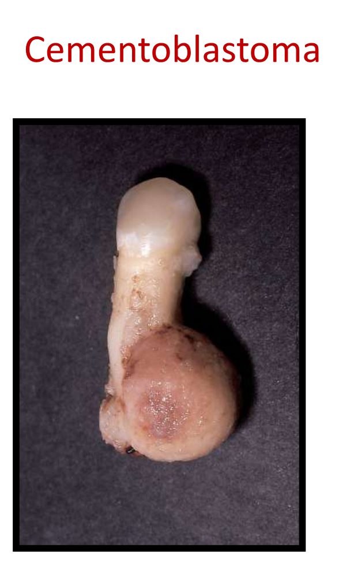
Treatment:
Cementoblastomas are benign and, if completely excised and the tooth extracted, there should be no recurrence.
Incomplete removal leads to continued growth.

Slide 30


Slide 31
Quiz
List the factors affecting the treatment of the premalignant lesions?
Mention the relations between types and treatment of ameloblastoma? From which bases use select specific treatment? Why?

