Slide 1

Bullet and messile injuries in maxillofacial region
Dr.bayad Jaza Mahmood
Board certified maxillofacial surgeon

Slide 2
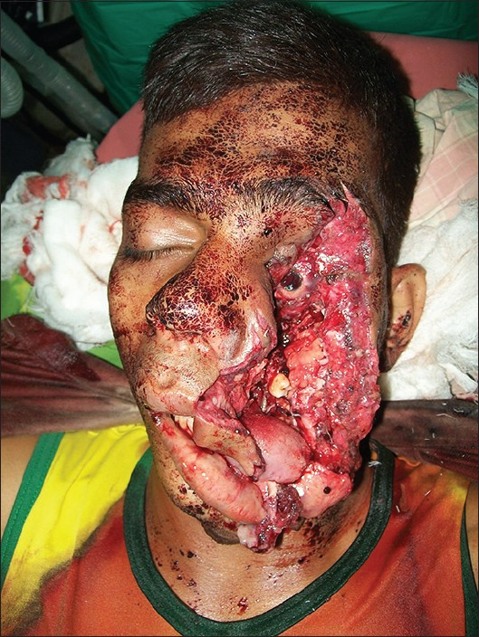
introduction
Major causes of facial combat injuries include blasts, high-velocity/high-energy missiles, and low-velocity missiles.
High-velocity bullets fired from assault rifles encompass special ballistic properties, creating a transient cavitation space with a small entrance wound and a much larger exit wound.
Blasts caused by high explosives often contain metal fragments, such as Claymore charges, which contains hundreds of metal pellets .
Victims who are close to the center of the explosion barely survive such a fatal injury.

Slide 3
Demographics
Gunshot wounds are the second most source of injury and death , after motor vehicle accidents .
The majority of civilian firearm injuries are sustained from handguns (86%), followed by shotguns (8%) and rifles (5%), about 40% involved the frontal bone and cranium, 9% involved the orbits, 14% involved the maxilla , 13% involved the mandible, and 24% involved multiple sites.
Shotgun injuries most commonly involved the mandible followed by the maxilla and zygoma Then orbits and nasal bones .
A 36% 0f patients die following admission. All of the deaths were secondary to injuries to the chest, abdomen, or brain. There is small percentage of deaths associated with isolated facial injuries

Slide 4
Velocity and Mass of the bullet
kinetic energy has been used as the basis to explain wounds caused by the gunshot
KE = MV2
Where KE is kinetic energy , ( m ) is the mass of the projectile, and ( v ) is the velocity of the projectile .
Wounding power is typically related to the amount of kinetic energy transferred to the target.
Based on these formulas, the velocity of a projectile considered more important than its mass in wounding power .
Considering a typically sized projectile velocity of approximately 50 m/s is required to penetrate the skin, and a velocity of around 65 m/s will fracture the bone .

Slide 5
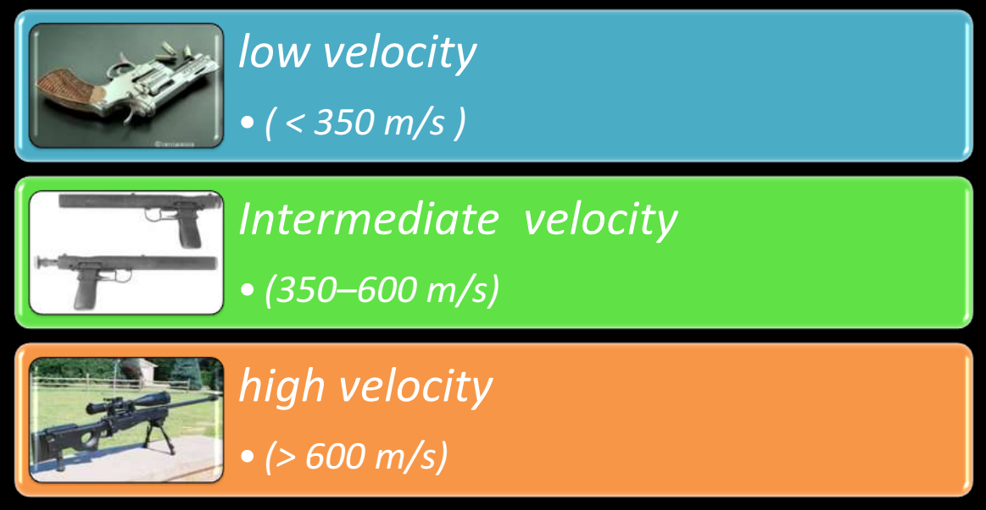
Classification of gunshot according to the velocity

Slide 6
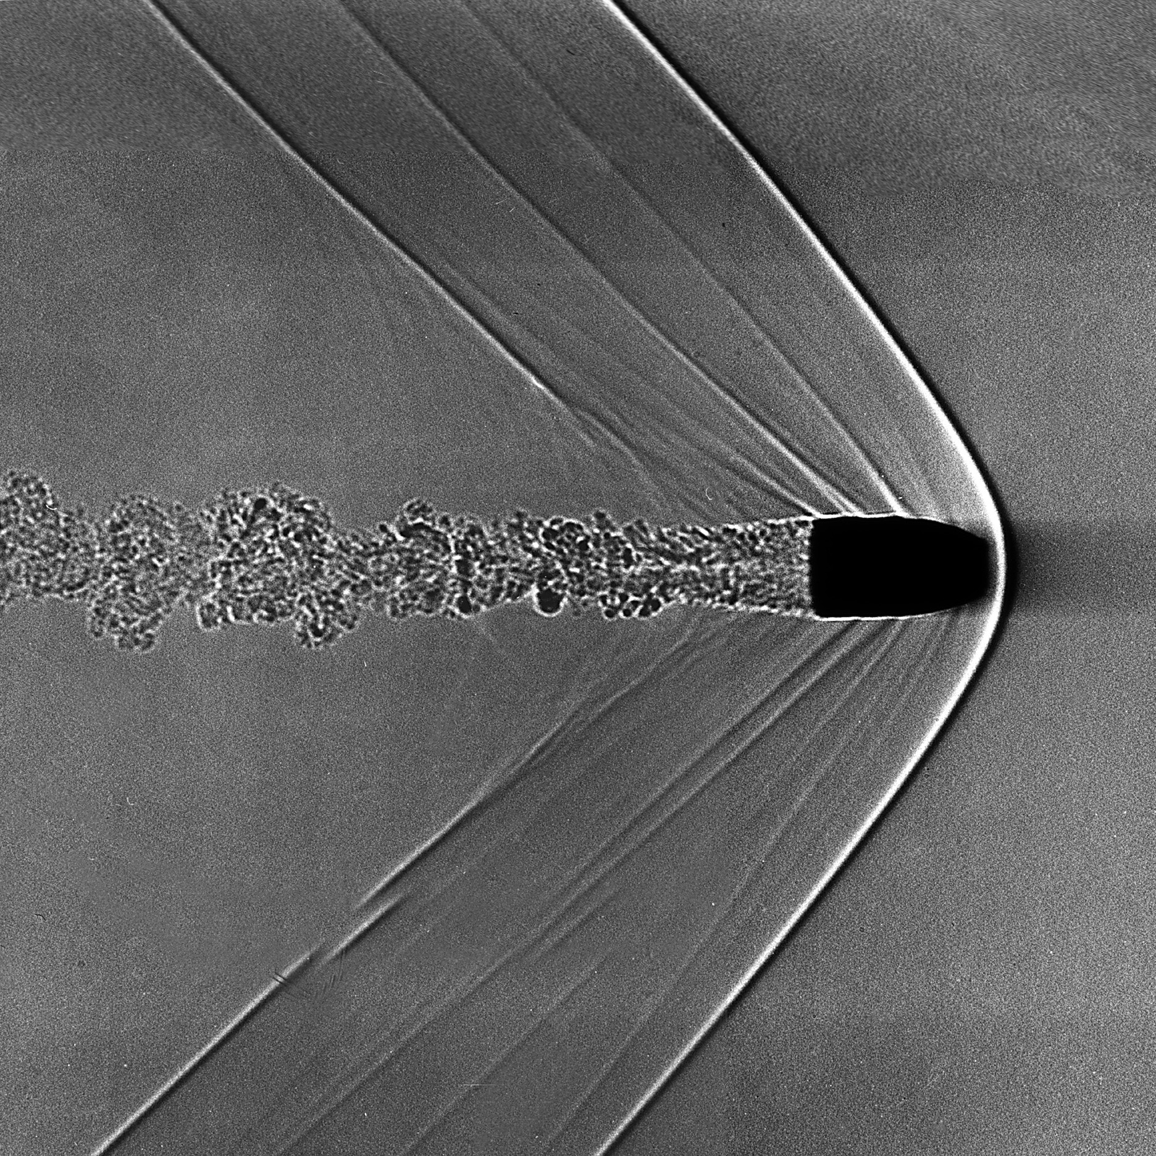
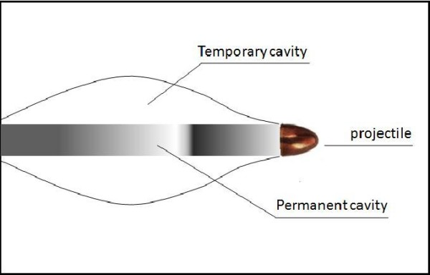
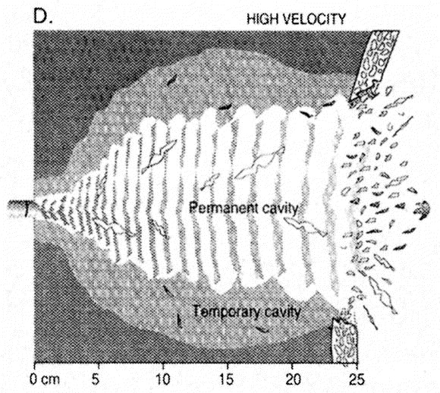
Physiology of bullet injury
Shock Wave
With higher velocities, damage to tissue away from area of impact can occur, (tissue in front of projectile is compressed moves away in form of shock wave).
Cavitation
Energy is dissipated forward and laterally away from the bullet and tract, at high velocity the cavity continues to enlarge even after bullet has passed.
Secondary Missiles
Bone fragments or metal fragments from helmet that move through tissue and cause damage.

Slide 7
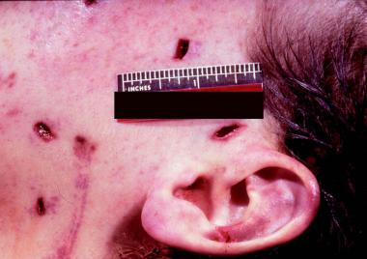
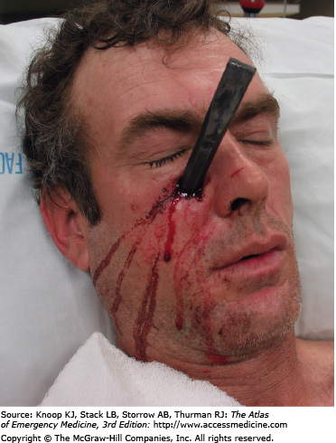
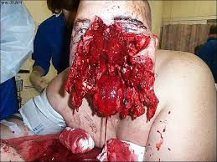
Type of missile wounds :
Nonpenetrating : blast wound.
Penetrating : low impact velocity ,bullet does not exit (there is no outlet of bullet or shells).
Perforating : high velocity, there is inlet and outlet of the bullet.
Avulsive : massive wounds with avulsion and loss of tissues .

Slide 8
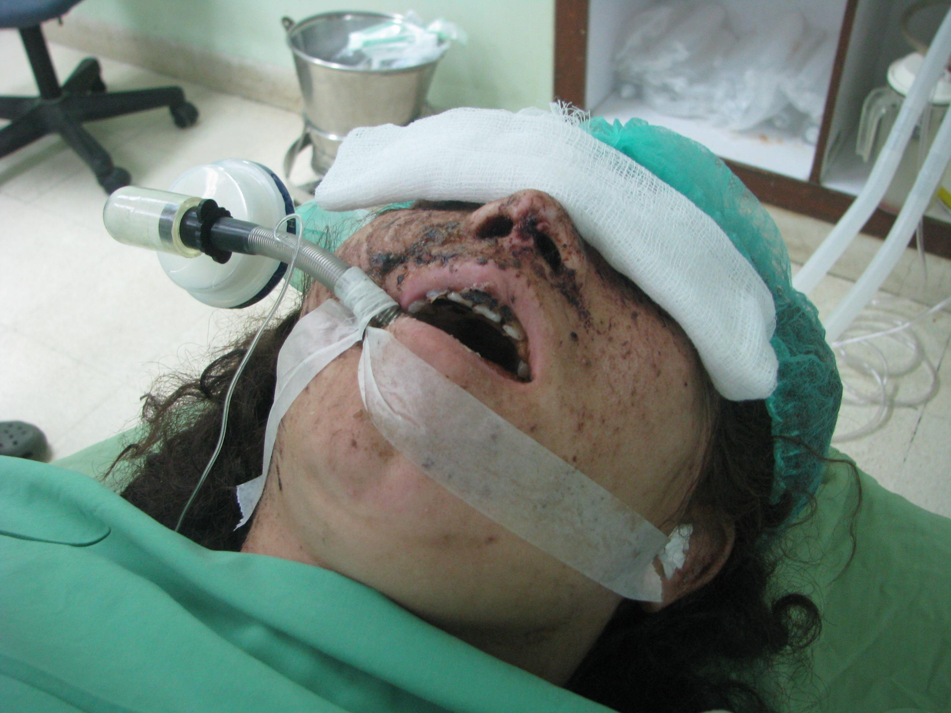
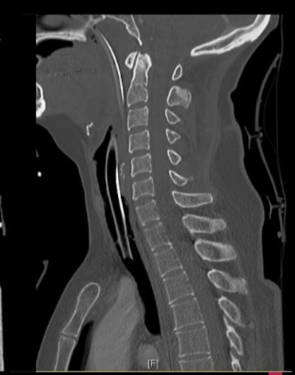
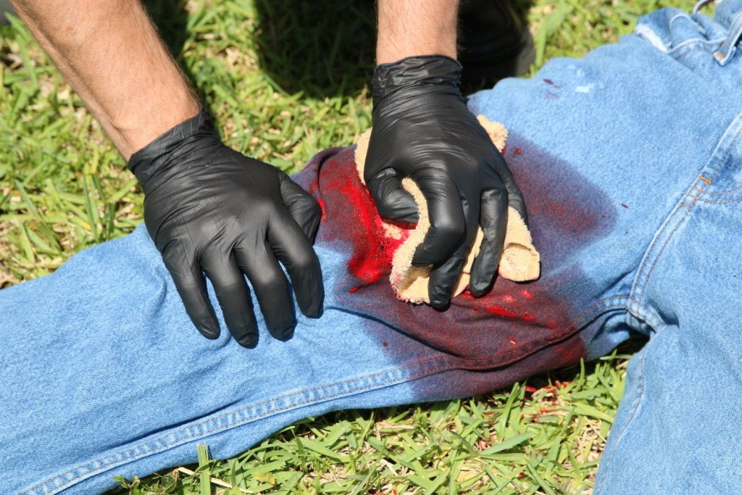
Treatment Protocol
The following is the treatment of high-velocity and high-energy ballistic injuries to the maxillofacial region:
1.Primary life saving and organ preservation procedures:
Intubation upon arrival or emergency tracheostomy.
Cervical spine radiography (to exclude injury).
Direct pressure and packing for hemostasis.
Hemodynamic stabilization in accordance with ATLS protocols.
Administration of antititanus (according to the
history of immunization and degree of contamination).
Antibiotics and analgesics.

Slide 9
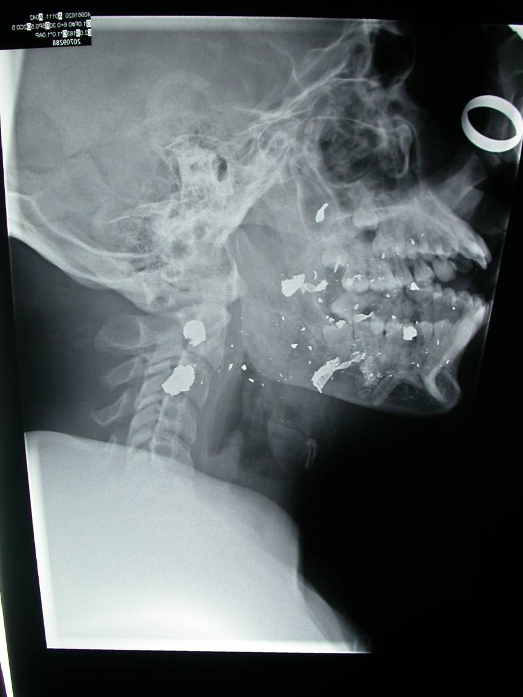
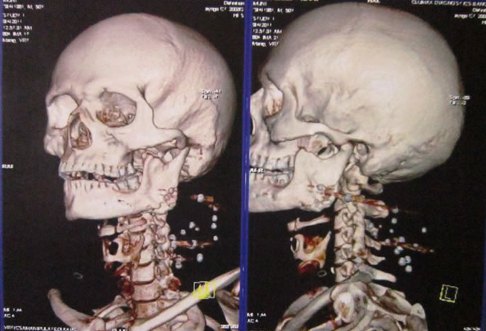
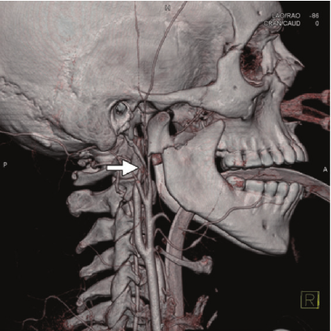
2. Imaging: the purpose of the it to localize, identify the number of shells and determine the injuries (fractures).
Conventional x-ray
Computed tomography (CT scan) or 3D CT.
CT- angiography in case of suspecting vascular injuries.

Slide 10
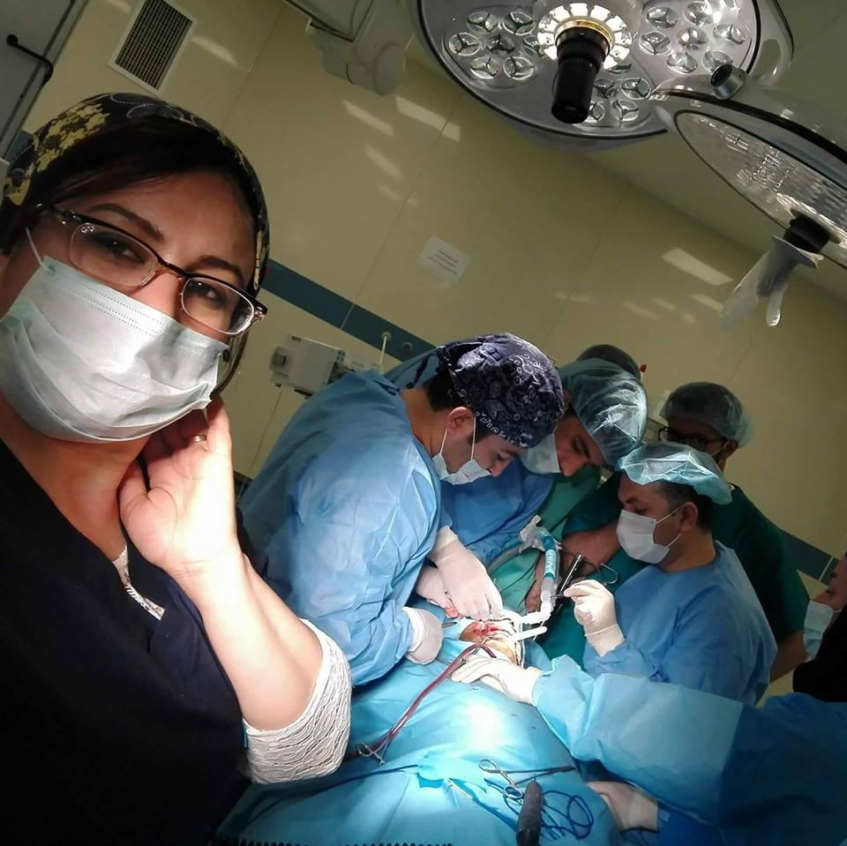
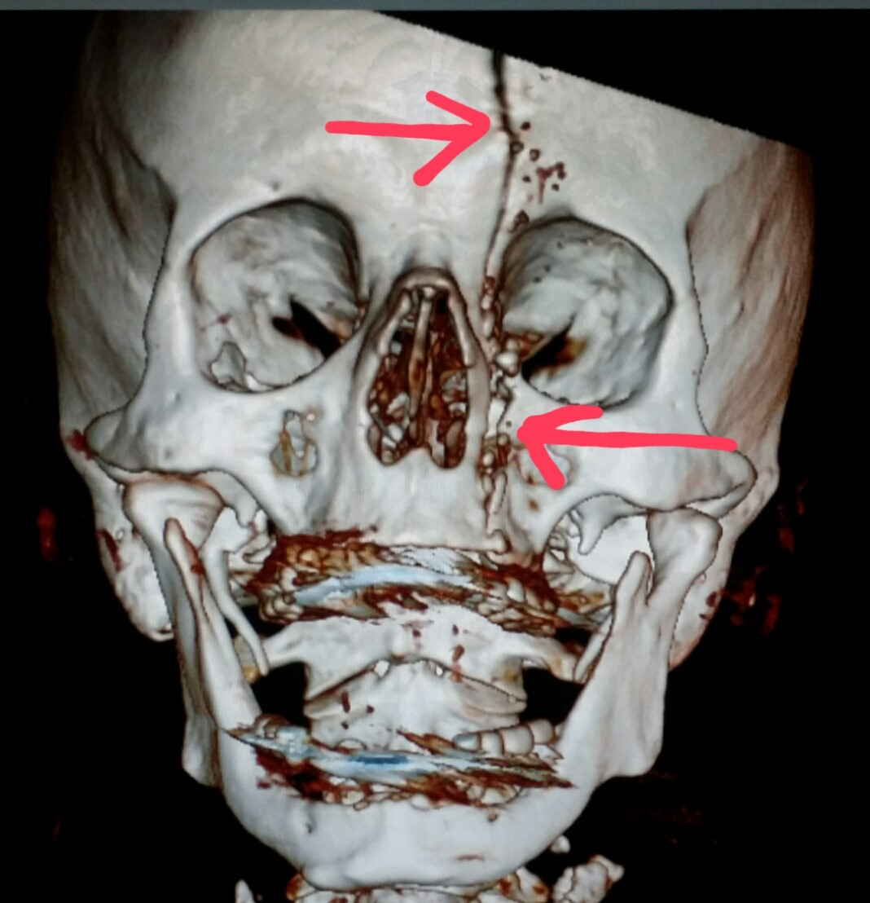
3. Interdisciplinary patient evaluation, registration and classification of injuries, establishment of a list of diagnoses, and formulation of a multidisciplinary treatment plan.

Slide 11
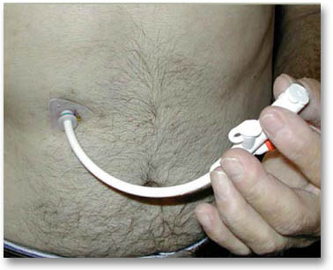
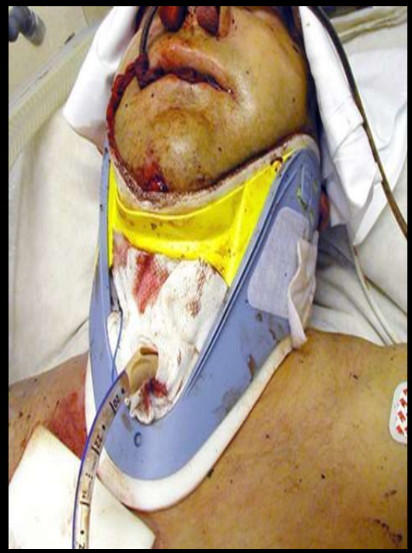
4. Tracheotomy and percutaneous gastrostomy in the operating theater in highly avulsive and complex injuries.

Slide 12
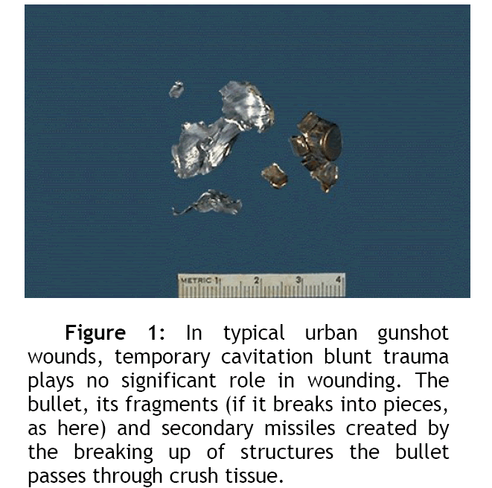
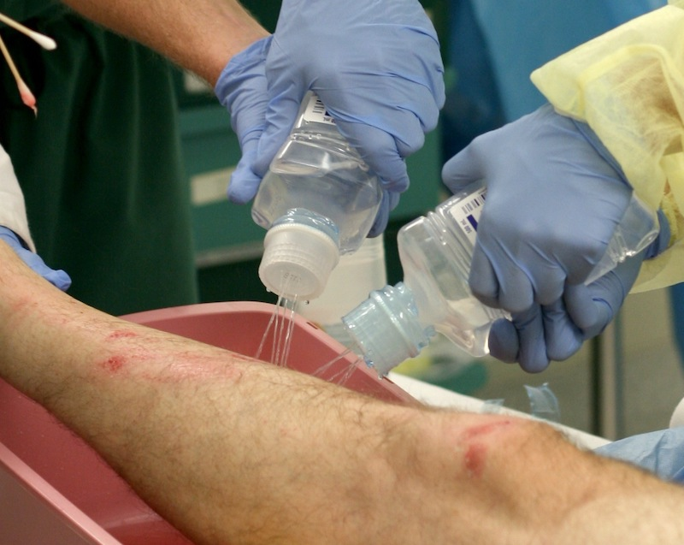
5. Removal of all fragments as much as possible, copious irrigation of the wounds through flushes of saline solution at least 2000cc should be performed to remove and washout the tiny fragments and cleaning out of burned areas.

Slide 13
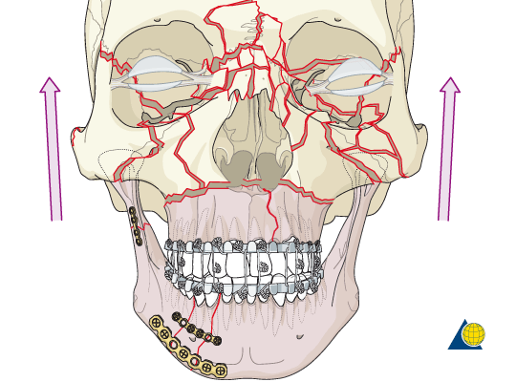
6. Restoration and stabilization of occlusal relations via (MMF) maxillomandibular fixation.
Facial bony frame work stabilization and rigid fixation using (2.4 mm) bicortical screws and plates in the mandible and (2.0 mm) monocortical screws and plates in the remaining facial skeleton.

Slide 14
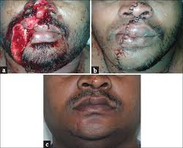
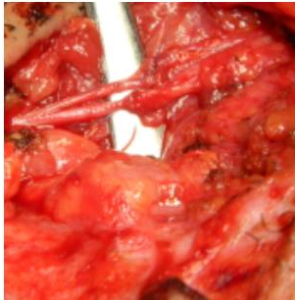
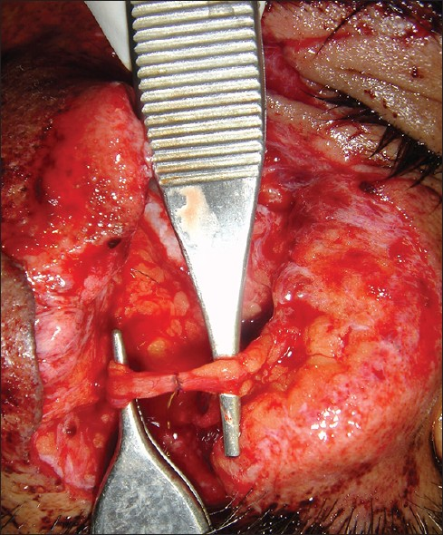
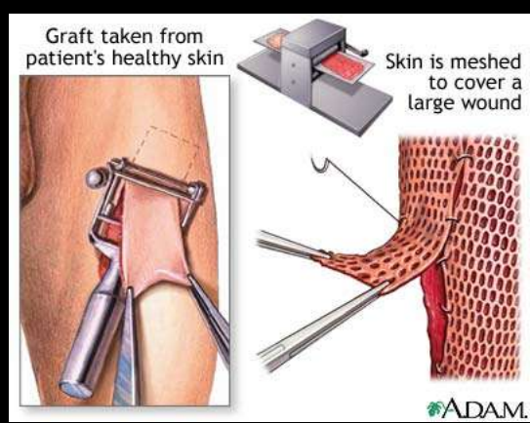
7. Tissue preservation:
meticulous primary closure of the intraoral and extraoral soft tissue to provide full coverage of the comminuted fractures, if not possible local flaps and skin grafts can be used.
8. Restoration of the vital structures primarly if possible such as facial nerve, parotid ducts either primarly or seconderly by using grafts.

Slide 15
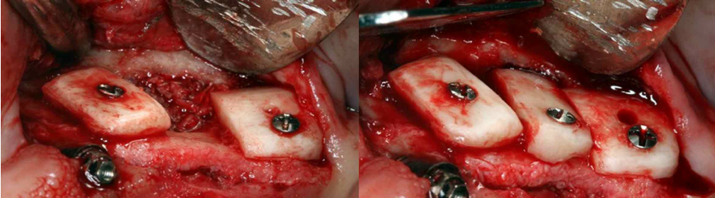
9. Immediate bone grafting of the midface , nasal orbital , and zygomatic structures if there is bone loss by using various types of bone grafts such as iliac crest, fibula, tibia, rib grafts.

Slide 16
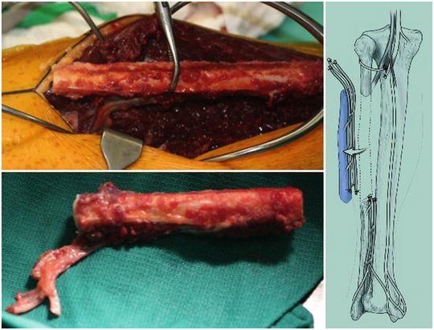
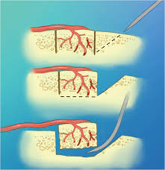
10. Secondary reconstruction of avulsive mandibular injuries using iliac crest bone grafts during the first weeks following trauma .
Implementation of vascularized free grafts only in cases of massive tissue avulsion or in cases of primary reconstruction failures .
Fibula flap

