Slide 1
Anticoagulants
Dr. Bayad J. Mahmood
BDS, FKBMS.MFS, AACME.HD

Slide 2
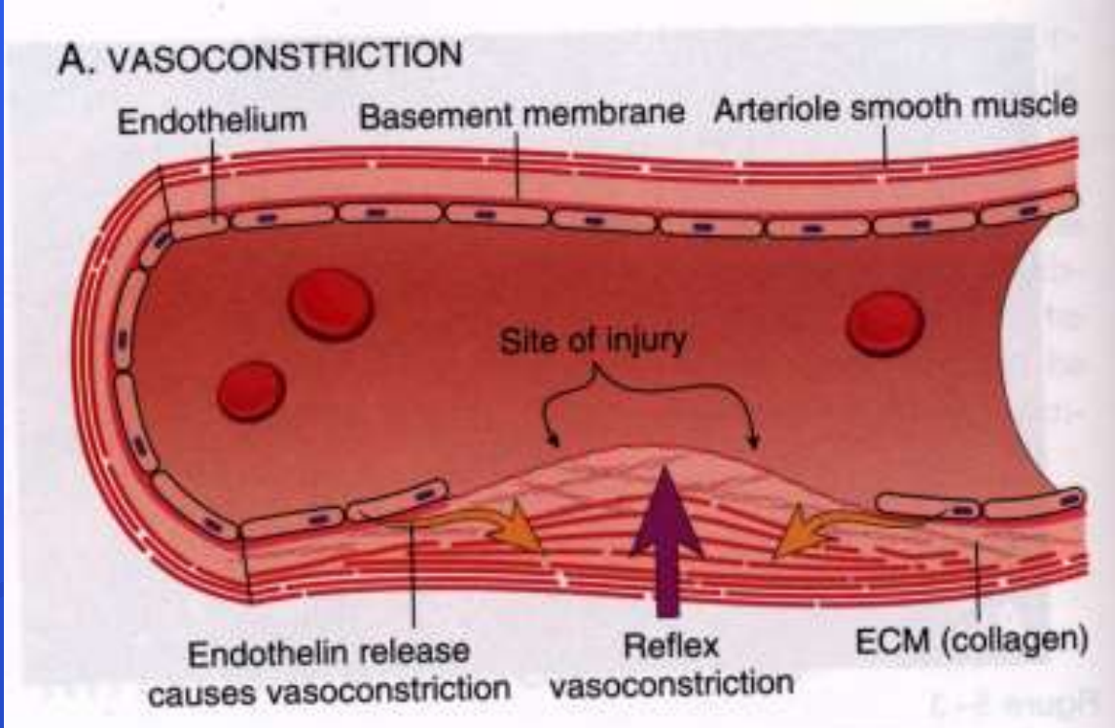
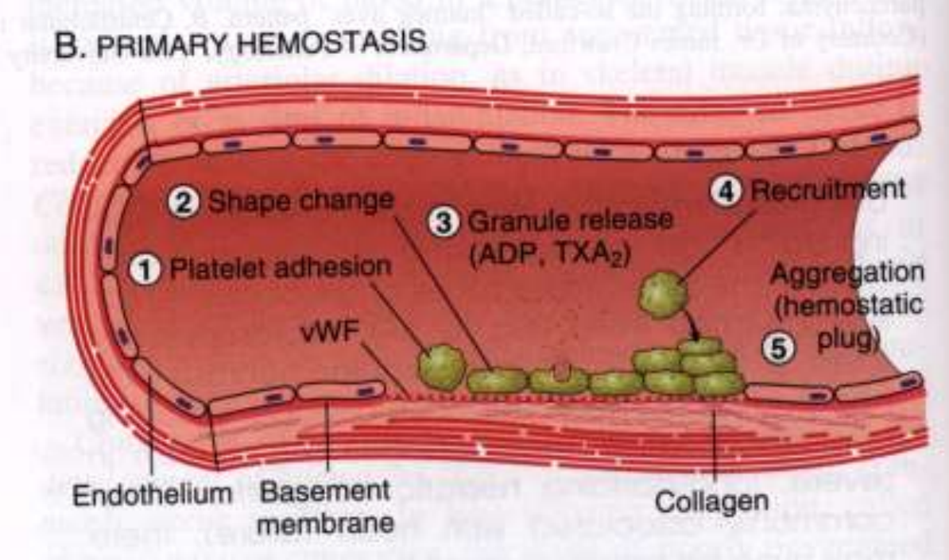
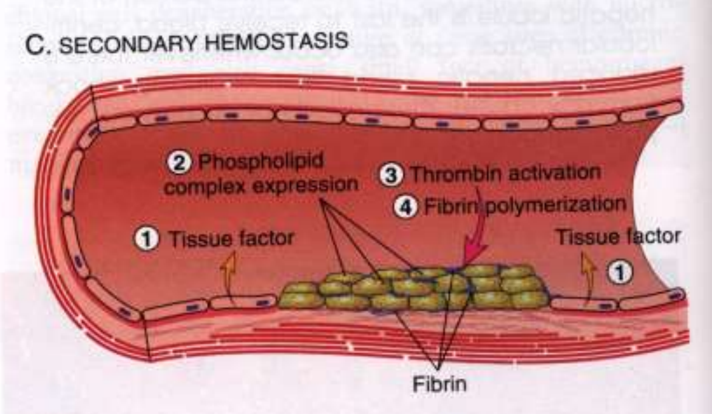
Normal Hemostasis
Following injury to a blood vessel:
1. Vascular phase: vasoconstriction to slow down blood loss.
2. Platelet phase: adherence of platelets to the vessel wall (endothelium) and then to each other to form a platelet plug.
3. Plasmatic phase: initiation of the coagulation cascade resulting in the formation and deposition of fibrin to form a clot.

Slide 3
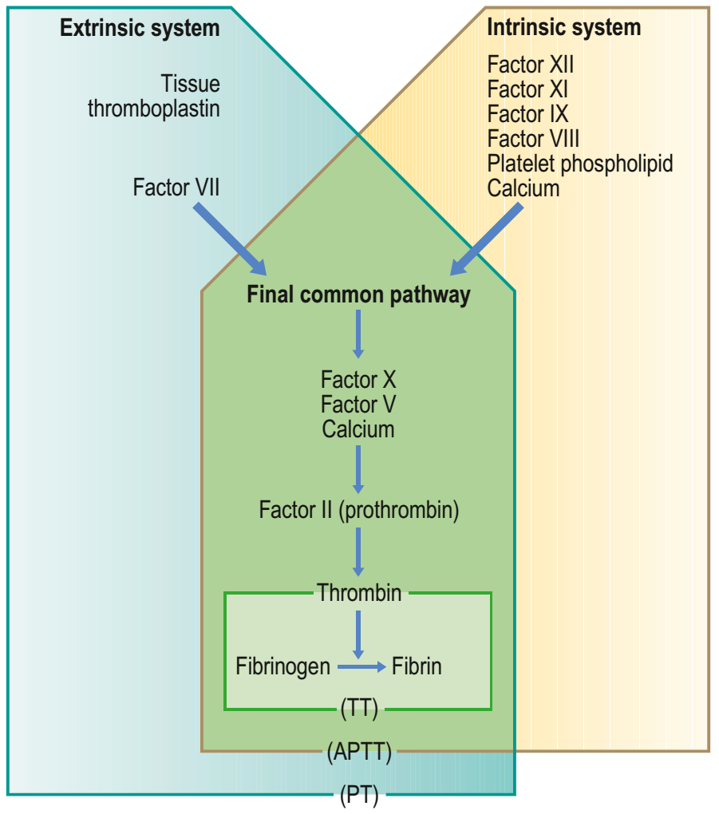
Coagulation Cascade
Extrinsic pathway:
Factor VII is activated by tissue factor
(phospholipid) that is released by injured
perivascular or vascular tissues; very rapid reaction.
Intrinsic pathway:
Factor XII is activated by exposure to collagen from vessel wall (endothelium) or blood cell membrane; slower reaction

Slide 4
Anticoagulants vs Antiplatelet Agents
Anticoagulants:
Inhibit the production of clotting factors.
Antiplatelet Agents:
Interfere with the functioning of platelets, thus inhibiting platelet aggregation.

Slide 5
Anticoagulants are given to prevent and treat thromboembolic disease:
Atrial fibrillation
Cardiac valvular disease
Ischaemic heart disease
Postmyocardial infarction
Deep venous thrombosis (DVT)
Pulmonary embolism
Cerebrovascular accident
Other conditions, and are used when there are heart valve replacements or renal dialysis.

Slide 6
Lab tests used in patients on anticoagulant.
APTT- (N: 33-45 seconds) in heparin therapy
PT- (N: 12-14 seconds) in warfarin therapy
BT (bleeding time)- normal is < 9min, in aspirin therapy
CT (clotting time), normal is around 12–13 seconds, it can be determined if the person has haemophilia or von Willibrand's disease.
INR

Slide 7

Warfarin
Mechanism of Action
A. Inhibits reduction of vitamin K epoxide, thereby limiting activation of vitamin K dependent clotting factors II (prothrombin), VII, IX, X.
Antithrombotic effect primarily due to reduction in prothrombin.
B. Inhibits synthesis of anticoagulant proteins C and S (potential procoagulant effects).

Slide 8
Management of patient on warfarin
Hospital admission, consultation of physician.
Preoperative investigation:
Full blood count.
INR
PT
Blood group and cross match.
Bleeding time, clotting time.
Radiograph to exclude pathology.

Slide 9
INR should be checked at least 72 hours before operation, but it is better to be measured at the morning of procedure.
Best INR is 1, but it should not be more than 3.5
Warfarin should be stopped 4-7 days before operation and the patient will be put on heparin.
Then, Heparin should be stopped 6 hours before operation and reinstalled 24 hours after operation.
Warfarin is usually reinstalled at the evening of the first day of operation.
The procedures should be atraumatic, minimal periosteal dissection and bone removal.
If L.A is used it is better to use intraligamentary technique.
Blood should be prepared for transfusion if needed.
Local measures (pressure pack 30 min, soft diet,….).
Prescribe antibiotics and avoid NSAIDS.

Slide 10
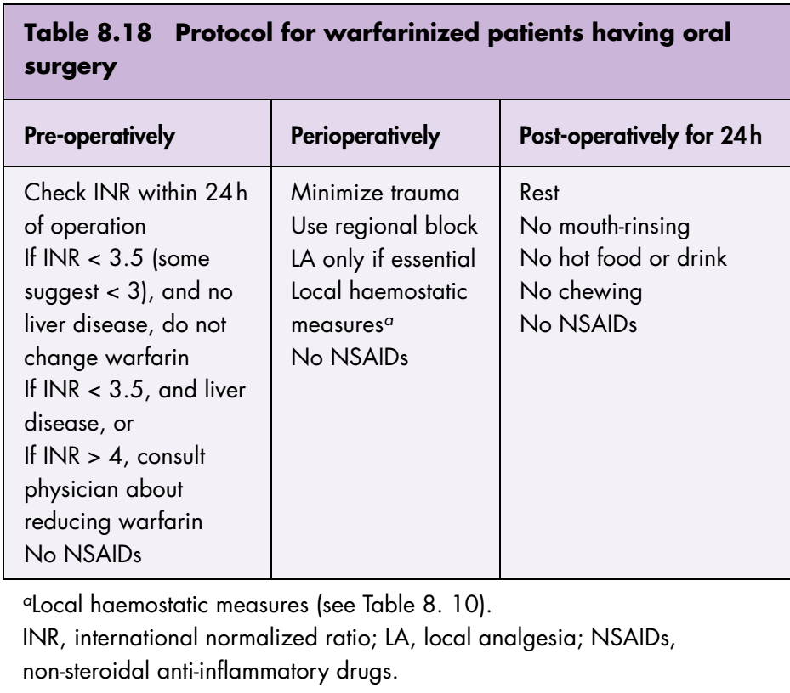

Slide 11
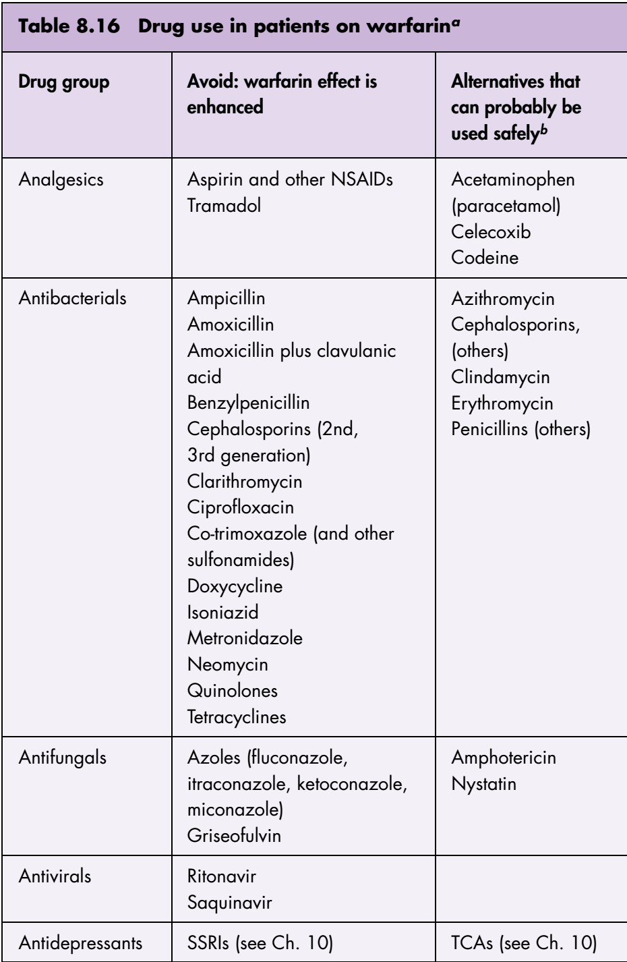

Slide 12
ASPIRIN
Aspirin irreversibly impairs platelet aggregation and is used long-term in the prevention of cardiovascular events and stroke in patients at risk.
In large doses, aspirin may also cause hypoprothrombinemia.
Even small doses of aspirin prolong the bleeding time and impair platelet adhesiveness.

Slide 13
Management of patients on Aspirin
In patients with no other cause for a bleeding tendency and receiving up to 100 mg aspirin daily, in general, for uncomplicated forceps extraction of 1–3 teeth, there is no need to interfere with aspirin treatment. Suturing and packing the socket with resorbable gelatin sponge, oxidized cellulose or microfirillar collagen can be carried out if necessary.
In patients with no other cause for a bleeding tendency and receiving doses of aspirin higher than 100 mg daily, if there is concern, the current value of the bleeding time should be established. If it is over 20 min, surgery should be postponed.
In patients receiving doses of aspirin higher than 100 mg daily and medically compromised: consult the physician, stop aspirin 7-10 days.

Slide 14
Heparin
Heparin is a natural product, abundant in granules of the mast cells that line the vasculature and is released in response to injury.
Heparin is also used as a parenteral anticoagulant given subcutaneously or intravenously.
It is used for acute thromboembolic episodes or for hospitalization protocols that include significant surgical procedures, to prevent deep venous thrombosis and pulmonary emboli.
Heparin acts immediately on blood coagulation to block the conversion of fibrinogen to fibrin and then prevent clotting.
The anticoagulant effect of is usually lost within 6 h of stopping it.

Slide 15
Heparin is available as standard or unfractionated heparin, or low-molecular-weight heparins (LMWHs).
Heparin is monitored by:
APTT (activated partial thromboplastin).
Factor Xa

Slide 16
Management of patients on Heparin
Minor surgery (1-3 teeth) extraction does not require to stop heparin.
Elective surgeries:
Measure APTT, factor Xa.
Stop Heparin 4-6 hours preoperatively and reinstall it 24 hours post operatively.
Emergency cases:
Use protamine sulfate to reverse the action of heparin (1mg/100 IU of heparin).
In patients with dialysis or cardiopulmonary bypass the best time to surgery is 24 hours after dialysis to decrease the effect of heparin and the patient can take the maximum benefit from dialysis.

