Slide 1

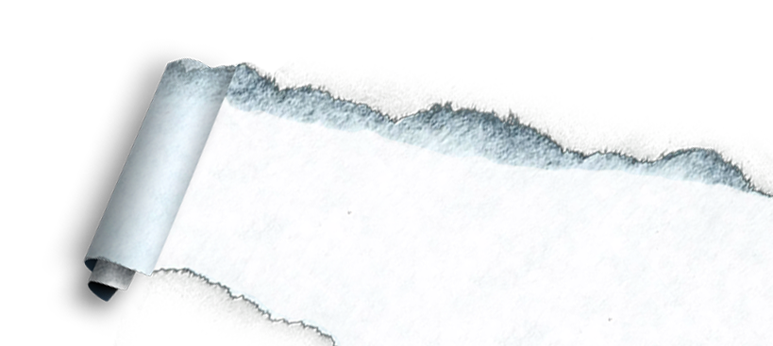
Resuscitation of Hypovolumic Shock
Clinical activity
Prepared by:
Bayad Jaza Mahmood

Slide 2
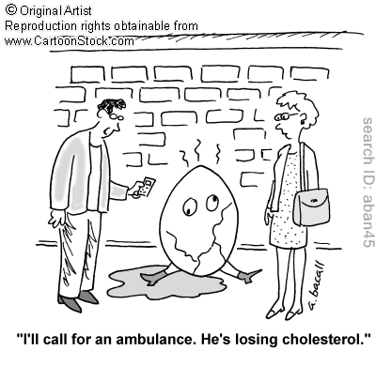
Shock
Is inadequate tissue perfusion of the body’s cells with oxygenated blood. (skin, kidneys and CNS).
Hypovolaemic shock
Is caused by a reduced circulating volume, and it may be due to hemorrhagic or non-hemorrhagic like poor ﬂuid intake (dehydration) and excessive ﬂuid loss because of vomiting, diarrhoea, urinary loss (e.g. diabetes), evaporation.

Slide 3
How do you know when a trauma patient is in hypovolaemic shock?
Low Blood Pressure: systolic blood pressure <90mmHg
Pulse is rapid and weak.
Respiration is rapid and shallow.
Skin is pale, cool, and clammy.
Drowsiness.
Arterial blood gases and assessment of base deficit
Haemoglobin <7 mg/dl
Lactate
Haematocrit.
Notes:
Hemoglobin (Hb) is the protein contained in red blood cells that is responsible for delivery of oxygen to the tissues. ... The hematocrit measures the volume of red blood cells compared to the total blood volume (red blood cells and plasma).

Slide 4
Classification of Hypovolumic Shock
 | Class I | Class II | Class III | Class IV
Blood Loss | <750ml | 750-1500ml | 1500-2000ml | >2000ml
% Blood Vol. | <15% | 15-30% | 30-40% | >40%
Pulse | <100 | >100 | >120 | >140
BP | normal | normal | decreased | decreased
Pulse Pres. | normal | decreased | decreased | decreased
Respiratory Rate | 14-20 | 20-30 | 30-40 | >35
Urine output | >30cc/hr | 30-40 | 5-15 | negligible
CNS | normal | anxious | confused | lethargic
Fluid Choice | crystalloid | crystalloid | crystalloid and blood | crystalloid and blood

Slide 5
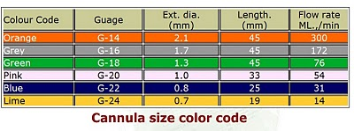
General Guidelines for resuscitation:
Establish patent airway.
Ensure adequate ventilation and oxygenation.
Secure venous access – large bore cannula x 2.
Control any external bleeding by applying direct pressure.
Early use of blood, if available, remains the optimal resuscitation fluid
for the hypovolemic patient.
Where blood is not available or delayed, Compound Sodium Lactate
(Hartmanns) is the preferred alternative .
0.9% Normal Saline is also an acceptable alternative.

Slide 6
Types of Fluids used for Resuscitaion
Colloid : a substance microscopically evenly dispersed throughout another, unable to cross a semi-permeable membrane.
Crystalloid : A substance that in solution can pass through a semi permeable membrane e.g. sugars and salts completely dissolved in water.
Table: General Differences between Colloids and Crystalloids:
Colloids | Crystalloids
Faster plasma expansion. | Lesser.
Less administered volume (Thicker and larger molecular size). | Crystalloids requires 3-4x the volume of colloids
Less pulmonary edema, and other organ. | More.
Remain for a longer period in circulation. | Less.
Potentiate inflammatory response (anaphylaxis). | Less.

Slide 7
Crystalloids
Colloids
Electrolyte content | NaCL 0.9% | Ringer Solution | Hartman’s solution
Na | 154 | 147 | 131
K | _ | 4 | 5
Ca | _ | 2.25 | 2
Cl | 154 | 155 | 112
Synthetic | Advantages
Dextran, Haemaccel, gelofusine | Provides oncotic pressure (tends to stay in the vascular space)
Natural | Advantages
RBCs | Provide oxygen carrying capacity
FFP | Provides oncotic pressure,clotting factors and other essential proteins
Albumin | Provides oncotic pressure (tends to stay in the vascular space)
D5W | 5% Dextrose in water

Slide 8
Formula and Notes for Volume replacement:
Total blood volume in a person based on gender, height and weight.
Blood volume is typically about 8% of body weight, An average sized adult has a blood volume of about 5 liters.
For Class 1 and 2 of shock the replacement can be successful by crystalloid or colloids otherwise the blood should be transfused.
Replacement of blood loss by crystalloids is 3:1
Roughly in: -Adults 2 liters.
-Children 20cc/kg or 4:2:1/hr and repeat if needed.
Colloids can be used to replace blood loss on a 1: 1 volume basis.

Slide 9
References:
Schawrtz principle of surgery 9th Ed.
Baily and Love 25th Ed.

Slide 10
…Thank you…

