Slide 1
CHRONIC OBSTRUCTIVE PULMONARY
DISEASE
Dr.Bayad Jaza Mahmood
Board certified maxillofacial surgeon
American Diploma in facial aesthetics

Slide 2
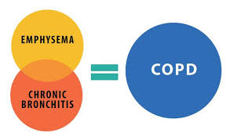
COPD
Chronic obstructive pulmonary disease (COPD; chronic obstructive airways disease; COAD) is a common, chronic, slowly progressive, irreversible disease (most frequently a combination of chronic bronchitis and emphysema).

Slide 3
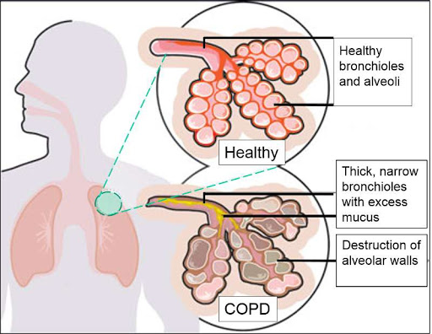
Characterized by
Breathlessness.
Wheeze (airways obstruction).
Cough.
Sputum (early morning mucoid sputum production).
Cyanosis.

Slide 4
The most important causes of COPD include
Cigarette smoking
Environmental pollution dusts, or occupational
exposures to chemicals.
Exposure to smoke from home cooking
or heating fuels may contribute.

Slide 5
The diagnosis of COPD is based upon
Clinical history and presentation.
Investigations include chest radiography (CXR; which may show hyper inflated lung fields).
Arterial blood gases (which should be measured if pulse oximetry shows oxygen saturation less than 92%).
Spirometry and Pulmonary function tests (PFTs).
Notes:
Spirometry is the most common type of pulmonary function or breathing test. This test measures how much air you can breathe in and out of your lungs, as well as how easily and fast you can the blow the air out of your lungs.

Slide 6
Patients with COPD who need dental care can be classified as follows.
Patients at low risk – experience dyspnoea on effort but have normal blood gas levels; these patients can receive all dental treatment with minor modifications.
Patients at moderate risk – experience dyspnoea on effort, are chronically treated with bronchodilators or recently with corticosteroids, and partial pressure of oxygen (PaO2) lowered – then a medical consultation is advised to determine the level of control of the disease before any dental treatment.
Patients at high risk – have symptomatic COPD that may be end-stage and poorly responsive to treatment. With these patients, a medical consultation is essential before any dental treatment is carried out.

Slide 7
General points:
Patients with COPD are best treated in an upright position at mid-morning or early afternoon, since they may become increasingly dyspnoeic if laid supine.
LA is preferred for dental treatment, but bilateral mandibular or palatal injections should be avoided.
Diazepam and midazolam should not be used as they are respiratory depressants. Patients should be given GA only if absolutely necessary.
The most important single factor in pre-operative care is cessation of smoking for at least 1 week pre-operatively.
Respiratory infections must also be eradicated, sputum should first be sent for culture and sensitivity, but antimicrobials such as amoxicillin should be started without awaiting results.
Patients taking corticosteroids should be treated with appropriate precautions.

