Slide 1
Osteomyelitis
Dr.Bayad J. Mahmood

Slide 2
Osteomyelitis:
is inflammation of the medullary cavity of a bone caused by an infection. It is seen particularly in those patients whose defense mechanism against infection is compromised because of local or systemic factors.

Slide 3
*Acute Osteomyelitis :
It’s also called acute pyogenic osteomyelitis because the pyogenic bacteria which cause the disease are similar to those causing odontogenic infections.
The bacteria which responsible for the infection includes streptococci, anaerobic cocci such as Peptostrepto-coccus,gram-negative rods such as Fusobacterium and Prevotella.
The disease usually occur after trauma or spread of odontogenic infection.

Slide 4
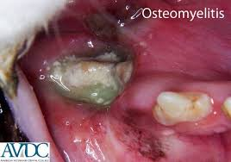
Clinical features:
Severe deep seated pain with tenderness and swelling in the affected area.
The mandible is affected more frequently than the maxilla.
An important symptom is a developing numbness over the lip and chin as a result of inferior alveolar nerve involvement .
The patient give a history of trauma or dental infection.
Pus formation and lymphadenopathy in addition to general manifestation like fever.

Slide 5

Management
Benzylpenicillin or clindamycin and metronidazole are normally started and altered as necessary according to the results of pus sensitivity testing.
The patient may require hospital admission for incision and drainage with irrigation of the area.
Removing obviously non vital teeth in the area of the infection is essential in the treatment.
For acute osteomyelitis that results from jaw fracture, wires or bone plates that may have been used to stabilize a fracture in the area, or any obviously loose pieces of bone.
Antibiotics should be continued for at least 4 weeks after control of the acute infection.

Slide 6
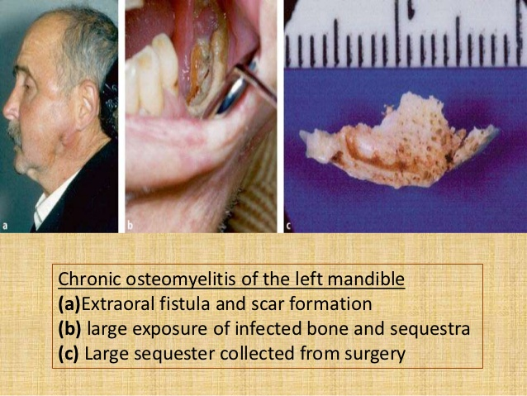
*Chronic osteomyelitis
Usually developed from untreated acute osteomyelitis or low grade infection, also other conditions may predispose to the development of the diseases like diabetes or long-term corticosteriod use and bone abnormalities such as Paget's disease or cemento-osseous dysplasia.

Slide 7
Clinical features:
Pain and swelling is less severing than in acute form of the disease.
Pus discharge from the skin or oral mucosa.
Mandible is enlarging due to bone deposition.
Sensation of the lower lip is intact

Slide 8
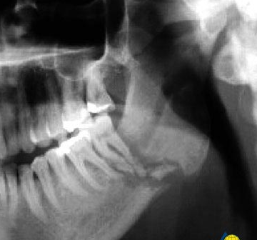
Radiographic features:
Irregular radio-opaque areas (sequestra) surrounded by radiolucencies are visible (moth eaten appearance).
A late sign of chronic osteomyelitis is radiological evidence of periosteal new bone at the lower border of the mandible or above the buccal or lingual cortices.

Slide 9
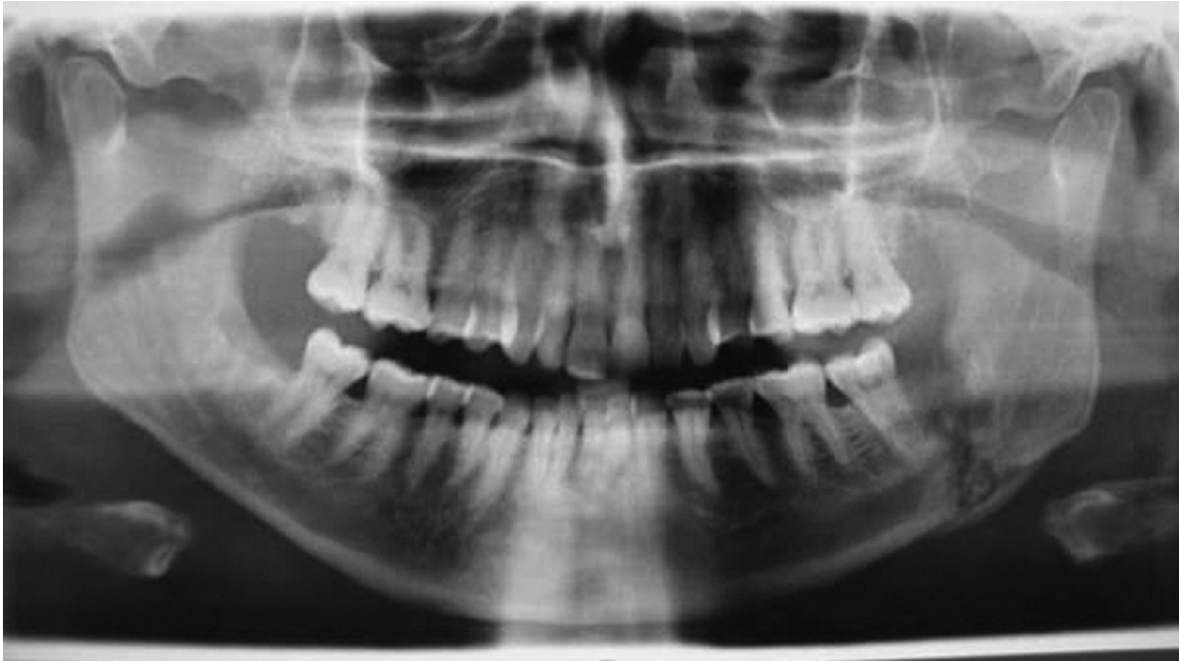

Slide 10
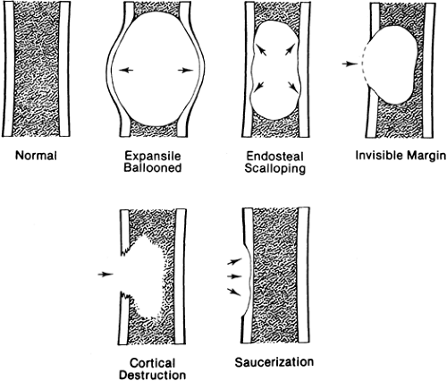
Treatment:
Before treatment of chronic osteomyelitis the following should be done:
*Biopsy: because some bone tumor give the same pictures of the disease.
*Culture and sensitivity test: to determine the type of the bacteria and microorganism.
The management of chronic osteomyelitis is usually surgical and medical as following :
1-Surgical drainage of pus and removal of the sequestra (sequestrectomy).
2-Excision of the external sinuses with irrigation of the area.
3-Bone saucerization .
4-Antibiotics coverage like acute form.

