Slide 1
Hemorrhage
Dr.Bayad J. Mahmood
BDS, FKBMS.MFS

Slide 2
Hemorrhage or haemorrhage
is blood escaping from the circulatory system from damaged blood vessels.
Massive hemorrhage
Blood loss exceeding circulating blood volume within a 24-hour period.
Blood loss of 50% of circulating blood volume within a 3-hour period.
Blood loss exceeding 150 ml/min.
Blood loss that necessitates plasma and platelet transfusion.

Slide 3
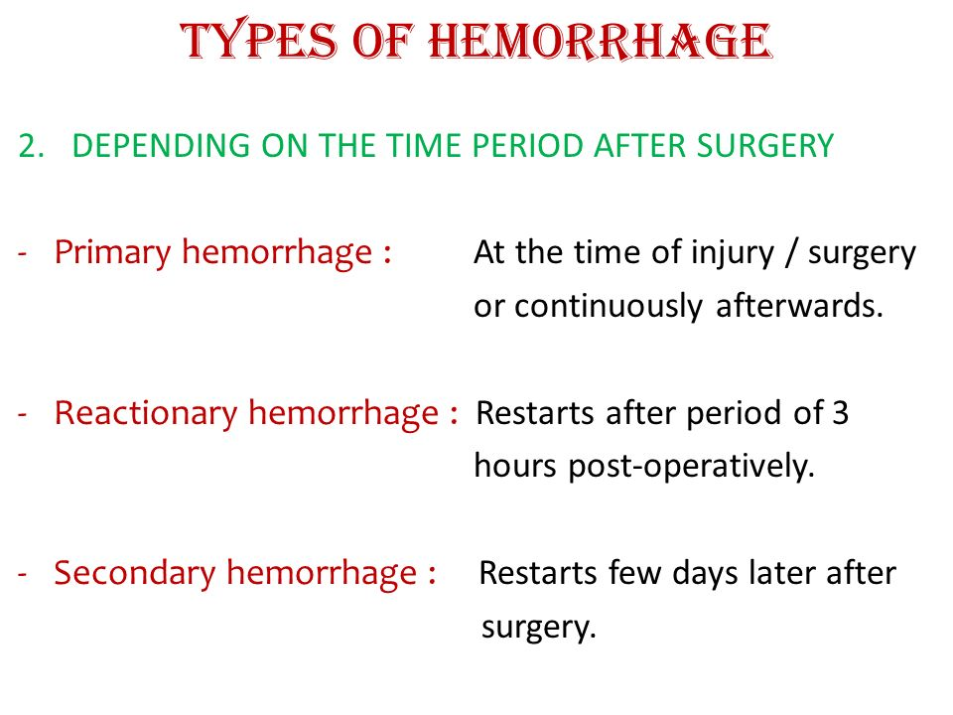

Slide 4
Reactionary haemorrhage
is delayed haemorrhage (within 24 hours) and is usually caused by dislodgement of clot by resuscitation, normalization of blood pressure and vasodilatation.
Reactionary haemorrhage may also result from technical failure such as slippage of a ligature.

Slide 5
Secondary haemorrhage
is caused by sloughing of the wall of a vessel. It usually occurs 7–14 days after injury and is precipitated by factors such as (such as from a drain) or infection, pressure necrosis and malignancy.

Slide 6
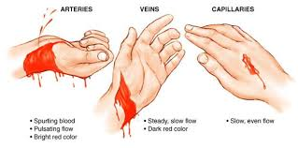

Slide 7
What are the common causes of bleeding?
Traumatic bleeding:
Lacerations (cuts)
Puncture wounds from items like needles, nails, or knives
Crushing injuries
Gunshot wounds
Medical conditions:
Hemophilia
Leukemia
Liver disease
Menorrhagia,
Thrombocytopenia
Von willebrand disease
Vitamin K deficiency
Medicines:
Antibiotics, when used on a long-term basis
Radiation therapy
Aspirin and other nsaids

Slide 8
The adult human has approximately 5 litres of blood
(70 ml kg–1 children and adults, 80 ml kg–1 neonates).

Slide 9
Hemorrhage is a common complication in oral surgery, and may occur during a simple tooth extraction or during any other surgical procedure,
Hemorrhage may be due to trauma of the vessels in the region as well as to problems related to blood coagulation
hemorrhage may occur as a result of injury or severance of the inferior alveolar vessels or the palatal artery.

Slide 10
Why Postoperative bleeding?
Trauma, poor hemostasis of the wound due to insufficient compression, or to inadequate removal of inflammatory and hyperplastic tissue from the surgical field.

Slide 11
Treatment
Compression aims at causing vasoconstriction and decreasing the permeability of the capillaries, and is achieved by placing gauze over the bleeding site with pressure.
Placing pressure by biting on a gauze for 10– 30 min over the postextraction wound or other superficial bleeding areas is usually sufficient

Slide 12
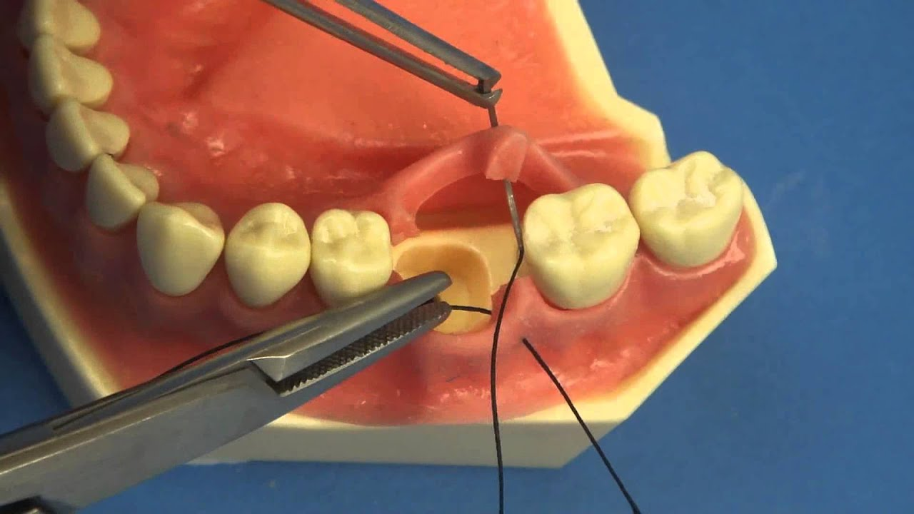
Suturing the wound mechanically obstructs the severed end of the bleeding vessel.
This technique is used for arresting soft tissue hemorrhage as well as post extraction bleeding that is treated with tightly suturing the wound margins

Slide 13
a gauze pack is placed over the wound, which is stabilized with sutures over the postextraction socket for 2–3 days

Slide 14
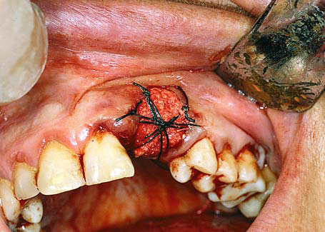

Slide 15
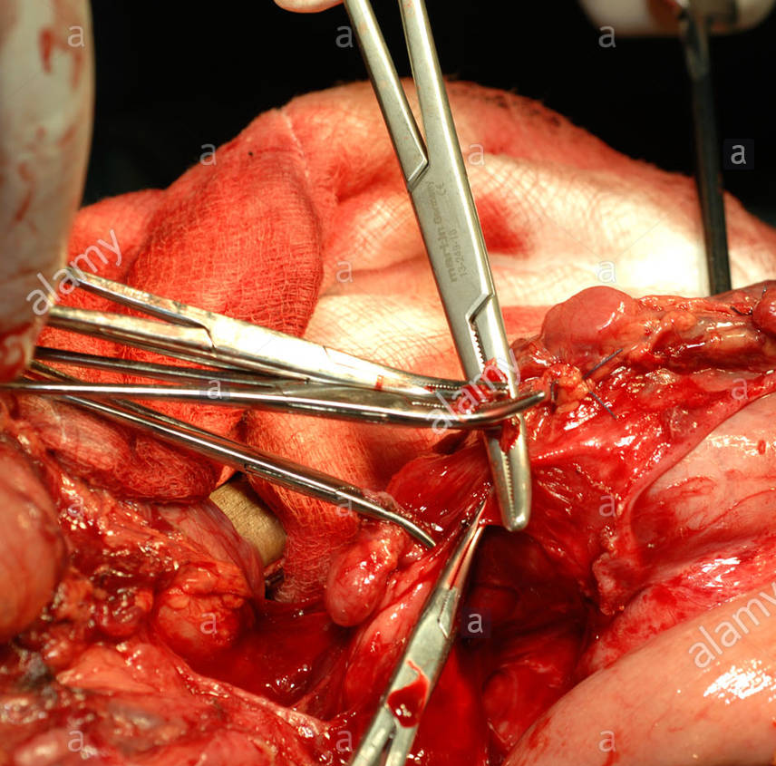
Ligation is the most successful way to control soft tissue hemorrhage that involves a large vessel.
small-sized vessel is bleeding, then a narrow hemostat is used to clamp the bleeding area of the soft tissues, arresting hemorrhage within a few minutes,without ligation of the tissues.

Slide 16
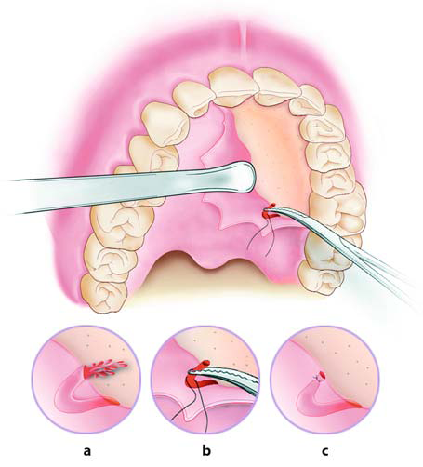

Slide 17
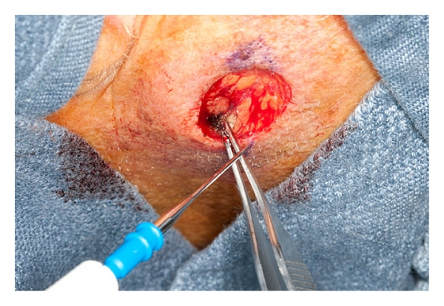
Electrocoagulation
is based on the coagulation of blood through the application of heat.

Slide 18
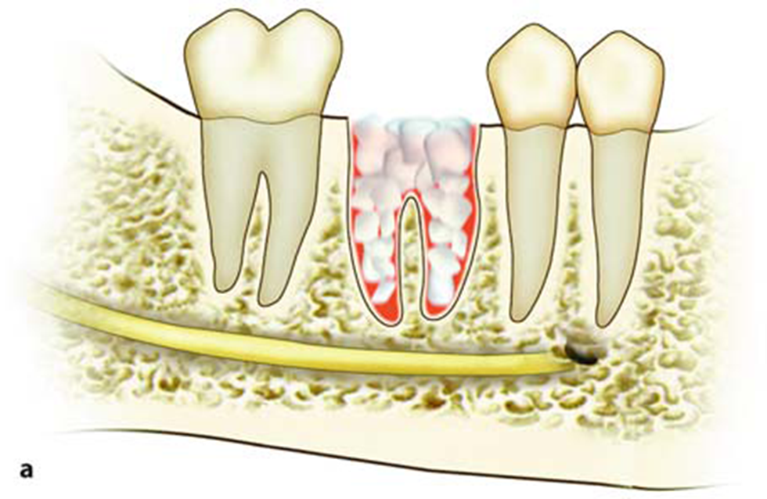
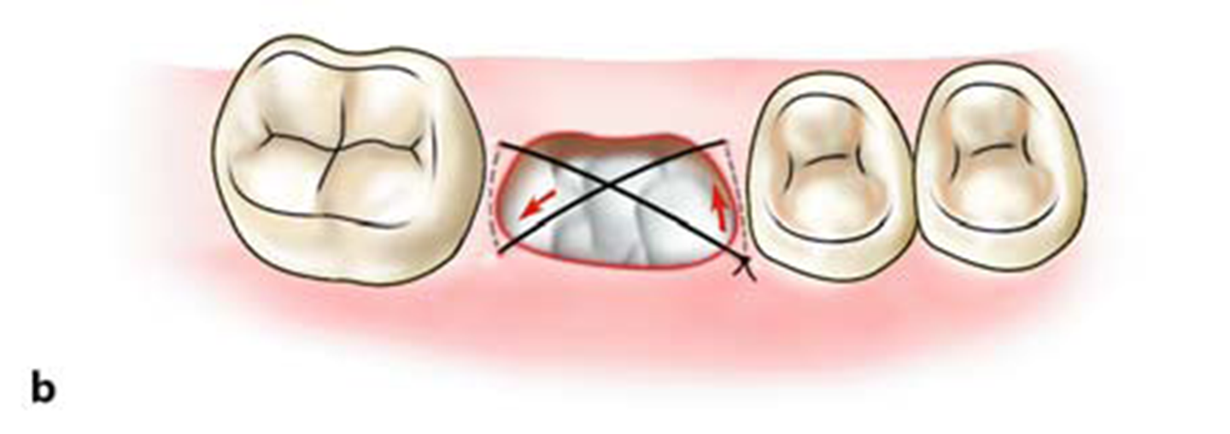
Hemostatic materials, such as vasoconstrictors (adrenaline), Surgicel., Bone wax have proven to be very effective in the control of bleeding

Slide 19
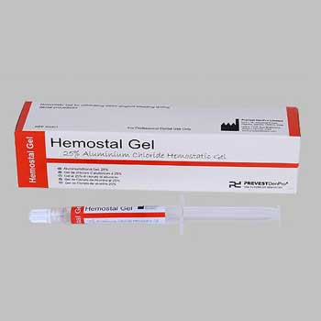

Slide 20
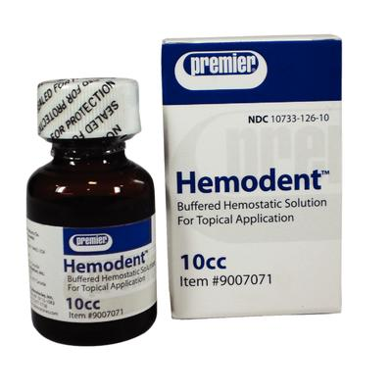

Slide 21
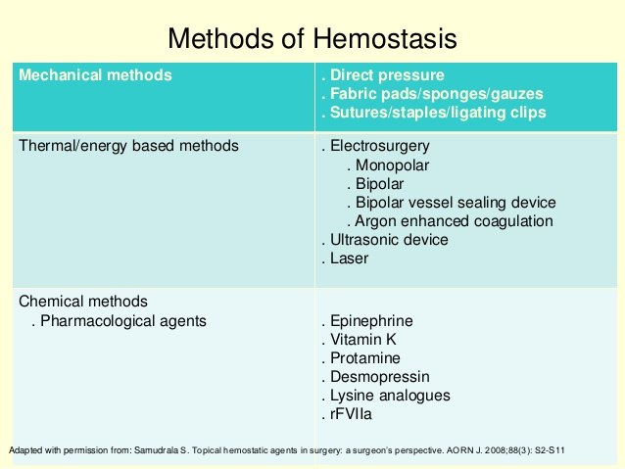

Slide 22
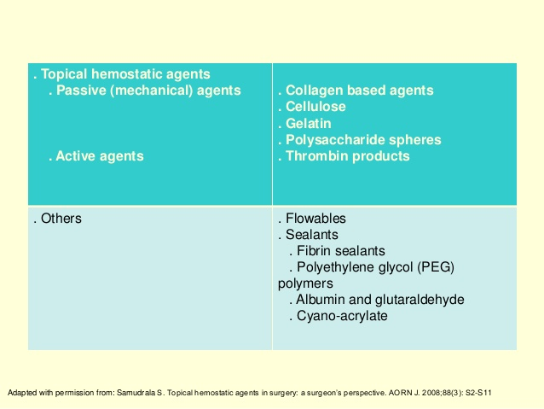

Slide 23
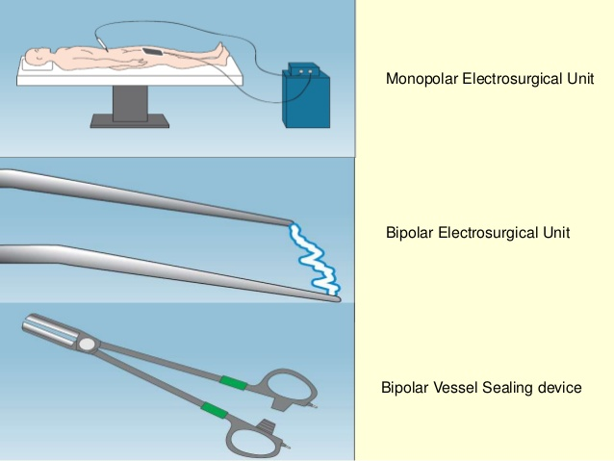

Slide 24
Thank You

