Slide 1
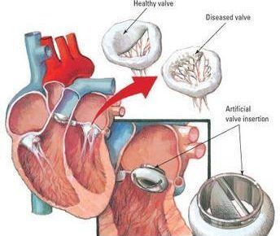
Prosthetic heart valve
Dr. Bayad J. Mahmood
BDS, FKBMS.AACME.HD

Slide 2
Prosthetic heart valve or Artificial Heart Valve
Any heart valve lesion can impair the circulation, ultimately resulting in heart failure.
There are two main concerns during dental treatment of patients with valvular disease:
First: The risk of infective endocarditis.
Second: The risk of bleeding in anticoagulated patients, due to the risk for thrombus formation either at the site of the injured valve or at the site of myocardium. All prosthetic valves increase the risk for thromboembolism.
(Patients with prosthetic valves should not discontinue their anticoagulants without taking cardiological advice).

Slide 3
Prosthetic heart valve or Artificial Heart Valve
In such patients, excessive bleeding may be encountered with surgical procedures; it is therefore necessary to determine the patient's bleeding history and a bleeding profile which will generally include the prothrombin time (PT), partial thromboplastin time (PTT) and the international normalized ratio, and the level of anticoagulation before any invasive procedure.
An anti-fibrinolytic mouthwash containing tranexamic acid (4.5%) can effectively suppress post-operative bleeding without needing to modify the dose of warfarin, and gelatin sponges, oxidized cellulose and micro crystalline collagen are other useful hemostatic agents.
The practitioner should be aware that many drugs can interact with anticoagulants, causing derangement of anti-coagulation.

Slide 4
INFECTIVE ENDOCARDITIS (IE):
Infective endocarditis is the microbial infection of a cardiac valve or the endocardium caused by bacteria, fungi, and diagnosis is confirmed by blood culture and echocardiogram.
IE can lead to death caused by heart failure or acute thromboembolic events.
The normal heart is relatively resistant to infection. Bacteria and fungi do not easily adhere to the endocardial surface, and constant blood flow helps prevent them from settling on endocardial structures.
There are conditions associated with increased risk for IE, for instance, mitral valve prolapse with regurgitation is a significant risk factor for IE.
Ideally, the patient who is going to receive a prosthetic heart valve operation (pHVO) should have all indicated dental treatment performed before the valve is placed.
Although there was evidence that prophylactic antibiotics provided no significant protection, but antibiotic therapy to prevent prosthetic valvular endocarditis, is used in susceptible patients having dental treatment that may produce blood borne microorganisms.

Slide 5


Slide 6
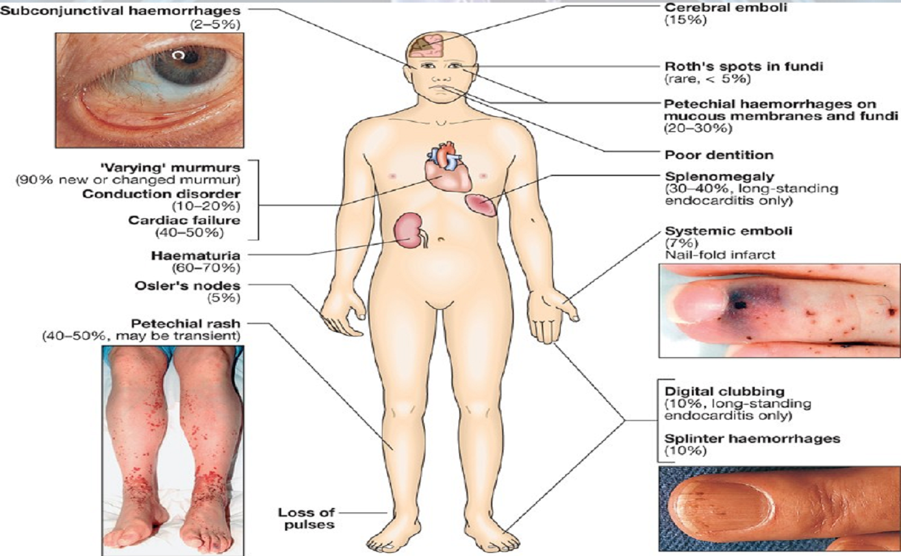
Signs and symptoms

Slide 7
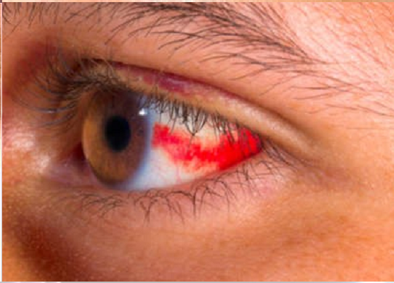
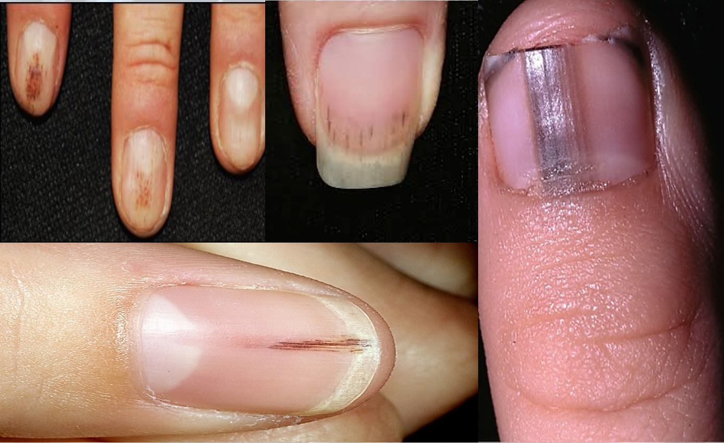
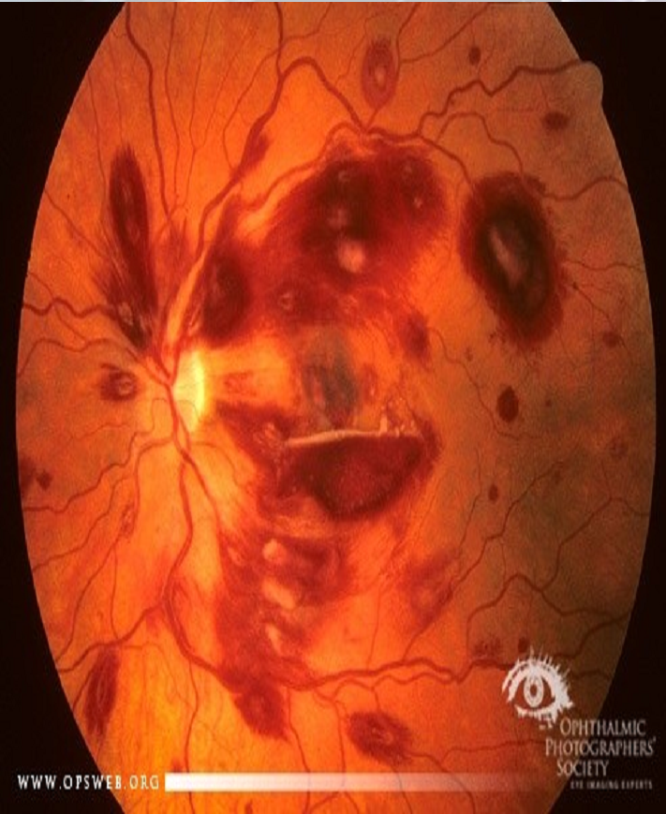
Roth’s spots by fundoscopy
Subconjunctival Hemorrhages
Splinter Hemorrhage tiny blood clots that tend to run vertically under the nails.

Slide 8
Reasons for abandoning the use of antibiotic prophylaxis for endocarditis:
1. There is no consistent association between dental procedures and an increased risk of infective endocarditis, Bacteremia associated with dental procedures is no greater than that from toothbrushing.
Regular toothbrushing almost certainly presents a greater risk of infective endocarditis than a single dental procedure because of repetitive exposure to bacteraemia.
2. Prophylactic antibiotic regimens fail in some instances.
3. Adverse reactions to antimicrobials are possible
4. The cost-effectiveness of prophylaxis is questionable
5. There is an increased risk of resistant bacteria in society

Slide 9
BUT
Diseases Society of America and Pediatric Infectious Diseases Society, recommended prophylaxis, but in only high-risk circumstances:
History of IE
Artificial heart valves

Slide 10
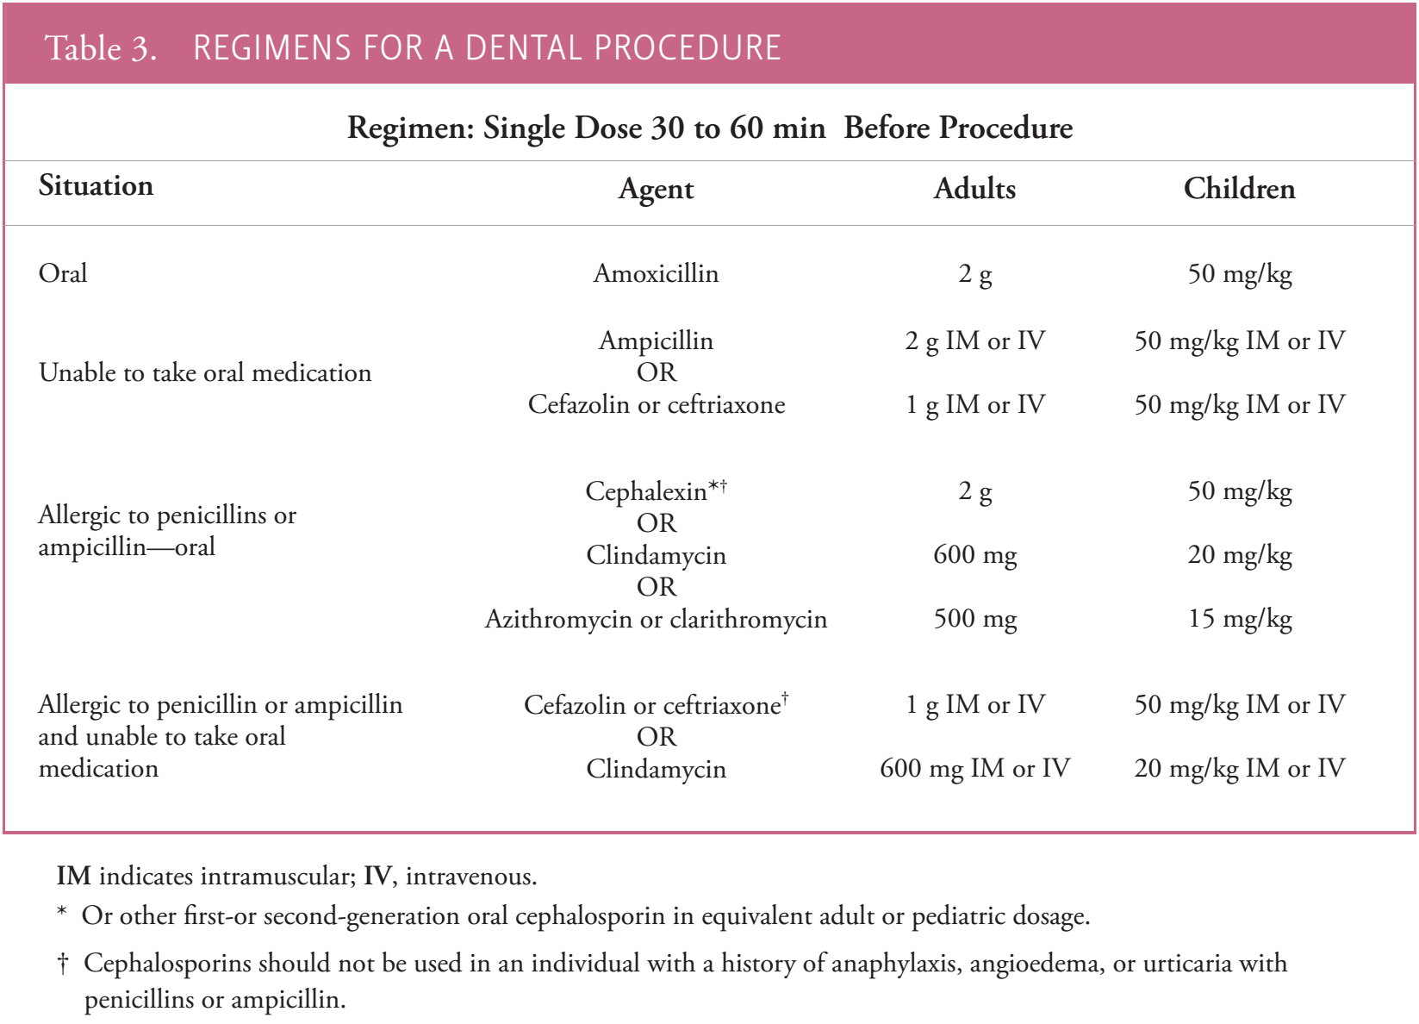

Slide 11


